Slide 1

Unit 5: Sports and hobbies
Lesson 1.3
Page 70

Slide 2
Lesson Outline
Warm-up
Practice
Speaking
Consolidation
Wrap-up

Slide 3
Objectives
By the end of this lesson, students will be able to…
Vocabulary: badminton, tennis, volleyball, basketball, soccer
Structure: Can you play soccer?
- Yes, I can./No, I can't.

Slide 4

WARM UP

Slide 5

Hidden
Pictures
Guessing
Game

Slide 6
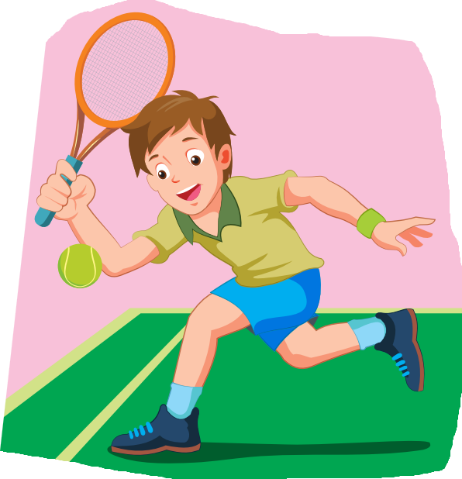
tennis

Slide 7
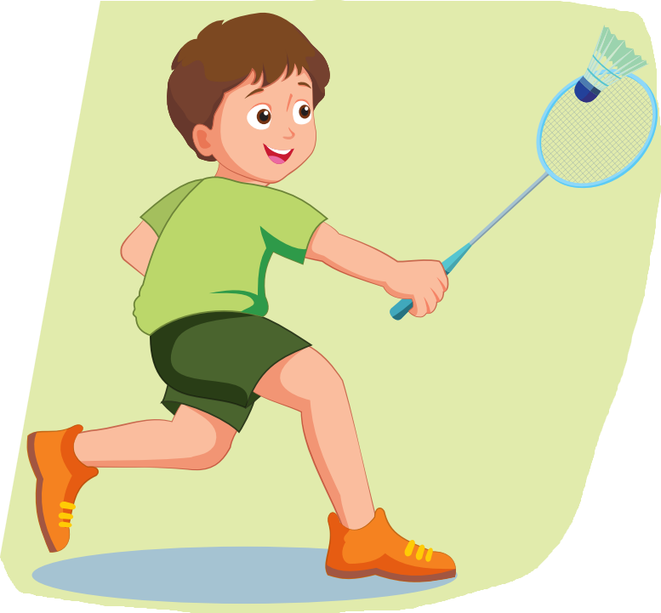
badminton

Slide 8
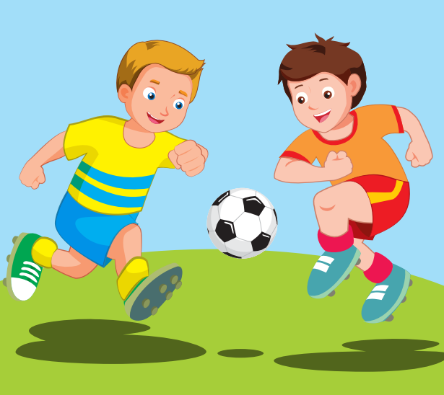
soccer

Slide 9

basketball

Slide 10

volleyball

Slide 11

It’s time to learn …

Slide 12

Practice

Slide 13

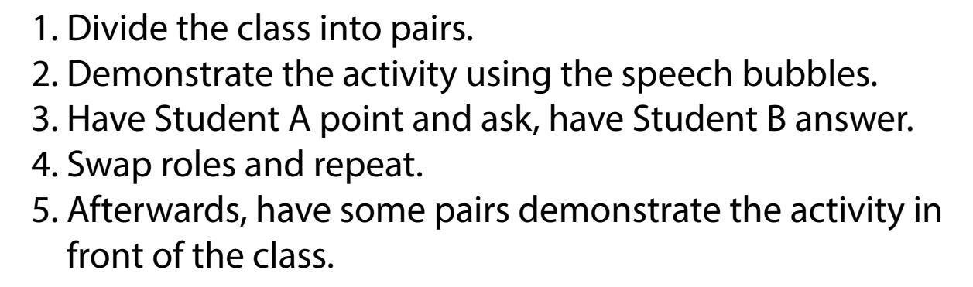

Slide 14
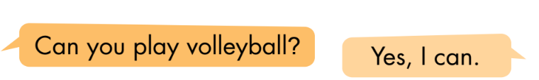
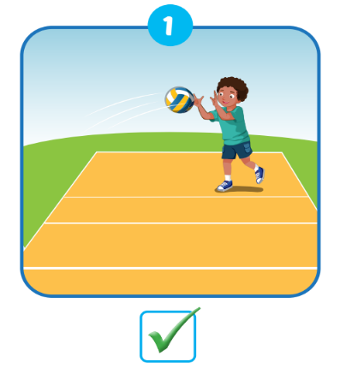
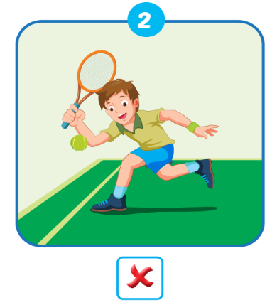
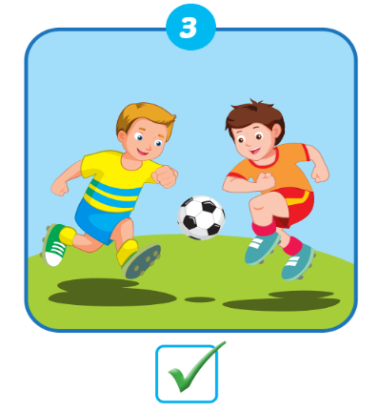

Slide 15
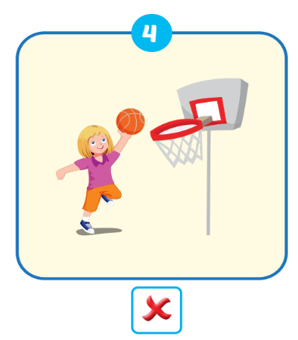
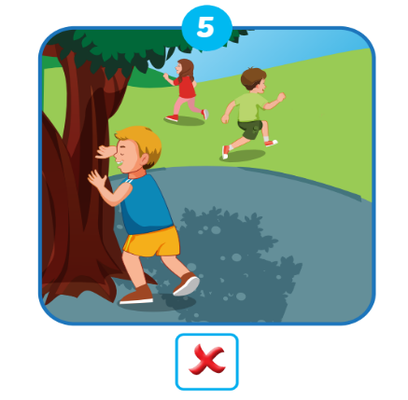
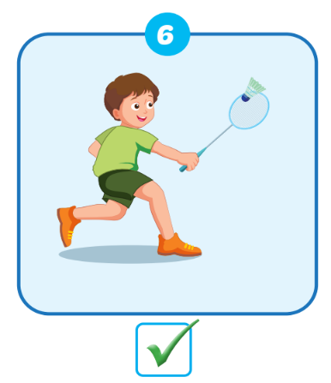

Slide 16

Speaking

Slide 17

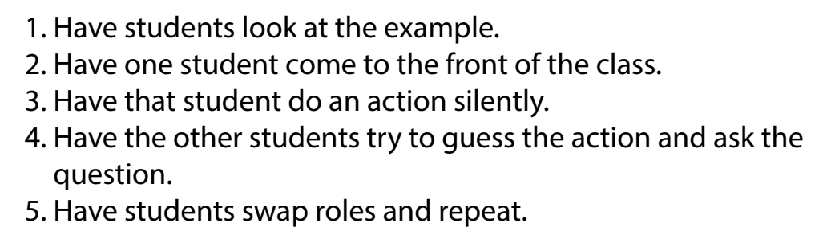

Slide 18
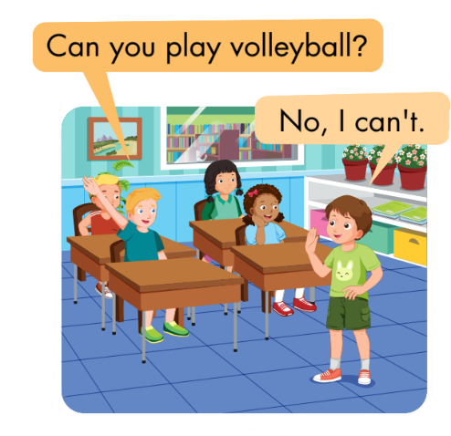
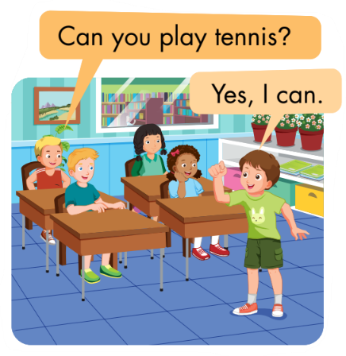


Slide 19

Practice with your partner
Student A draw a sport and share it with student B.
Student B has 5 seconds to guess the picture and ask the question
(Ex: Can you play tennis?).
Swap roles and repeat.

Slide 20

CONSOLIDATION

Slide 21
Early Production

Slide 22

Truth or lie?
How to play
Student A stands in front of the class.
Other students will ask 3 questions about the sports (Ex: Can you play tennis?).
Student A will tell 2 truths and 1 lie.
Student B guesses student A's lie.

Slide 23

WRAP-UP

Slide 24




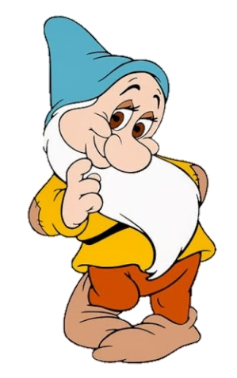
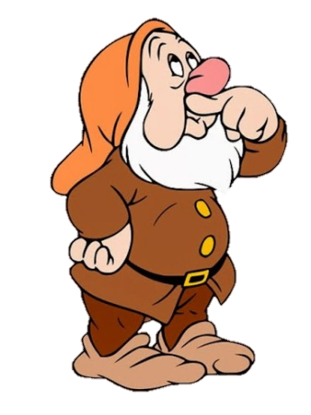


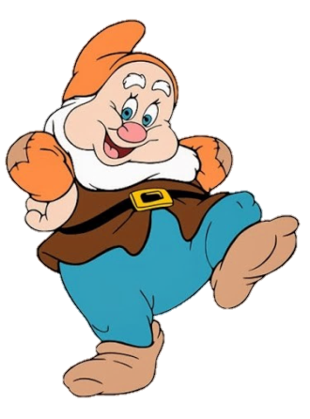
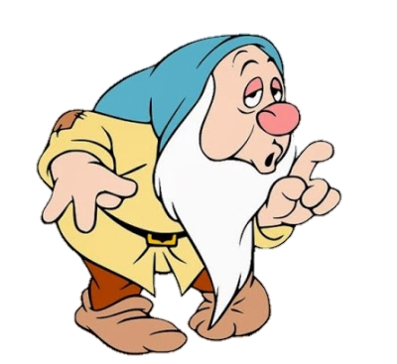


Hide and seek

Slide 25







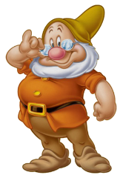


Next
Start
Find the correct word.
baminton
socer
tenis
basketball
Time up
Correct

Slide 26



Start
Find the correct word.
Next
socce
tennis
voleyball
batminton
Time up
Correct

Slide 27

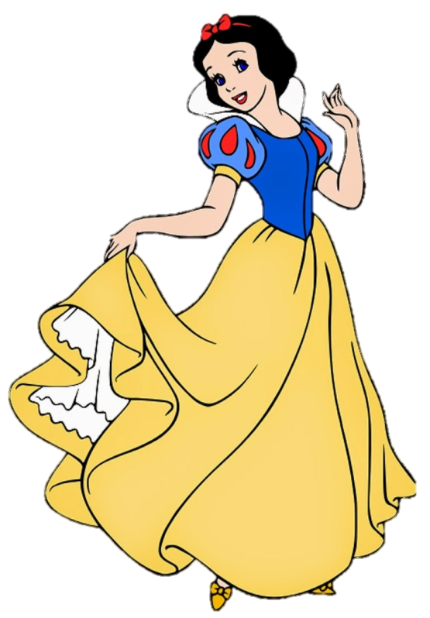
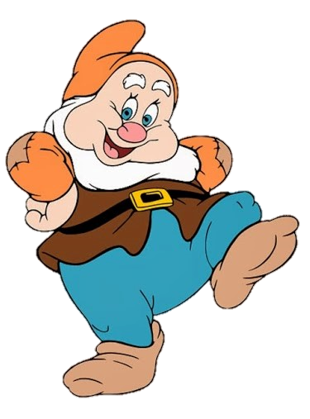
Start
Next
Can you play soccer?
Yes, I can
Yes, I can’t
No, I can
No can’t
Time up
Good job

Slide 28
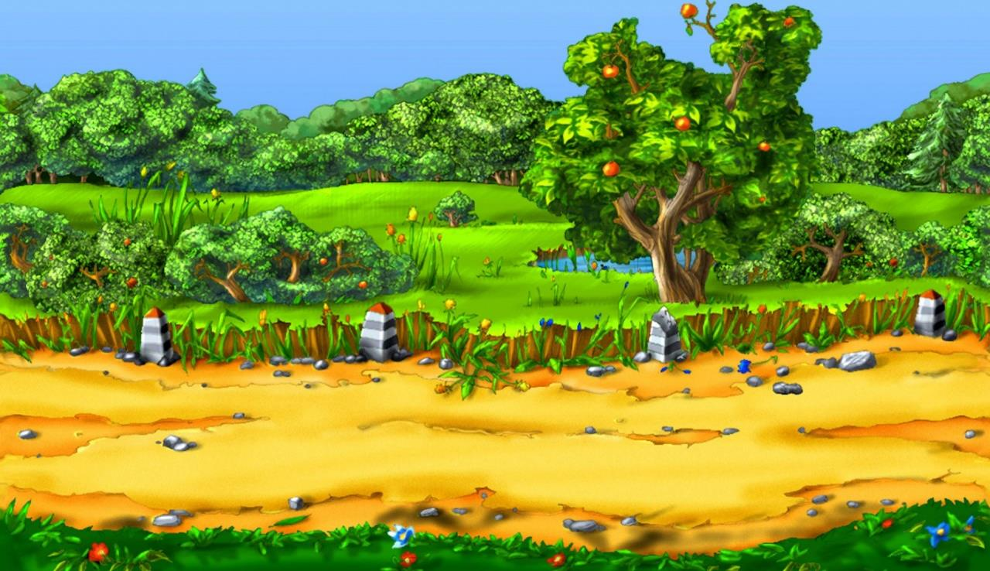

Start
Find the correct word.
Next
volleybal
baskatball
badminton
tenins
Time up
Very good

Slide 29

Start
Next
Can you play tennis?
Yes, you can
No, I can’t
No, I can
Yet, I can
Time up
Good job

Slide 30

Start
Next
Find the correct word.
teniss
volleball
batketball
soccer
Time up
Excellent

Slide 31
Start
Next
Find the correct word.
volleyball
teennis
sokcer
baseketball
Time up
Good job

Slide 32


Start
Next
Can you play badminton?
No, I can
Yes, I can
Yes, you can
Yes, I can’t
Time up
Very good

Slide 33
Today’s lesson
Vocabularies
badminton
tennis
volleyball
basketball
soccer
Structures/ Sentence patterns
Can you play soccer?
- Yes, I can./No, I can't.

Slide 34
Lesson 3
Homework
Practice vocabularies and structure. Make sentences using them.
Do the exercises in Tiếng Anh 3 i-Learn Smart Start Workbook (page 49)
Do the exercises in Tiếng Anh 3 i-Learn Smart Start Notebook (page 34)
Play the consolidation games in Tiếng Anh 3 i-Learn Smart Start DHA App on www.eduhome.com.vn
Prepare the next lesson (page 71)

Slide 35

Have a nice day!

