Slide 1

Unit 3: Music and Arts
Lesson 2.3: Pronunciation & Speaking
Page 25

Slide 2



LESSON OUTLINE
Consolidation

Slide 3

By the end of this lesson, students will be able to…
make plans to go to a music event.
learn that the intonation falls at the end of statements and apply it to real-life communication.

Slide 4

WARM-UP

Slide 5

Work in pairs.
Choose the word whose main stress is placed
differently from the others.
1. A. information B. biology C. technology D. geography
2. A. incredible B. traditional C. informative D. nonexistent
3. A. movie B. party C. author D. dessert
/ˌɪnfərˈmeɪʃən/
/baɪˈɑːlədʒi/
/tekˈnɑːlədʒi/
/dʒiˈɑːɡrəfi/
/ɪnˈkredəbl/
/trəˈdɪʃənl/
/ɪnˈfɔ:rmətɪv/
/ˌnɑːn ɪɡˈzɪstənt/
/ˈmuːvi/
/ˈpɑ:rti/
/ˈɑːθər/
/dɪˈzɜːrt/

Slide 6
Work in pairs.
Choose the word whose underlined part is
pronounced differently from that of the other words.
1. A. day B. gray C. lack D. play
2. A. speaking B. singer C. music D. liking
3. A. needs B. wants C. likes D. meets
/deɪ/
/greɪ/
/læk/
/pleɪ/
/ˈspi:kɪŋ/
/ˈsɪŋər/
/ˈmju:zɪk/
/ˈlaɪkɪŋ/
/ni:dz/
/wɑ:nts/
/laiks/
/mi:ts/

Slide 7

Work in pairs.
Talk about a music show you have attended.

Slide 8



Slide 9
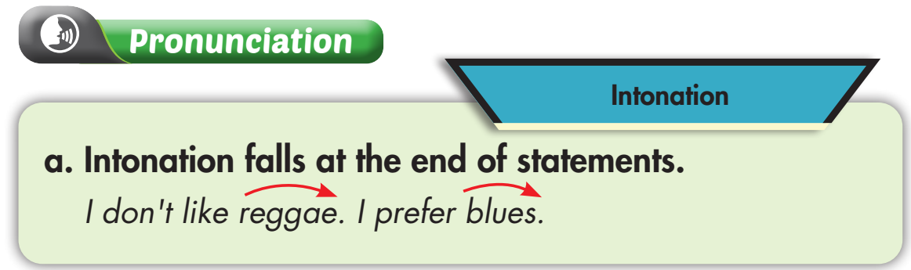
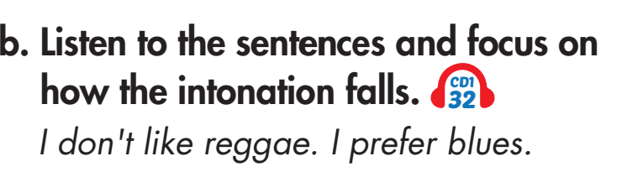


Slide 10
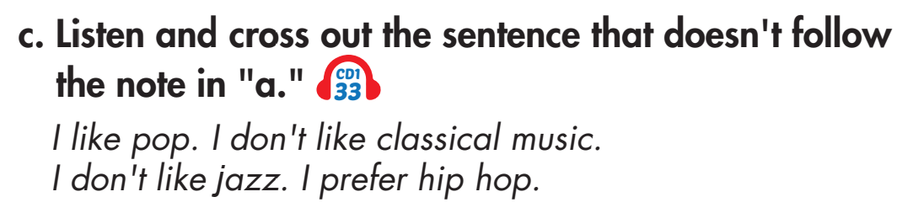
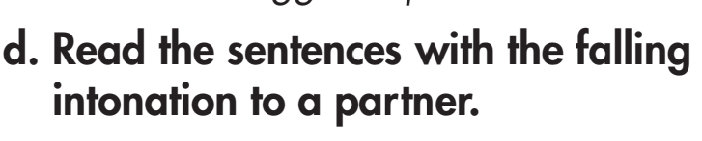

Slide 11


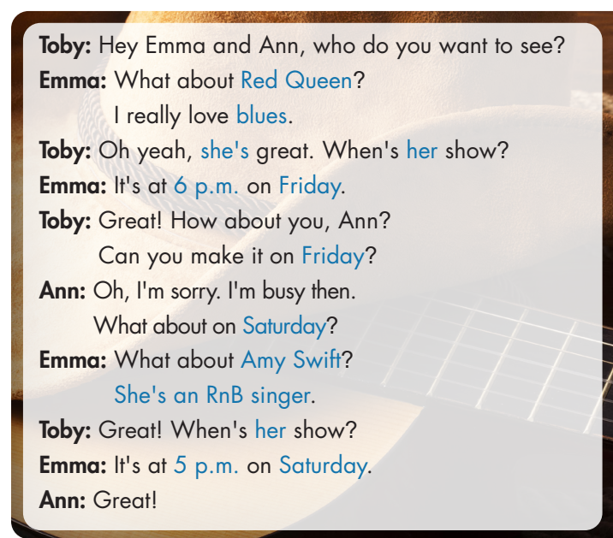
a. Practice the conversation. Mind your intonation.

Slide 12
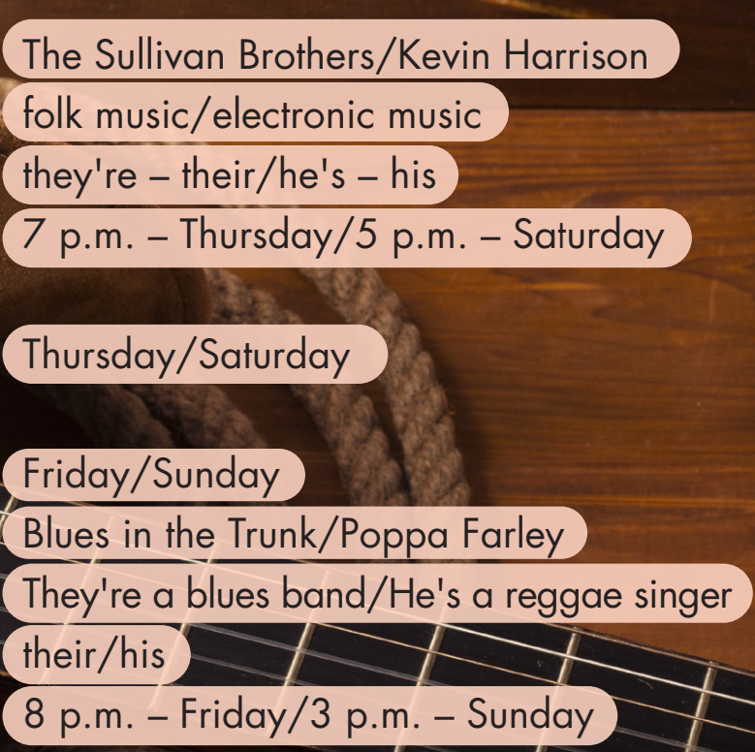
a. Swap your roles. Use the suggestions on the right to replace the words in blue. Mind your intonation!

Slide 13
b. Make similar conversations, using your own ideas. Mind your intonation.

Slide 14

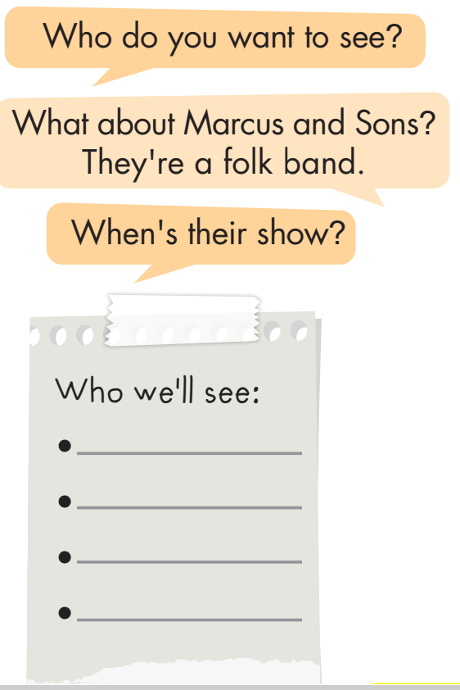
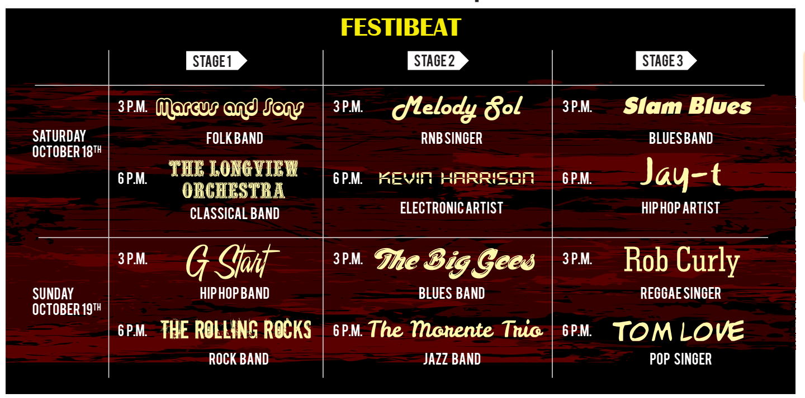
Ask and answer about different music shows, then choose 4 artists to see.
Work in groups.

Slide 15
Work in pairs.
Which bands or singers will you see at Festibeat?
I will see the music show of Tom Love. It’s at 6 p.m. I really love pop. How about you?
My favorite type of music is blues. I will see Slam Blues’ show. It’s at 3 p.m.

Slide 16

CONSOLIDATION

Slide 17
Work in pairs
Work with a partner. Make plans to go to a music event.

Slide 18

WRAP-UP

Slide 19
Today’s lesson
How to make plans to go to a music event.
Intonation falling at the end of statements.

Slide 20
Homework
Practice intonation for statements.
Review the vocabulary and grammar notes in Tiếng Anh 7 i-Learn Smart World Notebook (pages 16 & 17).
Prepare the next lesson (page 26 SB).
Play the consolidation games in Tiếng Anh 7 i-Learn Smart World DHA App on www.eduhome.com.vn

Slide 21

Lesson 3
Stay positive and have a nice day!

