Slide 1


Slide 2


Unit
7
ENVIRONMENTAL PROTECTION
LESSON 4: COMMUNICATION
1

Slide 3
LESSON 4: COMMUNICATION
WARM-UP
Jumbled conversation
Task 1: Listen and read the dialogue.
Task 2: Work in pairs. Make similar conversations to ask for and give clarification.
EVERYDAY ENGLISH
Task 3: Read the passage and tick the correct answers.
Task 4: Match the activities people do on Earth Day with their results.
Task 5: Work in pairs. Ask and answer.
EARTH DAY
CONSOLIDATION
Wrap-up
Homework

Slide 4

WARM-UP
1. Mi: And what do you mean by ‘in the
wild’?
2. Linda: That means animals that live in
their natural habitats, not in zoos.
JUMBLED CONVERSATION
3. Mi: Oh, I get it now. Thanks, Linda.
4. Linda: Endangered species are animals
in the wild that face a high risk of extinction.
5. Mi: Hey, Linda. What does ‘endangered species’ mean?

Slide 5

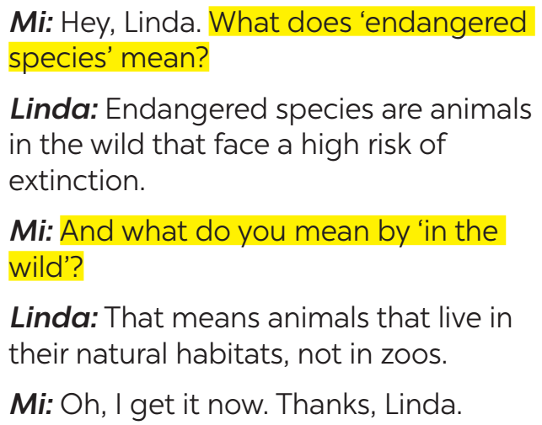
EVERYDAY ENGLISH
1
Listen and read the conversations. Pay attention to the highlighted sentences.
Asking for clarifications:
What does S mean?
What do you mean by …?
Giving clarifications:
It means … /
S is /are …
That means …

Slide 6

EVERYDAY ENGLISH
2
Work in pairs. Make similar conversations to ask for and give clarification.
SINGLE-USE PRODUCT:
A: What does it mean by ‘single-use products’?
B: ‘Single-use products’ are products made to be used once only.
A: Oh, thank you.
GLOBAL WARMING:
A: What do you mean by ‘global warming’?
B: It is the increase in the atmosphere’s temperatures caused by the rise of gases, especially carbon dioxide.
A: Oh, thank you.

Slide 7
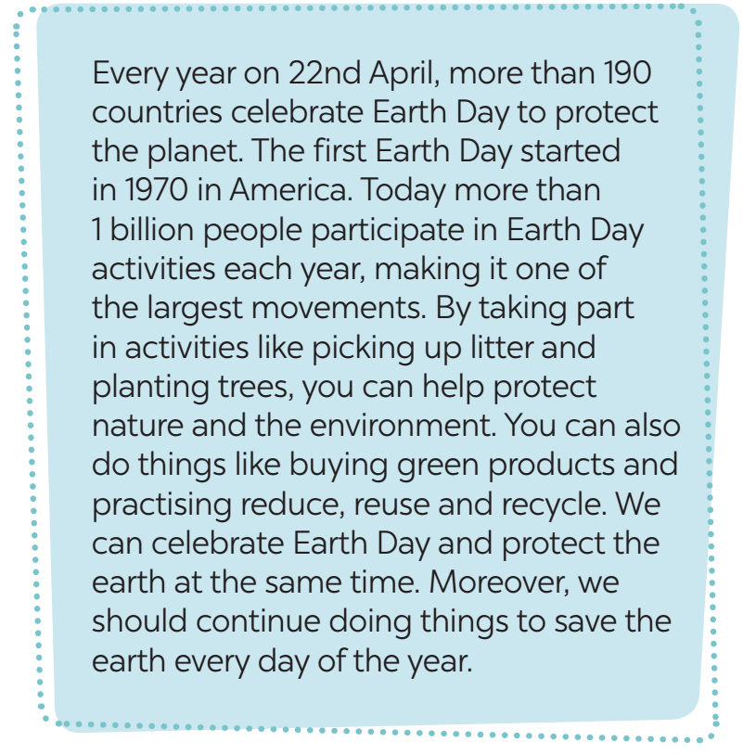

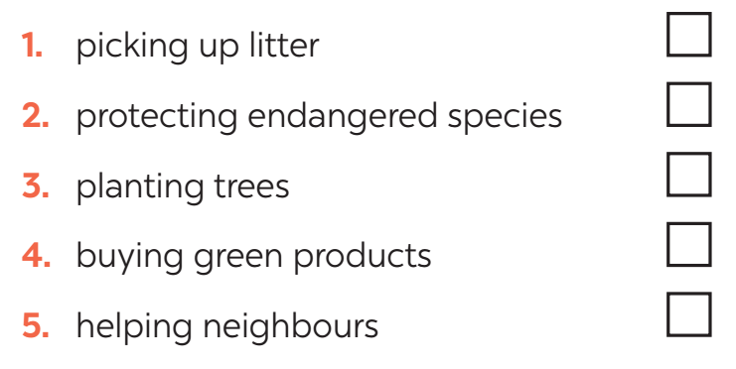
EARTH DAY
3
Read the passage and tick the correct answers.
WHAT ACTIVITIES DO PEOPLE DO ON EARTH DAY?

Slide 8
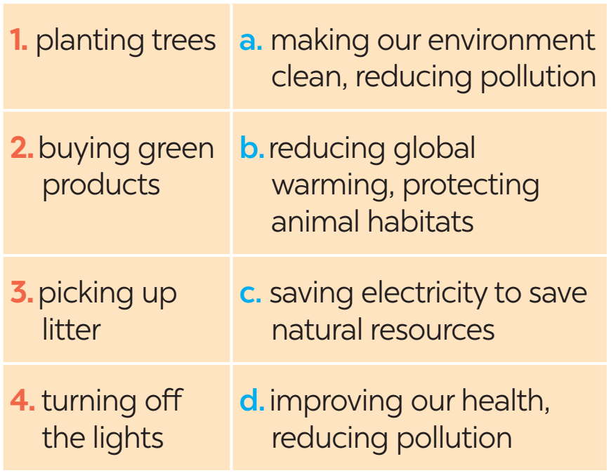
EARTH DAY
4
Match the activities people do on Earth Day with their results.

Slide 9
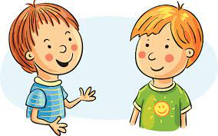
EARTH DAY
5
Work in pairs. Ask and answer about the things you and your friends do on Earth Day.
We pick up litter and clean the
streets. And you?
What do you do on Earth Day?
…

Slide 10

CONSOLIDATION
1
Wrap-up
What have we learnt in this lesson?
Asking for clarification
Get to know about Earth Day

Slide 11

CONSOLIDATION
2
Homework
Do exercises in the workbook.

Slide 12

Website: hoclieu.vn
Fanpage: facebook.com/www.tienganhglobalsuccess.vn/

