Slide 1


Slide 2

Unit
5
1
Unit
FAMILY LIFE
INVENTIONS
LESSON 3
READING
Artificial intelligence

Slide 3

Unit
1
1
FAMILY LIFE
Family Life
Unit
OBJECTIVES
Develop reading skill for main ideas and specific information about artificial intelligence.

Slide 4
LESSON 3
READING
Unit
GETTING STARTED
WARM-UP
Watch a video
PRE-READING
Activity 1: Look at the pictures of Asimo and Sophia and discuss the questions below in pairs.
Vocabulary
Activity 2: Read the text below and choose the best title for it.
Activity 3: Read the text again and match the pictures with the uses of AI.
Activity 4: Decide whether the following statements are true (T) or false (F).
WHILE-READING
POST-READING
Activity 5: Work in groups and discuss how AI can be used in schools. Then share your ideas with the whole class.
CONSOLIDATION
Wrap-up
Homework

Slide 5
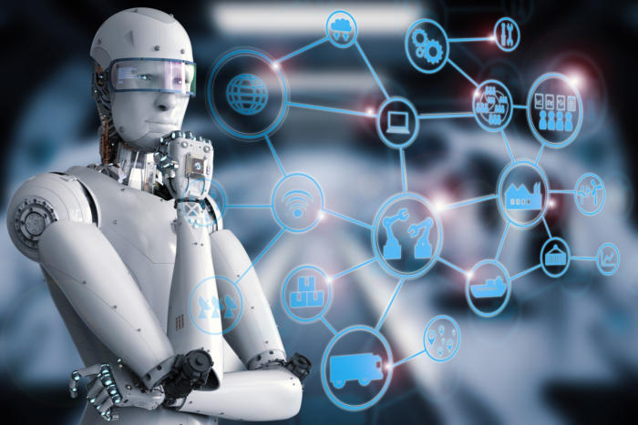

LESSON 3
READING
Unit
GETTING STARTED
WARM-UP
Watch a video
Work individually.
Watch a video and take notes.
Answer the questions using the notes.

Slide 6
LESSON 3
READING
Unit
GETTING STARTED
WARM-UP
Watch a video
1. What is artificial intelligence?
AI is the development of computer systems that perform tasks requiring human intelligence such as recognizing images, making decision, or engaging in dialogues.
2. What are some real-life cases in which we have probably dealt with AI?
- When we watch films, listen to music, shop online, AI gives us recommendations about what we might like
- AI is capable of converting spoken language into text and translating it into other languages.
3. What benefits do robots/ AI bring to us?
- Robots make our everyday lives easier or take on strenuous activities.
- Self driving vehicles recognize their environment through AI and can react to it.
- In medicine, AI supports doctors when diagnosing diseases.
- In education, AI helps to individualize learning activities.
4. Can AI replace human?
No, when we would rather make our own decision, AI will not replace humans. It is just getting better and better at supporting us.

Slide 7
LESSON 3
READING
Unit
GETTING STARTED
WARM-UP
Watch a video
PRE-READING
Activity 1: Look at the pictures of Asimo and Sophia and discuss the questions below in pairs.
Vocabulary

Slide 8
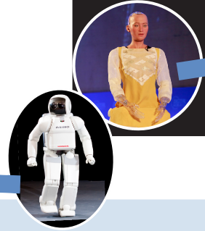
PRE-READING
1
Look at the pictures of Asimo and Sophia and discuss the questions below in pairs (p.55).
1. What are they?
They are robots.
2. What do you think they can do?
They can walk, talk, show emotions, and do household chores.

Slide 9
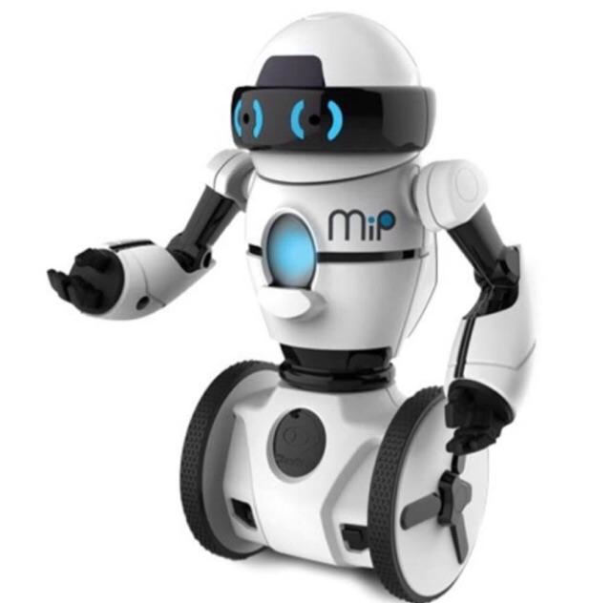

VOCABULARY
Robot (n)
/ˈrəʊbɒt/
a machine that can perform a complicated series of tasks by itself

Slide 10

VOCABULARY
communicate (v)
/kəˈmjuːnɪkeɪt/
to share or exchange information, news, ideas, feelings, etc

Slide 11

VOCABULARY
emotion (n)
/ɪˈməʊʃn/
a strong feeling such as love, fear or anger; the part of a person’s character that consists of feelings

Slide 12

VOCABULARY
artificial intelligence (AI) (n)
/ɑːtɪfɪʃl ɪnˈtelɪdʒəns/
the study and development of computer systems that can copy intelligent human behaviour

Slide 13
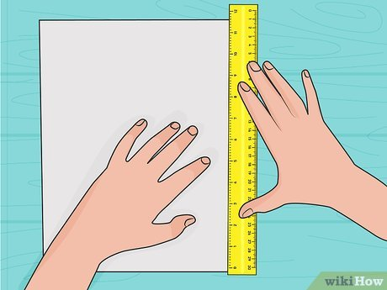
VOCABULARY
measure (v)
/ˈmeʒə(r)/
to find the size, quantity, etc. of something in standard units

Slide 14
VOCABULARY
New words | Pronunciation | Meaning
1. robot (n) | /ˈrəʊbɒt/ | a machine that can perform a complicated series of tasks by itself
2. communicate (v) | /kəˈmjuːnɪkeɪt/ | to share or exchange information, news, ideas, feelings, etc.
3. emotion (n) | /ɪˈməʊʃn/ | a strong feeling such as love, fear or anger; the part of a person’s character that consists of feelings
4. artificial intelligence (AI) (n) | /ˌɑːtɪfɪʃl ɪnˈtelɪdʒəns/ | the study and development of computer systems that can copy intelligent human behaviour
5. measure (v) | /ˈmeʒə(r)/ | to find the size, quantity, etc. of something in standard units

Slide 15
LESSON 3
READING
Unit
GETTING STARTED
WARM-UP
Watch a video
PRE-READING
Activity 1: Look at the pictures of Asimo and Sophia and discuss the questions below in pairs.
Vocabulary
Activity 2: Read the text below and choose the best title for it.
Activity 3: Read the text again and match the pictures with the uses of AI.
Activity 4: Decide whether the following statements are true (T) or false (F).
WHILE-READING

Slide 16
WHILE-READING
2
Read the text and choose the best title for it (p.55).
A. AI development over time
B. Robots: The best AI inventions
C. AI in use today
D. AI in education

Slide 17
WHILE-READING
2
Read the text and choose the main idea.
In 2000, Asimo, a robot created by Honda amazed everyone by just walking down the stairs. Twenty years later, a robot named Sophia can even communicate with people by using human language and expressing emotions.
However, robots are just one example of Artificial Intelligence (AI) – the study and development of machines that can copy human intelligence. Nowadays, AI has bene applied to various areas of life.
At home, devices such as vacuum cleaners can now use AI to measure the room size and recognize any furniture. They can then decide on the most effective way to clean the house.
In transport, AI can be used on many smartphones to collect information about traffic. This can then help drivers find the most suitable route. Travelling has become much more convenient thanks to AI.
At work, the uses of AI are even more useful and exciting. Computer programmes, such as software or chatbots, can help customers plan their holidays, book flights and hotels, and answer questions.
AI is one of the most important inventions of the 21st century. It has completely changed our daily work and life.

Slide 18
WHILE-READING
2
Read the text and choose the best title for it (p.55).
A. AI development over time
B. Robots: The best AI inventions
C. AI in use today
D. AI in education

Slide 19

WHILE-READING
3
Read the text again and match the pictures with the uses of AI (p.55).
Uses of AI at home
Uses of AI at work
Uses of AI in transport

Slide 20
WHILE-READING
3
Read the text again and match the pictures with the uses of AI (p.55).
b. Uses of AI at work
c. Uses of AI in transport
Uses of AI at home

Slide 21
WHILE-READING
PRACTICE
4
Decide whether the following statements are true (T) or false (F) (p.55).
 | T | F
1. Sophia can show emotions when talking to humans.
2. AI helps to make machines that think and act like humans.
3. AI is one of the most important inventions of the 20th century.
✓
✓
✓

Slide 22
LESSON 3
READING
Unit
GETTING STARTED
WARM-UP
Watch a video
PRE-READING
Activity 1: Look at the pictures of Asimo and Sophia and discuss the questions below in pairs.
Vocabulary
Activity 2: Read the text below and choose the best title for it.
Activity 3: Read the text again and match the pictures with the uses of AI.
Activity 4: Decide whether the following statements are true (T) or false (F).
WHILE-READING
POST-READING
Activity 5: Work in groups and discuss how AI can be used in schools. Then share your ideas with the whole class.

Slide 23
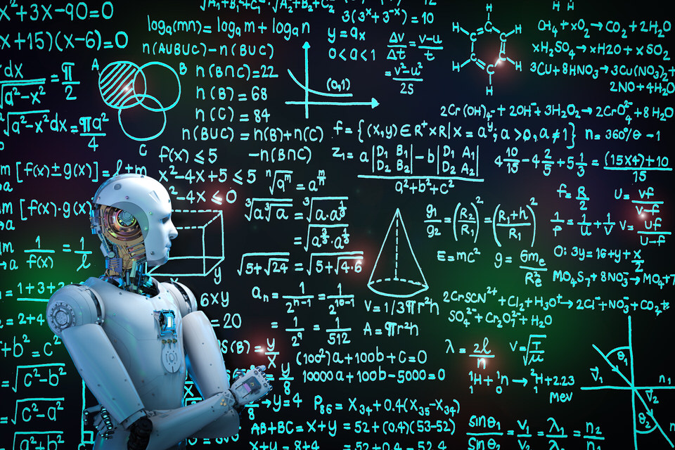
POST-READING
5
Work in groups and discuss how AI can be used in schools. Then share your ideas with the whole class (p.55).
Work in groups and brainstorm possible uses of AI in schools.
Present group’s ideas.
Give comments for friends’ groups and vote for the most interesting presentation.

Slide 24
LESSON 3
READING
Unit
GETTING STARTED
WARM-UP
Watch a video
PRE-READING
Activity 1: Look at the pictures of Asimo and Sophia and discuss the questions below in pairs.
Vocabulary
Activity 2: Read the text below and choose the best title for it.
Activity 3: Read the text again and match the pictures with the uses of AI.
Activity 4: Decide whether the following statements are true (T) or false (F).
WHILE-READING
POST-READING
Activity 5: Work in groups and discuss how AI can be used in schools. Then share your ideas with the whole class.
CONSOLIDATION
Wrap-up
Homework

Slide 25
CONSOLIDATION
1
Wrap-up
Reading for general and specific information about artificial intelligence.

Slide 26
CONSOLIDATION
2
Homework
Prepare for the next lesson: Unit 5: Speaking
2. Do exercises in the workbook

Slide 27


