Slide 1

Unit 2: Fit for life
Lesson 2d: Everyday English
Page 35

Slide 2
Lesson Outline
Warm-up
Everyday Eng.
Pronunciation
Consolidation
Wrap-up

Slide 3
Objectives
By the end of this lesson, students will be able to…
act out a dialogue ordering at the school canteen.
design a healthy menu for a school canteen (optional).
pronounce the sounds: /w/, /v/.

Slide 4

WARM-UP

Slide 5
Choose the word whose underlined part is pronounced differently from that of the others.
1. A. punchbag B. capsule C. music D. menu
/ˈpʌntʃbæɡ/ /ˈkæpsjuːl/ /ˈmjuːzɪk/ /ˈmenjuː/
2. A. clever B. selfish C. pretty D. special
/ˈklevər/ /ˈselfɪʃ/ /ˈprɪti/ /ˈspeʃəl/
3. A. fight B. climb C. bite D. kick
/faɪt/ /klaɪm/ /baɪt/ /kɪk/

Slide 6


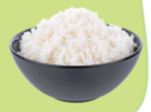



Say the name of the food below:
salad
chicken
rice
burger
pizza
grapes

Slide 7

It’s time to learn …

Slide 8
Pre-speaking
Read the dialogue and fill in the gaps with the sentences (A-G). Two sentences are extra.
Woman: Hello, Dan. 1) _________________________
Dan: Let’s see. I’d like chicken and potatoes, please.
Woman: OK. Would you like carrots or salad with that?
Dan: 2) _________________________
Woman: You’re hungry today! 3) _________________________ We’ve got apple pie or ice cream.
Dan: Ice cream, please!
Woman: OK. 4) _________________________
Dan: A glass of orange juice, please.
Woman: So, that’s chicken and potatoes with carrots and salad, ice cream and a glass of orange juice. 5) _________________________
Dan: Here you are.
Woman: Thank you.

Slide 9
Pre-speaking
Read the dialogue and fill in the gaps with the sentences (A-G). Two sentences are extra.
A How about dessert?
Woman: Hello, Dan. 1) _________________________
Dan: Let’s see. I’d like chicken and potatoes, please.
Woman: OK. Would you like carrots or salad with that?
Dan: 2) _________________________
Woman: You’re hungry today! 3) _________________________ We’ve got apple pie or ice cream.
Dan: Ice cream, please!
Woman: OK. 4) _________________________
Dan: A glass of orange juice, please.
Woman: So, that’s chicken and potatoes with carrots and salad, ice cream and a glass of orange juice. 5) ____________________
Dan: Here you are.
Woman: Thank you.
B What would you like today?
C That’s £6.00, please.
D That’s all.
B A small portion of each, please.
F Anything to drink?
G Please take a seat.

Slide 10

Pre-speaking
Listen and check your answers. What do you notice about the speakers’ intonation and rhythm?
B What would you like today?
The speaker’s voice goes up or down and the speaker stressed some words in the sentences.
Woman: Hello, Dan. 1) _________________________
Dan: Let’s see. I’d like chicken and potatoes, please.
Woman: OK. Would you like carrots or salad with that?
Dan: 2) _________________________
Woman: You’re hungry today! 3) _________________________ We’ve got apple pie or ice cream.
Dan: Ice cream, please!
Woman: OK. 4) _________________________
Dan: A glass of orange juice, please.
Woman: So, that’s chicken and potatoes with carrots and salad, ice cream and a glass of orange juice. 5) ____________________
Dan: Here you are.
Woman: Thank you.
A How about dessert?
B What would you like today?
C That’s £6.00, please.
E A small portion of each, please.
A How about dessert?
D That’s all.
E A small portion of each, please.
F Anything to drink?
F Anything to drink?
C That’s £6.00, please.
G Please take a seat.

Slide 11

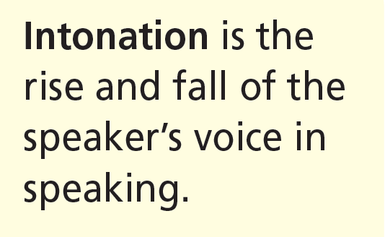
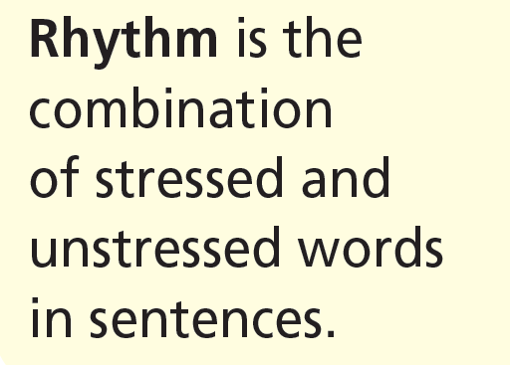

Slide 12
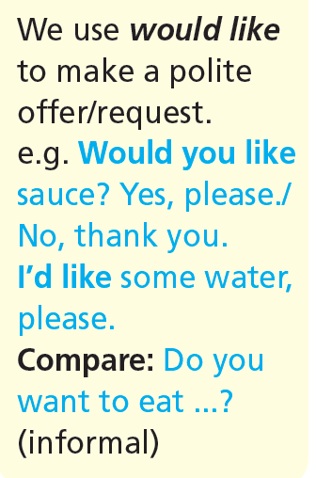
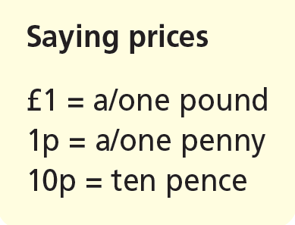

Slide 13
While-speaking
Take roles and read the dialogue in Exercise 1 aloud.
What would you like today?
Woman: Hello, Dan. _________________________
Dan: Let’s see. I’d like chicken and potatoes, please.
Woman: OK. Would you like carrots or salad with that?
Dan: _________________________
Woman: You’re hungry today! ________________ We’ve got apple pie or ice cream.
Dan: Ice cream, please!
Woman: OK. _________________
Dan: A glass of orange juice, please.
Woman: So, that’s chicken and potatoes with carrots and salad, ice cream and a glass of orange juice. __________________
Dan: Here you are.
Woman: Thank you.
A small portion of each, please.
How about dessert?
Anything to drink?
That’s £6.00, please.

Slide 14
While-speaking
Say what Dan ordered.
Woman: Hello, Dan. What would you like today?
Dan: Let’s see. I’d like chicken and potatoes, please.
Woman: OK. Would you like carrots or salad with that?
Dan: A small portion of each, please.
Woman: You’re hungry today! How about dessert? We’ve got apple pie or ice cream.
Dan: Ice cream, please!
Woman: OK. Anything to drink?
Dan: A glass of orange juice, please.
Woman: So, that’s chicken and potatoes with carrots and salad, ice cream and a glass of orange juice. That’s £6.00, please.
Dan: Here you are.
Woman: Thank you.
Dan ordered chicken and potatoes with carrots and salad, ice cream and a glass of orange juice.

Slide 15

Listen and repeat. Think of more words with the same sounds. Practise saying them with a partner.
/w/ what, would, water, waiter, why, where, when, white, we, walk, work, wet, want, worried
/v/ very, vegetables, valley, village, vet, van, visit, view, verb, video, Vietnamese

Slide 16

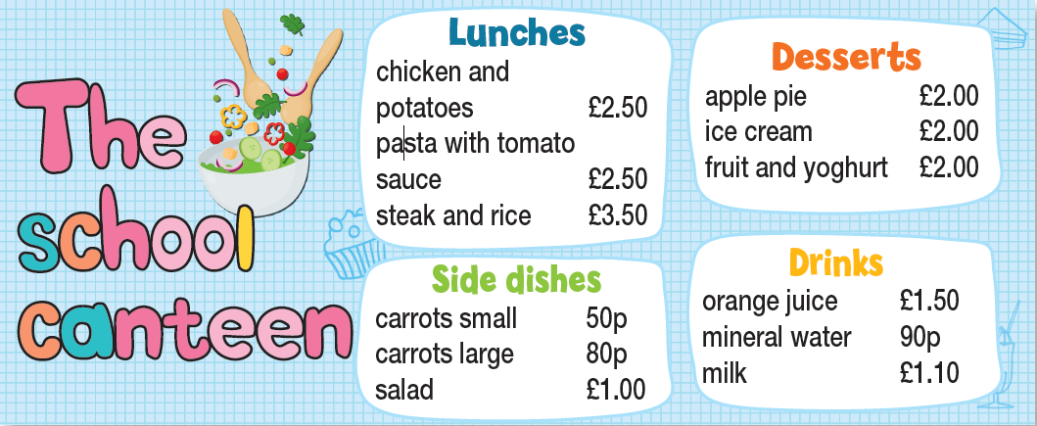
Post-speaking
Imagine you are in the school canteen. Use the menu to act out a dialogue similar to the one in Exercise 1. Mind your intonation and rhythm.

Slide 17
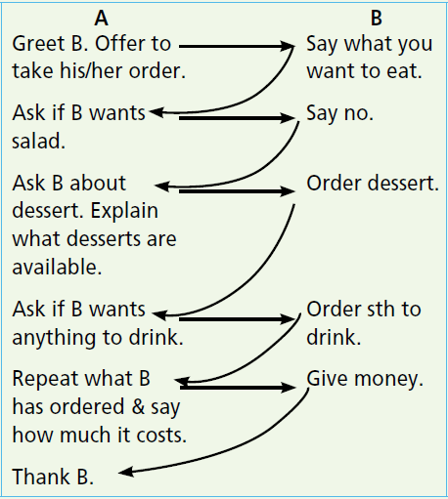
Use the diagram to help you:

Slide 18
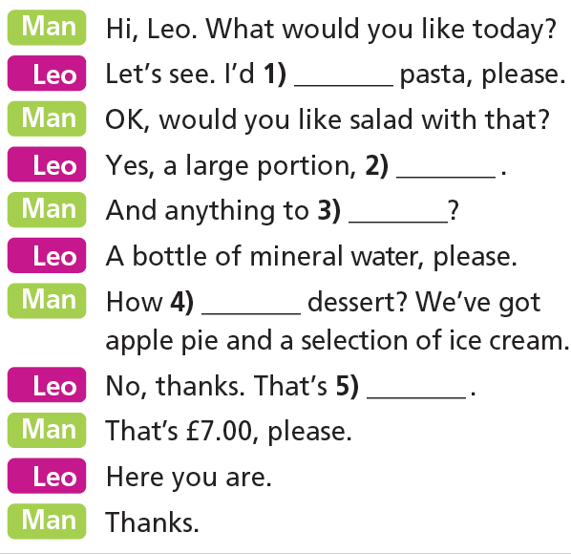
Extra Practice
WB, page 19
Fill in each gap in the dialogue with one word. Read the dialogue aloud. Mind your intonation and rhythm.
like
please
drink
about
all

Slide 19

CONSOLIDATION

Slide 20
Write a paragraph (60-80 words) to describe your favourite food and drink, using vocabulary and structures in the lesson.

Slide 21

WRAP-UP

Slide 22
Today’s lesson
Pronunciation:
Intonation
Rhythm
Sound /v/ and /w/
Speaking:
- Ordering at the school canteen
would like + to V-inf
Say prices

Slide 23
Homework
Practise the intonation and rhythm and the dialogue.
Do the exercises in TA 7 Right on WB (page 19)
Prepare the next lesson (page 36 SB)

Slide 24
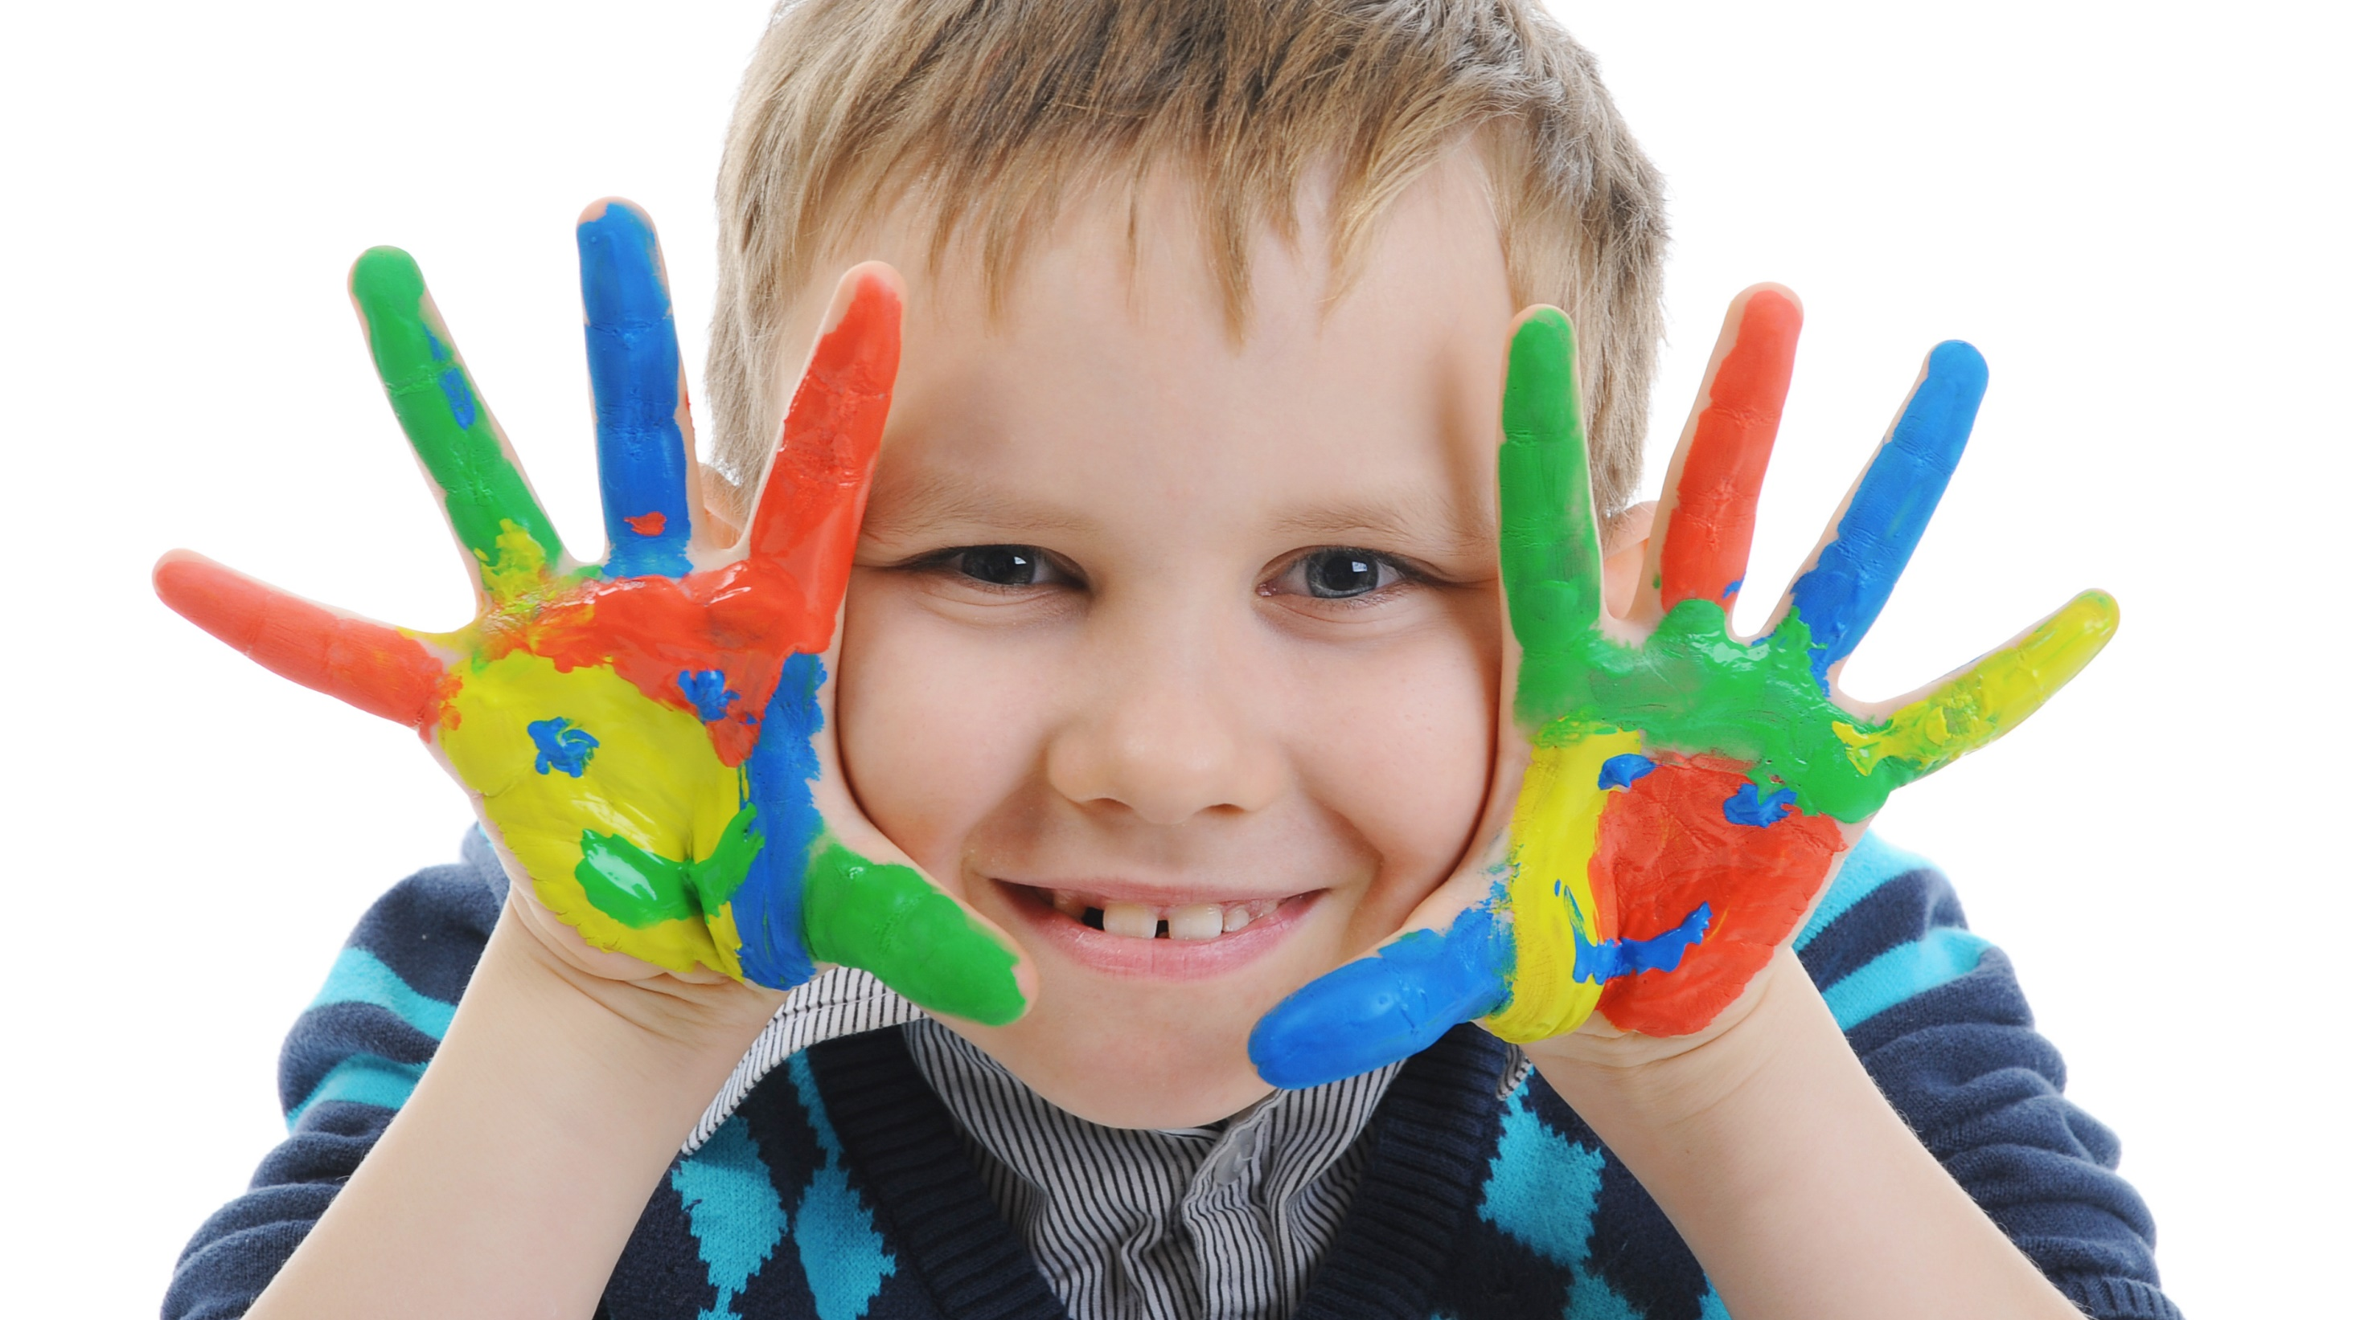
Enjoy your day!

