Slide 1

Unit 1: My Friends
Lesson 2
Page 15

Slide 2
Lesson Outline
Warm-up
Structure
Consolidation
Wrap-up

Slide 3
Objectives
By the end of this lesson, students will be able to practice and use …..
Vocabulary: the USA, the UK, Italy, India, Japan, Alpha
Structure: Where are you from?
I'm from the USA.
Where's she from?
She's from Japan.
Aim: Students will be able to ask where people are from.

Slide 4

WARM UP

Slide 5






Mystery Circles





1
2
3
4
5

Slide 6

It’s time to learn …

Slide 7
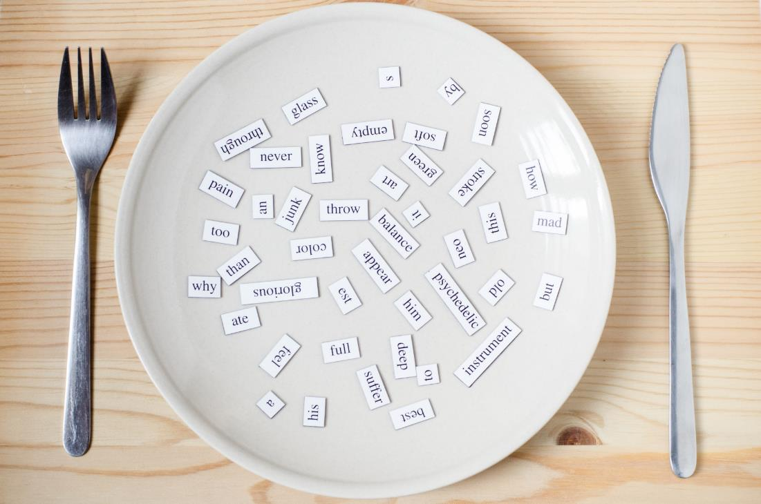
Structure
Where are you from?
I’m from…
Where’s she/he from?
She’s/He’s from…

Slide 8

Presentation

Slide 9

Welcome to Fruit World!
1
7
6
2
3
4
5
Notes:
Instructions:
Introduce that this is a magic tree with a lot of fruit. They will choose one by one to open the question and they have to answer is to get points.
There’s an extra question related to the lesson. Who can open and answer it get the most point.
Click on the numbers to move to the questions.

Slide 10

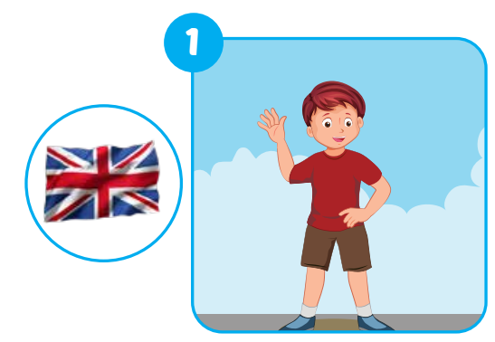



E
Point, ask and answer.
Where’s he from?
He’s from the UK.
Notes:
Instructions:
Ask “ Is it a girl or a boy?”
If it’s a boy, Students say: a boy -> teacher open the boy’s picture and get students to say: “Where’s he from?” -> let students guess where the person is from.
If it’s a girl, Students say: a girl -> teacher open the girl’s picture and get students to say: “Where’s she from?”-> let students guess where the person is from.
Teacher open the picture of the flag and check students’ answer.
Get all students to practice asking and answering the question.
Click the button to comeback
Click on the icons to show question and answer.

Slide 11
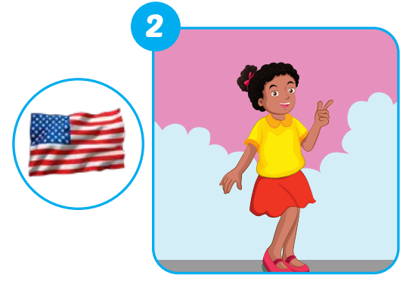


E
Point, ask and answer.
Where’s she from?
She’s from the USA.
Notes:
Instructions:
Ask “ Is it a girl or a boy?”
If it’s a boy, Students say: a boy -> teacher open the boy’s picture and get students to say: “Where’s he from?” -> let students guess where the person is from.
If it’s a girl, Students say: a girl -> teacher open the girl’s picture and get students to say: “Where’s she from?”-> let students guess where the person is from.
Teacher open the picture of the flag and check students’ answer.
Get all students to practice asking and answering the question.

Slide 12
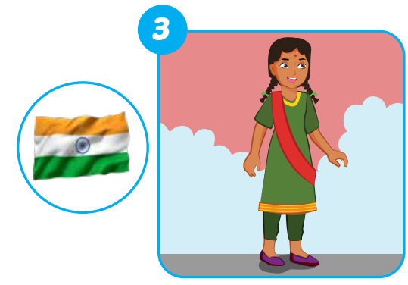
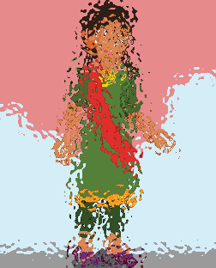

E
Point, ask and answer.
Where’s she from?
She’s from India.
Notes:
Instructions:
Ask “ Is it a girl or a boy?”
If it’s a boy, Students say: a boy -> teacher open the boy’s picture and get students to say: “Where’s he from?” -> let students guess where the person is from.
If it’s a girl, Students say: a girl -> teacher open the girl’s picture and get students to say: “Where’s she from?”-> let students guess where the person is from.
Teacher open the picture of the flag and check students’ answer.
Get all students to practice asking and answering the question.

Slide 13
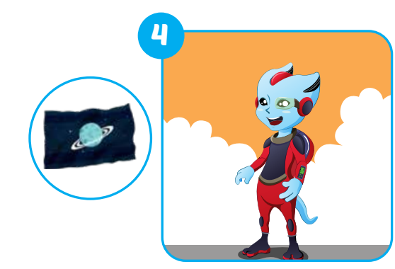


E
Point, ask and answer.
Where’s he from?
He’s from Alpha.
Notes:
Instructions:
Ask “ Is it a girl or a boy?”
If it’s a boy, Students say: a boy -> teacher open the boy’s picture and get students to say: “Where’s he from?” -> let students guess where the person is from.
If it’s a girl, Students say: a girl -> teacher open the girl’s picture and get students to say: “Where’s she from?”-> let students guess where the person is from.
Teacher open the picture of the flag and check students’ answer.
Get all students to practice asking and answering the question.

Slide 14
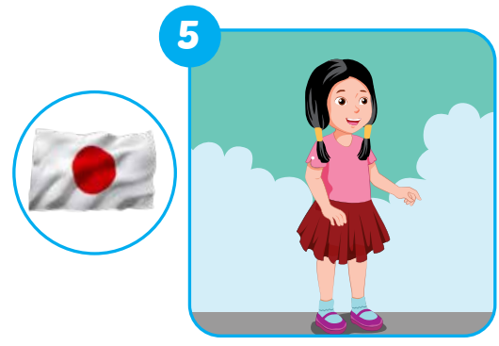


E
Point, ask and answer.
Where’s she from?
She’s from Japan.
Notes:
Instructions:
Ask “ Is it a girl or a boy?”
If it’s a boy, Students say: a boy -> teacher open the boy’s picture and get students to say: “Where’s he from?” -> let students guess where the person is from.
If it’s a girl, Students say: a girl -> teacher open the girl’s picture and get students to say: “Where’s she from?”-> let students guess where the person is from.
Teacher open the picture of the flag and check students’ answer.
Get all students to practice asking and answering the question.

Slide 15
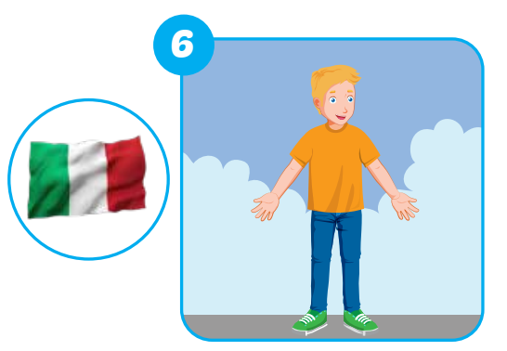
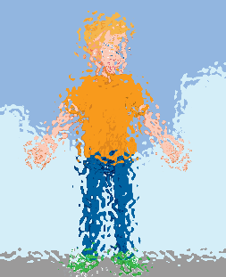

E
Point, ask and answer.
Where’s he from?
He’s from Italy.
Notes:
Instructions:
Ask “ Is it a girl or a boy?”
If it’s a boy, Students say: a boy -> teacher open the boy’s picture and get students to say: “Where’s he from?” -> let students guess where the person is from.
If it’s a girl, Students say: a girl -> teacher open the girl’s picture and get students to say: “Where’s she from?”-> let students guess where the person is from.
Teacher open the picture of the flag and check students’ answer.
Get all students to practice asking and answering the question.

Slide 16

E
Point, ask and answer.
Where are you from?
I’m from Vietnam.
Notes:
This is the extra question from this part.
They can choose to be in any country as they want. It doesn’t have to be in Vietnam.

Slide 17
Practice

Slide 18
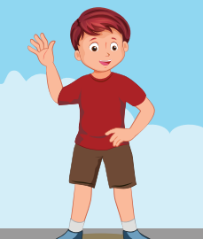
Activity 1
Look and read. Choose the best answer.
Question 1: where’s he from?
a. He’s from the USA.
b. He’s from the UK.
Notes:
Ask:
It’s a “he” or “she”?
Now you ask: Where’s she/he from?
Show the answer and let students to choose.
Click on the answers to check.
Red -> incorrect
Purple -> correct

Slide 19
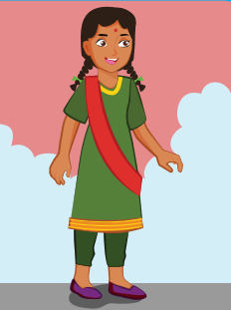
Activity 1
Look and read. Choose the best answer.
Question 2: where’s she from?
a. She’s from Japan.
b. She’s from India.
Notes:
Ask:
It’s a “he” or “she”?
Now you ask: Where’s she/he from?
Show the answer and let students to choose.
Click on the answers to check.
Red -> incorrect
Purple -> correct

Slide 20

Activity 1
Look and read. Choose the best answer.
Question 3: where’s he from?
a. He’s from UK.
b. He’s from the Italy.
Notes:
Ask:
It’s a “he” or “she”?
Now you ask: Where’s she/he from?
Show the answer and let students to choose.
Click on the answers to check.
Red -> incorrect
Purple -> correct

Slide 21
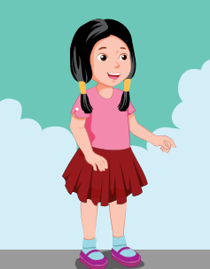
Activity 1
Look and read. Choose the best answer.
Question 4: where’s she from?
a. She’s from Japan.
b. She’s from Vietnam.
Notes:
Ask:
It’s a “he” or “she”?
Now you ask: Where’s she/he from?
Show the answer and let students to choose.
Click on the answers to check.
Red -> incorrect
Purple -> correct

Slide 22
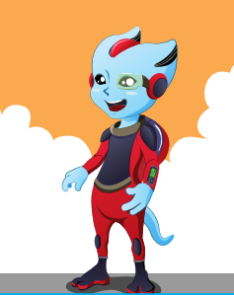
Activity 1
Look and read. Choose the best answer.
Question 5: where’s he from?
a. He’s from Alpha.
b. He’s from the USA.
Notes:
Ask:
It’s a “he” or “she”?
Now you ask: Where’s she/he from?
Show the answer and let students to choose.
Click on the answers to check.
Red -> incorrect
Purple -> correct

Slide 23
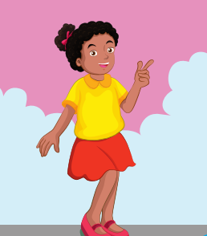
Activity 1
Look and read. Choose the best answer.
Question 6: where’s she from?
a. She’s from the USA.
b. She’s from Italy.
Notes:
Ask:
It’s a “he” or “she”?
Now you ask: Where’s she/he from?
Show the answer and let students to choose.
Click on the answers to check.
Red -> incorrect
Purple -> correct

Slide 24

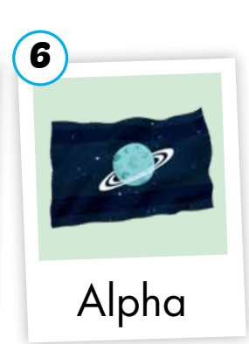
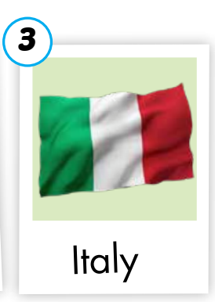
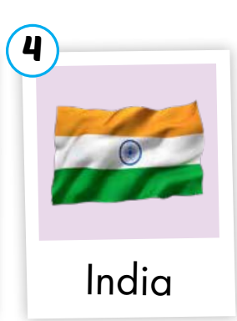


Activity 2
E
Play Guess the picture.
Notes:
Instructions:
Get 1 student to come up on the board, face to the class.
Teacher show a random flag. The class ask “ Where are you from?”. The student on the board has to guess by answering “I’m from…”. If he/she gets it right, the class say “YES”, if she/he gets it wrong, the class say NO -> the student on the board have 3 chances to guess. Once they get it right, give them 1 point.

Slide 25
Extra Activity 1
Let’s talk!
I’m from the USA.
Where are you from, Anna?
NAME | COUNTRY
Anna | The USA
…… | ……
…… | ……
…… | ……
…… | ……
Notes:
In this activity, students have to interview their friends.
First of all, each of them choose a country they like and answer the question “Where are you from?” in their notebook.
Then, they draw a table like the sample on the screen and practice asking their friends.
Make sure they interview both boys and girls.

Slide 26
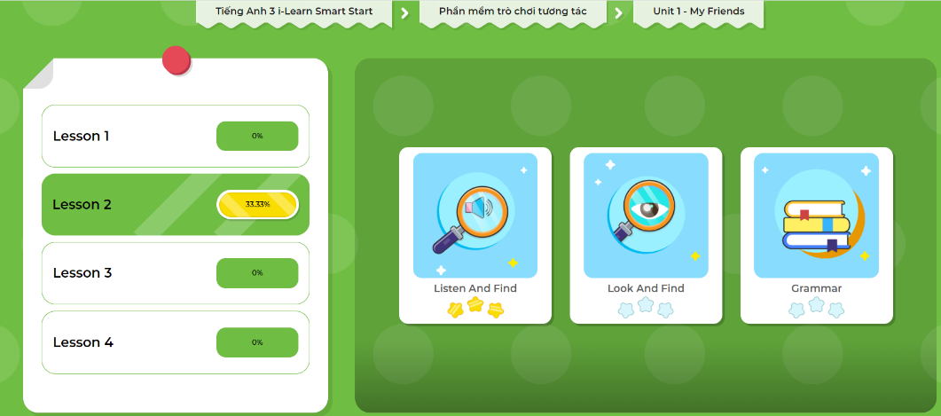
Extra-Act2. DHA app.
Click here to play the games

Slide 27
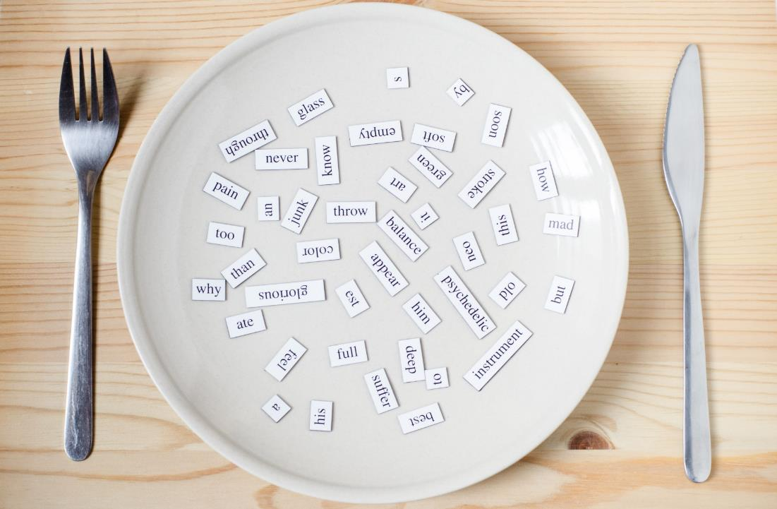
Consolidation

Slide 28

Write about your friend.
Anna
My name’s….. I’m….years old. I’m from…..
I’m writing this about my friends.
Picture 1 is Anna. She’s from the USA.
Picture 2 is Alfie. He’s from Alpha.
2
The USA
Alfie
1
Alpha
Notes:
Ask students to use their interview result (extra activity 1) to draw the pictures of their friends and prepare a writing task like this.

Slide 29

WRAP-UP

Slide 30
Today’s lesson
Vocabulary
The USA
The UK
Italy
India
Japan
Alpha
Structures/ Sentence patterns
Where are you from?
I’m from…
Where’s she from?
She’s from….
Where’s he from?
He’s from…..

Slide 31
Lesson 3
Homework
Practice vocabularies and structure. Make sentences using them.
Do the exercises in Tiếng Anh 3 i-Learn Smart Start Workbook (page 11)
Practice the vocabulary and structure in Tiếng Anh 3 i-Learn Smart Start Notebook (page 11)
Play consolidation games in Tiếng Anh 3 i-Learn Smart Start DHA App on www.eduhome.com.vn
Prepare the next lesson (page 16)

Slide 32

Enjoy your day!

