Slide 1


Slide 2
Unit
6
Preserving our heritage
Unit
FAMILY LIFE
LESSON 8
LOOKING BACK AND PROJECT

Slide 3
LESSON 8
LOOKING BACK AND PROJECT
WARM-UP
Who is faster?
Pronunciation: Intonation
Vocabulary: Preserving heritage
Grammar: To-infinitive clauses
LOOKING BACK
PROJECT
Presentation: How can we preserve our heritage?
CONSOLIDATION
Wrap-up
Homework

Slide 4
WARM-UP
WHO IS FASTER?
- Ss work in group of four.
- Teacher gives each group a worksheet
- Ss read and match the paragraphs with appropriate headings.
- The first team which completes correctly is the winner.

Slide 5
Form a volunteer group
1. Gather fellow residents who care about preserving your community’s recent past places. Working together, you can research and nominate buildings for landmark designation; become your community’s advocate for the recent past and Modern design; create a website and maintain a discussion board.

Slide 6
Offer tours
2. Tours are a tried-and-true method for building a community’s appreciation for its historic resources and significant architecture. Put together a bus tour that takes guests past modern structures throughout the neighborhood. Create a self-guided driving tour accompanied by a booklet that visitors and residents can continue to use.

Slide 7
Host special events
3. Special events encourage those interested in mid-century architecture to connect with like-minded people. These can include fundraising events; special exhibits (complete with opening night parties) that feature the architecture and modern heritage of your community; or a lecture series that features local historians, architects, or professors to speaking about the area’s modern architecture.

Slide 8
Conduct community workshops
4. Workshops and seminars can be useful ways to educate specific audiences about buildings and cultural sites from the recent past. These classes can help teach participants the basics of historic preservation, give them an overview of the history of post-war architecture, offer tips on how to identify threats or problems, find appropriate replacement materials to keep mid-century homes looking true to their original architecture, and more. Contact a local preservation group for help or partnership opportunities.

Slide 9

LOOKING BACK
1
Listen and mark the intonation in the following sentences, using falling or level-rising intonation.
1. The trip to Hoi An Ancient Town was amazing .
2. Turn off the air conditioner. It wastes too much electricity.
3. A boat tour is the best way to experience wildlife habitats.
4. In Ha Long Bay you can go swimming , diving and fishing.

Slide 10
LOOKING BACK
2
Choose the correct word to complete each sentence
1. Many ancient houses in the city are not
well preserved / well promoted because of changes over time and bad weather.
2. His historical / historic novels are based on events that happened in the early 19th century.

Slide 11
LOOKING BACK
2
Choose the correct word to complete each sentence
3. Older generations worry that folk / festival music and dances will die out because young people only listen to pop music.
4. The heritage site is promoted / protected as a tourist destination on social media.

Slide 12
LOOKING BACK
3
Rewrite the sentences using to-infinitive clause.
1. Mai went to Soc Son because she wanted to attend the Giong Festival.
→ _____________________________________
2. The first place that you can visit on the
trip is Hue Imperial Citadel.
→ _____________________________________
Mai went to Soc Son to attend Giong Festival.
The first place to visit on the trip is Hue Imperial
Citadel.

Slide 13
LOOKING BACK
3
Rewrite the sentences using to-infinitive clause.
3. Our music teacher gave lessons in xoan singing because she wanted to help us appreciate our cultural heritage.
→ ___________________________________________
4. The most famous site that you can see is the old bridge across the river.
→ ___________________________________________
Our music teacher gave lessons in xoan singing to help us appreciate our cultural heritage.
The most famous site to see is the old bridge across the river.

Slide 14
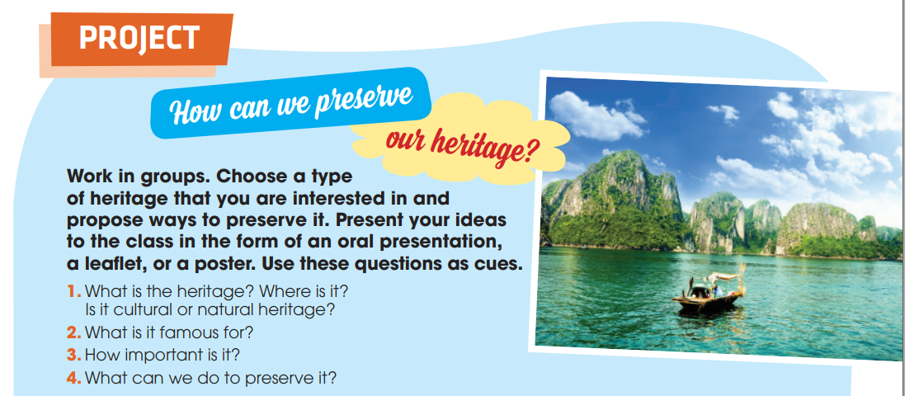
PROJECT
HOW CAN WE PRESERVE OUR HERITAGE?

Slide 15
CONSOLIDATION
1
Wrap-up
What have you learnt today?
- Review the vocabulary and grammar of Unit 6.
- Apply what you have learnt (vocabulary and grammar) into practice through a project.

Slide 16
CONSOLIDATION
2
Homework
- Do exercises in the workbook.
- Prepare for Unit 7.

Slide 17

Website: hoclieu.vn
Fanpage: facebook.com/tienganhglobalsuccess.vn/
Website: hoclieu.vn
Fanpage: facebook.com/sachmem.vn/

