Slide 1

Unit 2: Fit for life
Lesson 2b: Grammar
Page 32

Slide 2
Lesson Outline
Warm-up
Grammar
Consolidation
Wrap-up

Slide 3
Objectives
By the end of this lesson, students will be able to…
- review the Past Simple and spelling rules -ed ending regular verbs.
- talk about the activities they did by using the Past Simple.
- pronounce -ed ending regular verbs correctly.

Slide 4

WARM-UP

Slide 5
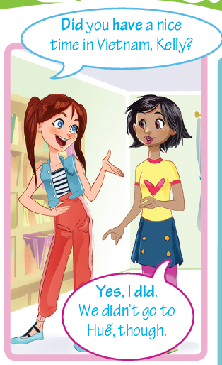
Look at the conversation, pay attention to the verbs in the sentences.
Which tense do people use in these sentences?
=> Past Simple

Slide 6

It’s time to learn …

Slide 7

Presentation

Slide 8

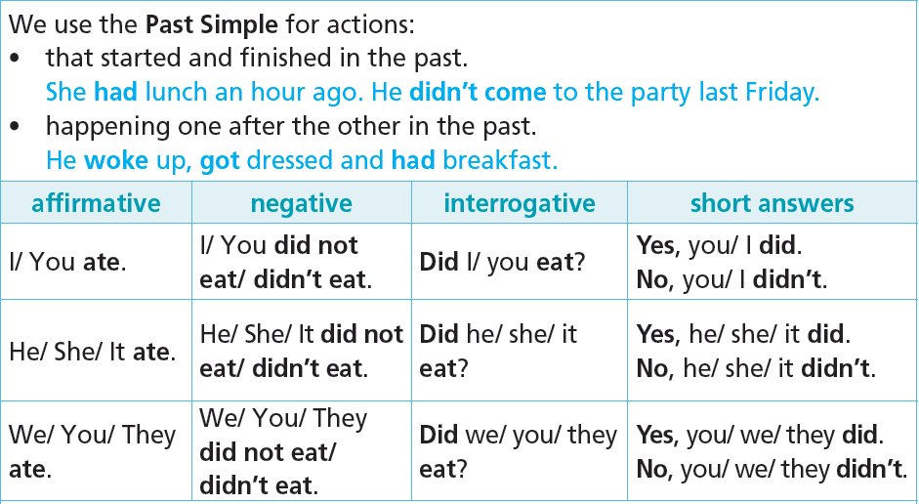

Slide 9
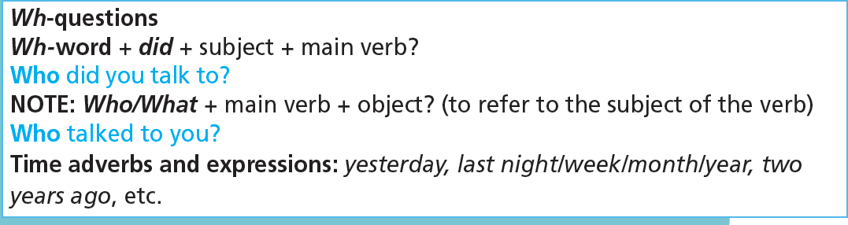

Slide 10


-ed ending regular verbs
• verbs ending in -e: add -d arrive ➝ arrived
• verbs ending in consonant + -y: change -y to -i and add -ed
study ➝ studied
• verbs ending in vowel + -y: add -ed play ➝ played
• verbs ending in consonant + vowel -l: double the final l and add -ed travel ➝ travelled
• verbs ending in a consonant after a stressed vowel: double the consonant and add -ed stop ➝ stopped
Pronunciation
/ɪd/ after the sounds /t/, /d/ wanted, ended
/t/ after the sounds /f/, /k/, /p/, /s/, /∫/, /t∫/ liked, watched
/d/ after all the other sounds played, smiled

Slide 11

Practice

Slide 12
1. Write the verbs in the Past Simple in the correct column.
• add • pass • work • need • live • sign • stay • taste
/ɪd/ | /t/ | /d/
added
passed
lived
needed
worked
signed
tasted
stayed

Slide 13

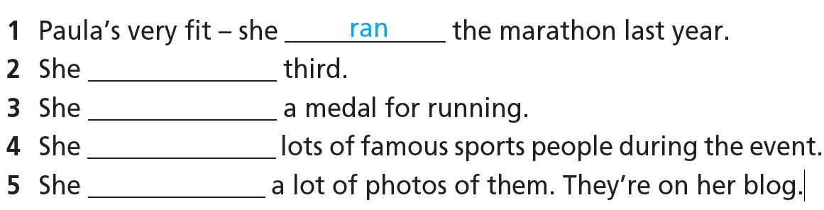
2. Complete the sentences. Use the verbs from the list in the Past Simple affirmative.
finished
won
met
took

Slide 14
3. Put the verbs in brackets in the Past Simple negative or interrogative. Then complete the answers with did or didn't.
1 Mary didn’t have (not/have) a beach holiday last year.
2 __________________ (she/try) kickboxing? Yes, she ___________ .
3 __________________ (they/stay) at a hotel? Yes, they ___________ .
4 They __________________ (not/play) basketball yesterday.
5 __________________ (her parents/go) jogging? No, they ___________ .
Did she try
did
Did they stay
did
didn’t play
Did her parents go
didn’t

Slide 15
Extra Practice
WB, Page 17
★ Put the verbs in brackets into the Past Simple.
A Hi, Sally. 1) ___________ (you/have) a good weekend?
B Oh yeah! On Saturday, I 2) ___________ (go) rollerblading with my sister and then, we 3) ___________ (eat) at Rob’s Pizza.
A 4) ___________ (you/like) it?
B Yes, the food 5) ___________ (be) great. What about you? 6) ___________ (you/do) anything interesting?
A Not really. I 7) ___________ (not/go) out. I 8) ___________ (surf) the Net and 9) ___________ (watch) TV. You know – all the usual boring things.
B I hope you 10) ___________ (not/forget) the history project!
A Oh, no!
Did you have
went
ate
Did you like
was
Did you do
didn’t go
surfed
watched
didn’t forget

Slide 16
Extra Practice
WB, Page 17
★★ Use the verbs in the list in the Past Simple to complete the sentences.
• swim • eat • visit • not/play • not/win • sleep • not/go • not/finish
1 I ______________ for eight hours last night.
2 My brother ______________ four sandwiches for lunch!
3 My mum ______________ to work this morning. She was ill.
4 We ______________ London on a day trip last month.
5 I ______________ the maths exercises at school, so I have to do them for homework.
6 John ______________ the race, but he came third and got a medal.
7 Kelly ______________ 1,000 metres at the pool last night!
8 Our team ______________ a football match last weekend because it rained.
slept
ate
didn’t go
visited
didn’t finish
didn’t win
swam
didn’t play

Slide 17

Production

Slide 18

Work in pairs. Make sentences about your activities you did last weekend using the Past Simple.
For example:
Student 1: I went to the cinema last weekend.
Student 2: I played football with my cousins last weekend.

Slide 19

CONSOLIDATION

Slide 20
More practice
Choose the correct option.
1. I joined/am joining a gym yesterday.
2. Mia went/goes jogging last weekend.
3. Emma didn’t watch/isn’t watching the match last night.
4. Did/Do you enjoy the yoga class last week?
5. Our team wins/won the ice hockey competition last year.

Slide 21
More practice
Put the verbs in brackets into the Past Simple.
1. _________________ (you/see) Tom last weekend?
2. She _________________ (not/come) to the tennis lesson yesterday afternoon.
3. We _________________ (ride) our bikes to school last Friday.
4. _________________ (your team/win) the football match yesterday?
5. He _________________ (not/buy) new trainers last weekend.
Did you see
didn’t come
rode
Did your team win
didn’t buy

Slide 22

WRAP-UP

Slide 23
Today’s lesson
Structures/ Sentence patterns
- Past Simple
- Spelling rules and pronunciation: -ed ending regular verbs.

Slide 24
Homework
- Do exercises in workbook on page 17.
- Complete the grammar notes in TA 7 Right On notebook (page 13).
- Prepare the next lesson (page 33 SB)

Slide 25
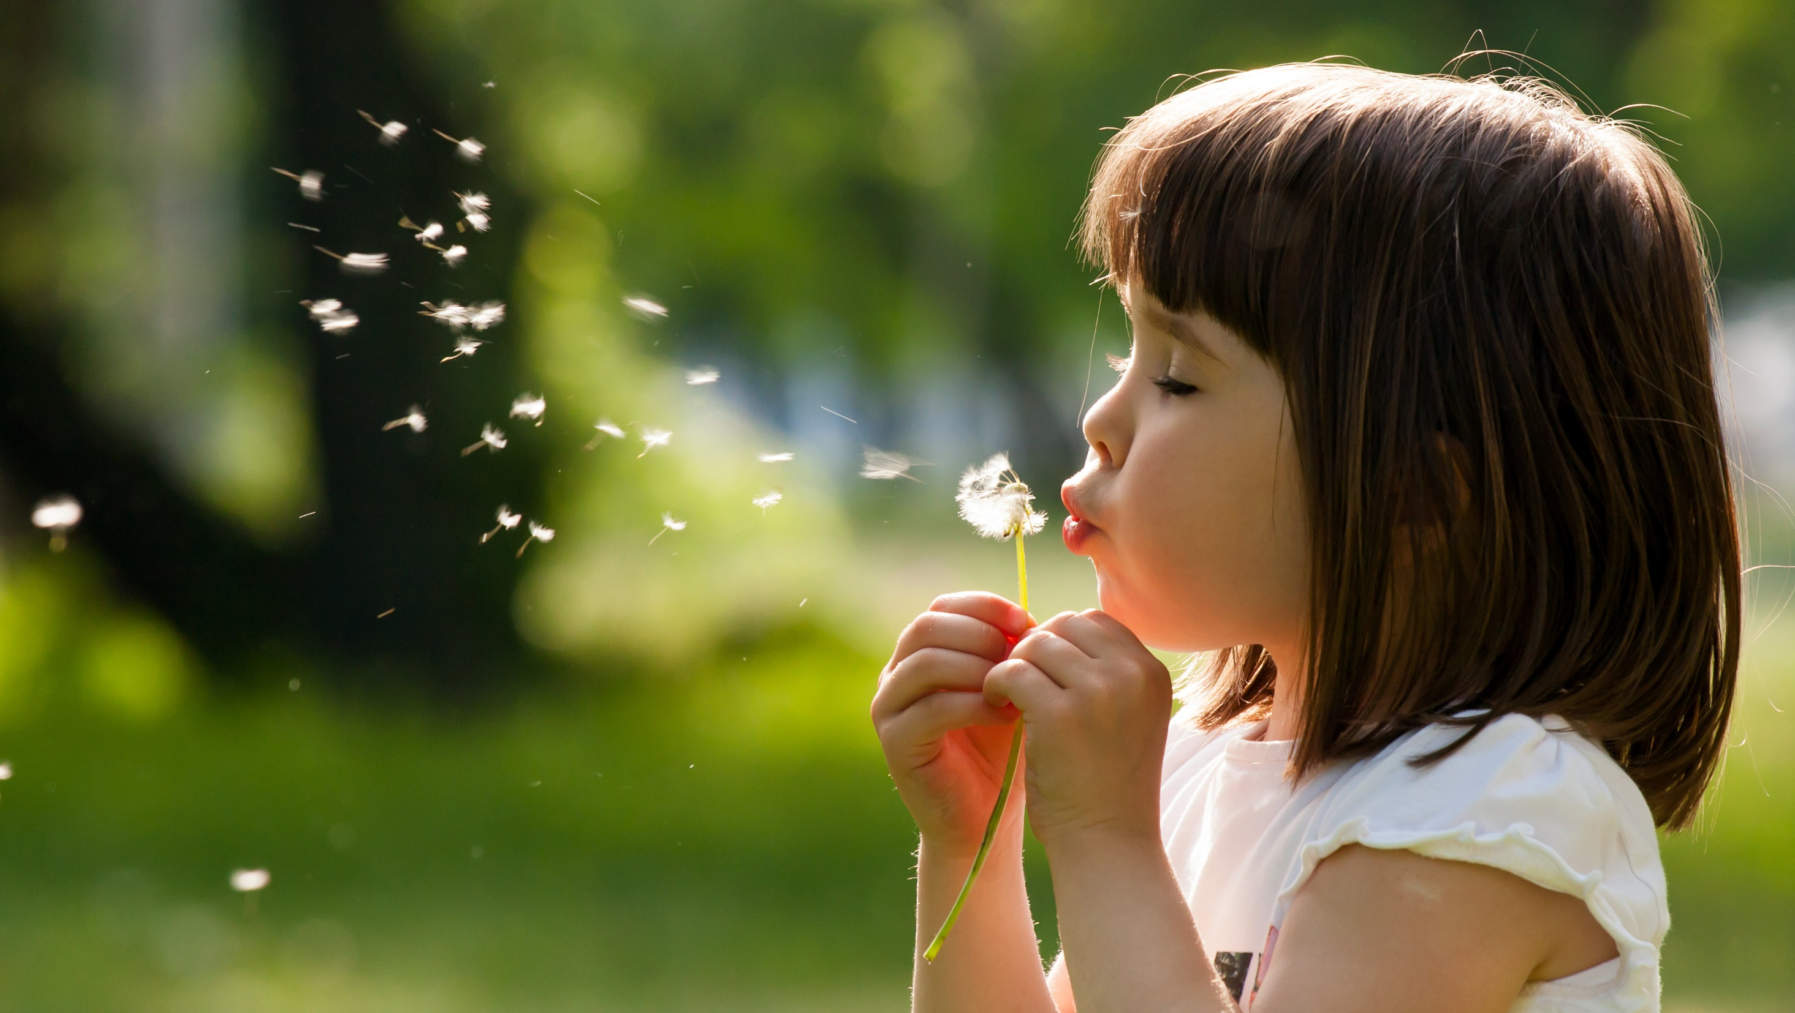
Enjoy your day!

