Slide 1

Unit 3: School
Lesson 4.1
Page 47

Slide 2
Lesson Outline
Warm-up
Vocabulary
Structure
Consolidation
Wrap-up

Slide 3
Objectives
By the end of this lesson, students will be able to ask what people's favorite color is and know how to answer it. They also learn how to express how they can make a certain color.
Vocabulary: green, orange, pink, purple, gray, favorite
Structure: What's your favorite color?
- My favorite color is orange.
I can make orange with yellow and red.

Slide 4

WARM UP

Slide 5
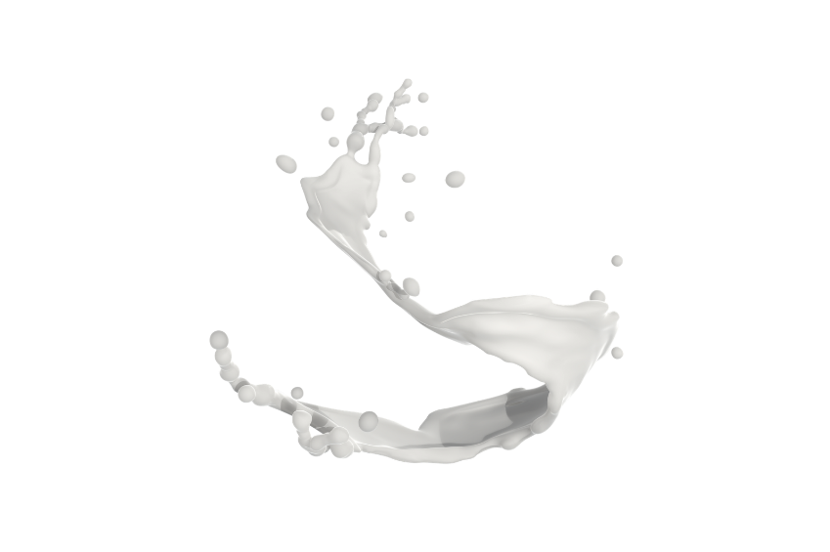

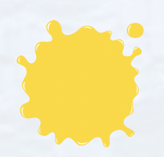

What color is it?

Slide 6

It’s time to learn …

Slide 7
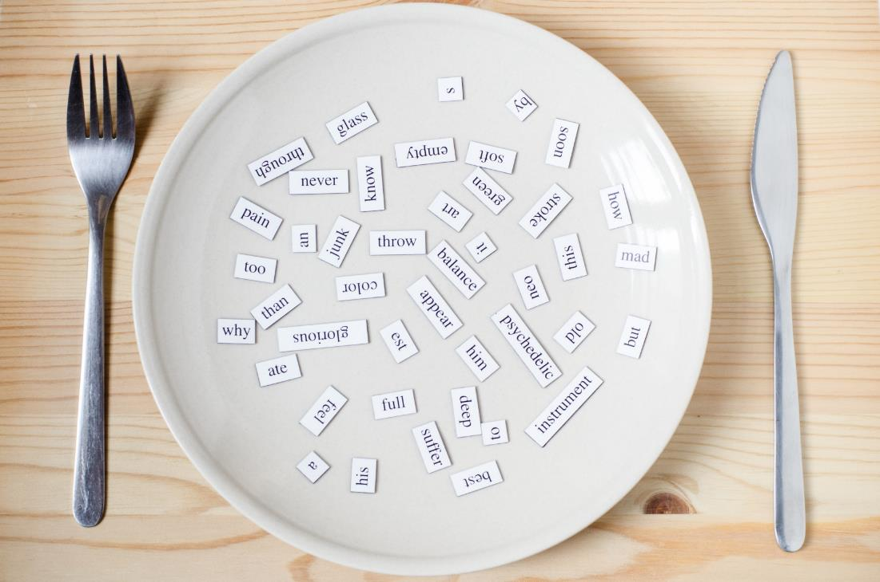
New words
green,
orange,
pink,
purple,
gray,
favorite

Slide 8

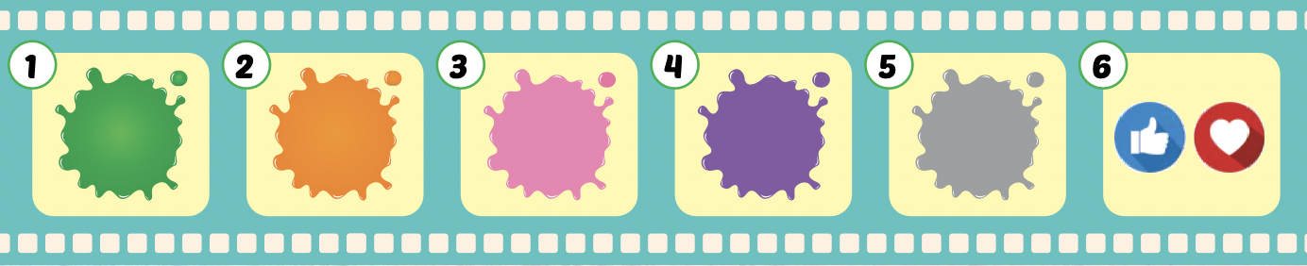
Listen and point.
Click the icon to hear the sound.

Slide 9
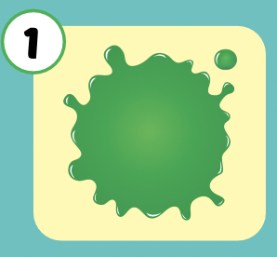
Listen and repeat.
Click each picture to hear the sound.
green
/ɡriːn/
màu xanh lá

Slide 10
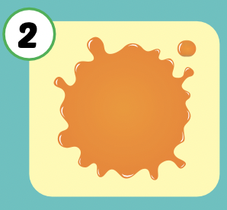
Listen and repeat.
Click each picture to hear the sound.
orange
/ˈɔːrɪndʒ/
màu cam

Slide 11
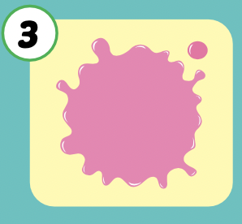
Listen and repeat.
Click each picture to hear the sound.
pink
/pɪŋk/
màu hồng

Slide 12
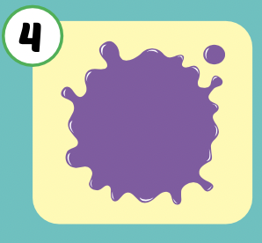
Listen and repeat.
Click each picture to hear the sound.
purple
/ˈpɜːrpl/
màu tím

Slide 13
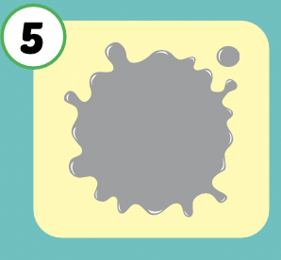
Listen and repeat.
Click each picture to hear the sound.
gray
/ɡreɪ/
màu xám

Slide 14
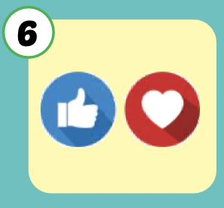
Listen and repeat.
Click each picture to hear the sound.
favorite
/ˈfeɪvərɪt/
yêu thích

Slide 15

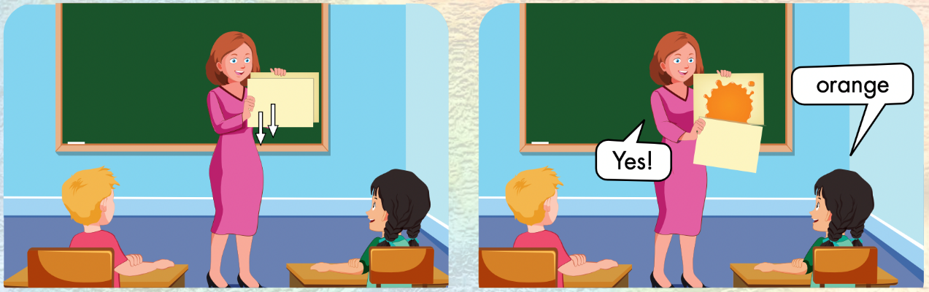

Slide 16
Let’s play!

Slide 17

What color is this?
green
Well done !
blue
orange

Slide 18

What color is this?
red
Well done !
orange
brown

Slide 19

What color is this?
red
Well done !
pink
purple

Slide 20

What color is this?
purple
Well done !
pink
blue

Slide 21

What color is this?
white
Well done !
gray
blue

Slide 22
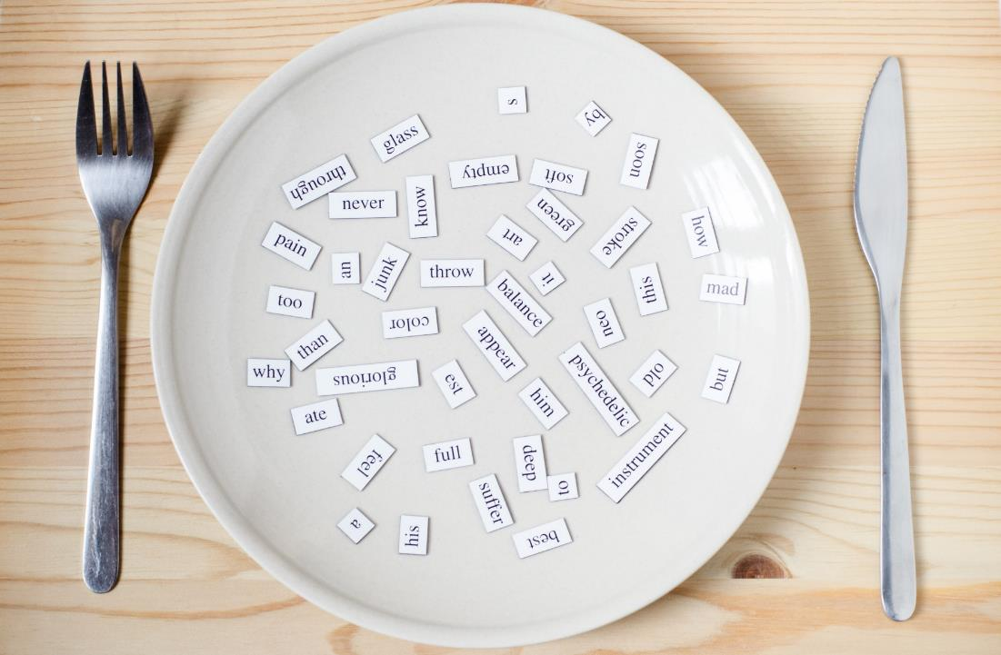
Structures
What's your favorite color?
- My favorite color is orange.
I can make orange
with yellow and red.

Slide 23

Presentation

Slide 24


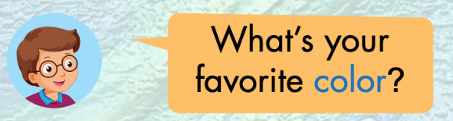

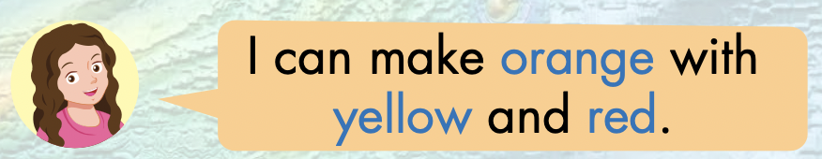


Slide 25
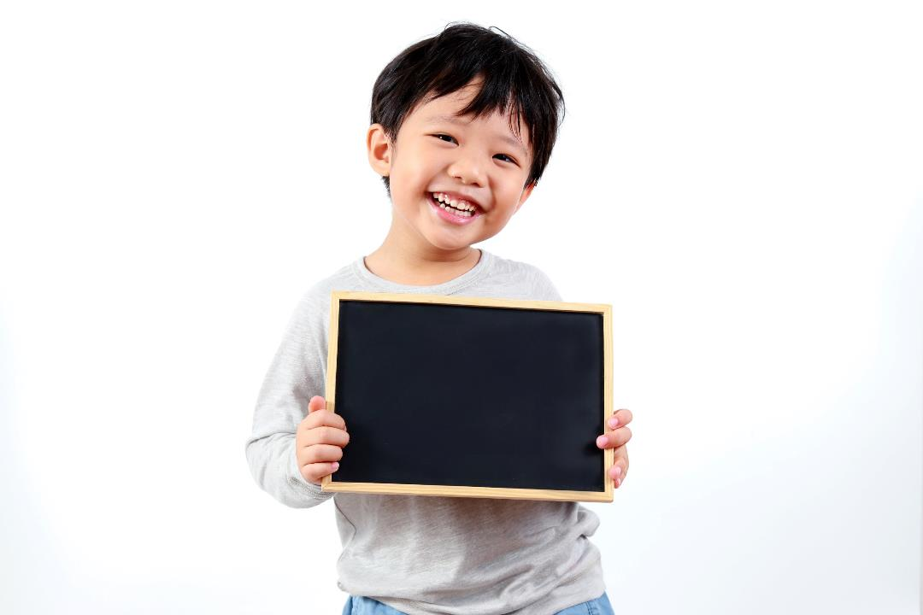
Practice

Slide 26

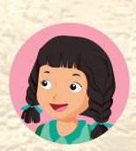
What’s your favorite color?
My favorite color is………..

Slide 27
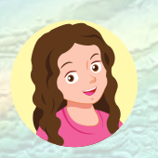
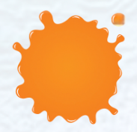

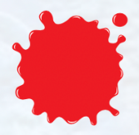
I can make ……………with ………… and …………

Slide 28
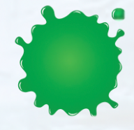


I can make ……………with ………… and …………

Slide 29

Production

Slide 30

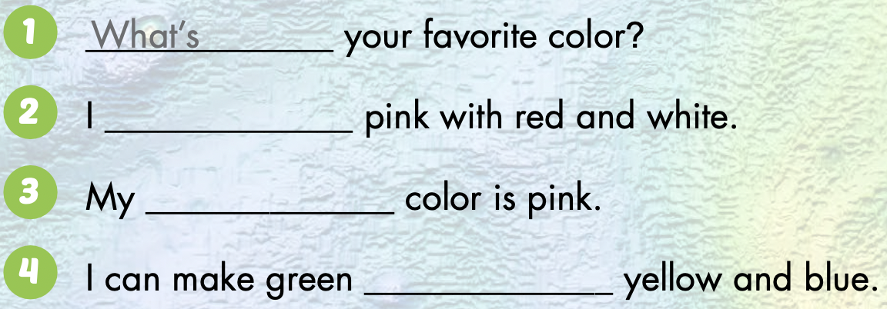
can make
favorite
with
Notes:
Demonstrate the activity using the example.
Have students fill in the blanks.
Divide the class into pairs. Have pairs check each other's work.
Check the answers as a whole class.
Have pairs practice saying the sentences.

Slide 31

CONSOLIDATION

Slide 32
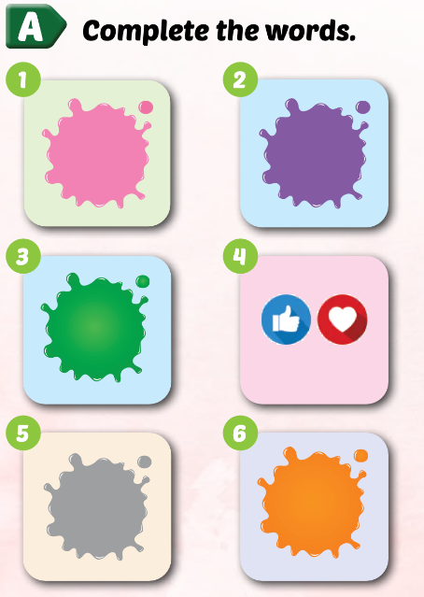
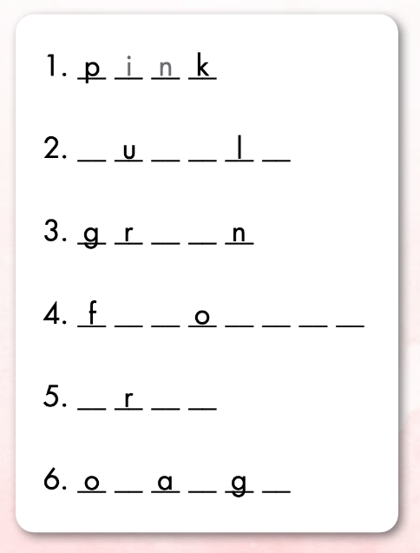
Extra Practice
WB p. 28
p
r
p
e
e
e
a
v
r
i
t
e
g
a
y
r
n
e

Slide 33
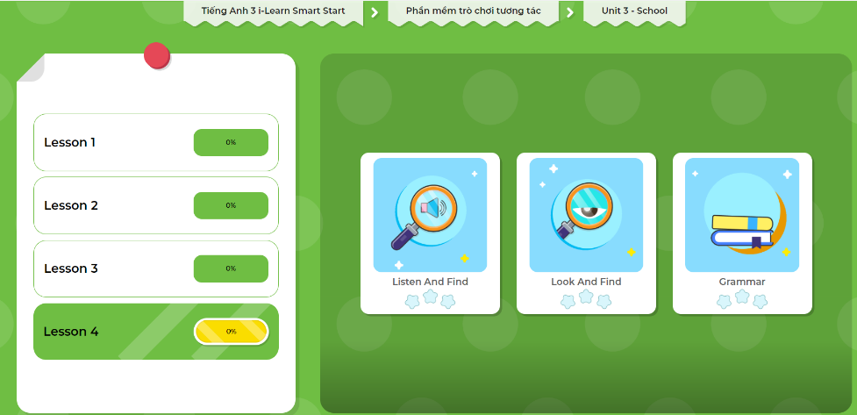
Extra Practice
DHA App
Let’s play!
Click here to play the game.

Slide 34
Let’s color!
My favorite color is……………

Slide 35

WRAP-UP

Slide 36
Lesson 3
Today’s lesson
Vocabularies
green, orange, pink, purple, gray, favorite
Structures/ Sentence patterns
What's your favorite color?
- My favorite color is orange.
I can make orange with yellow and red.

Slide 37
Lesson 3
Homework
Learn by hearts vocabularies and make sentences using them.
Do the exercises on page 33 WB
Do the exercises in Tiếng Anh 3 i-Learn Smart Start Notebook on page 25.
Prepare the next lesson (page 48 SB)
Play the consolidation games on Tiếng Anh 3 i-Learn Smart Start DHA App on www.education.com.vn

Slide 38
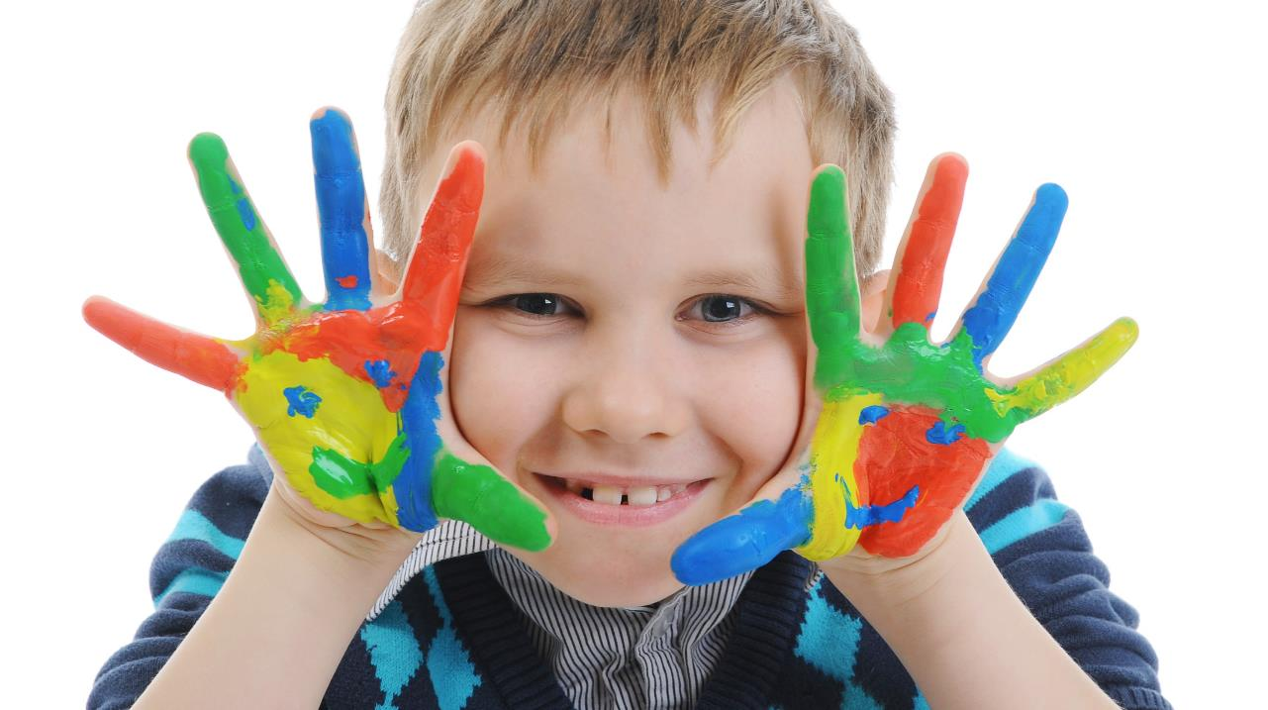
Enjoy your day!

Slide 39
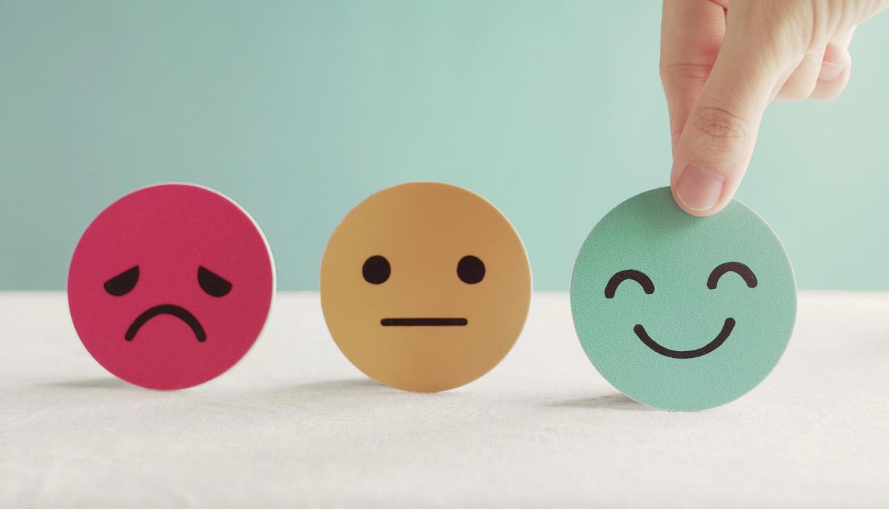
Lesson 3
Stay positive and have a nice day!

