Slide 1

Unit 2: Every Day
Lesson 2a – Reading
Page 38

Slide 2
Lesson Outline
Warm-up
Reading
Speaking
Consolidation
Wrap-up

Slide 3
Objectives
By the end of this lesson, students will be able to…
Know the school days of students in the UK.
Practise reading skills (read for general ideas and specific information).

Slide 4

WARM-UP

Slide 5
Pair work
Ask and answer about your daily routine.
1. What time do you get up?
2. Where do you have breakfast?
3. How do you go to school?
4. When does your first class start?
5. How many classes do you have a day?
6. What time do you come home?

Slide 6
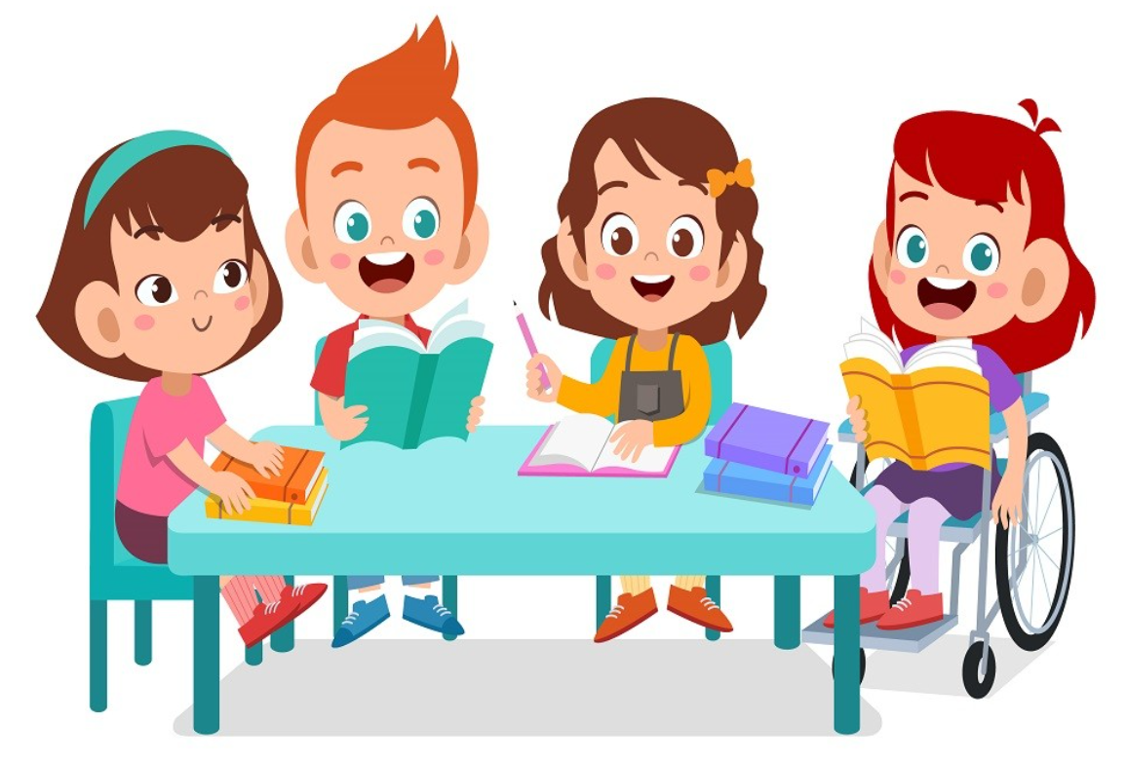
It’s time to learn …

Slide 7
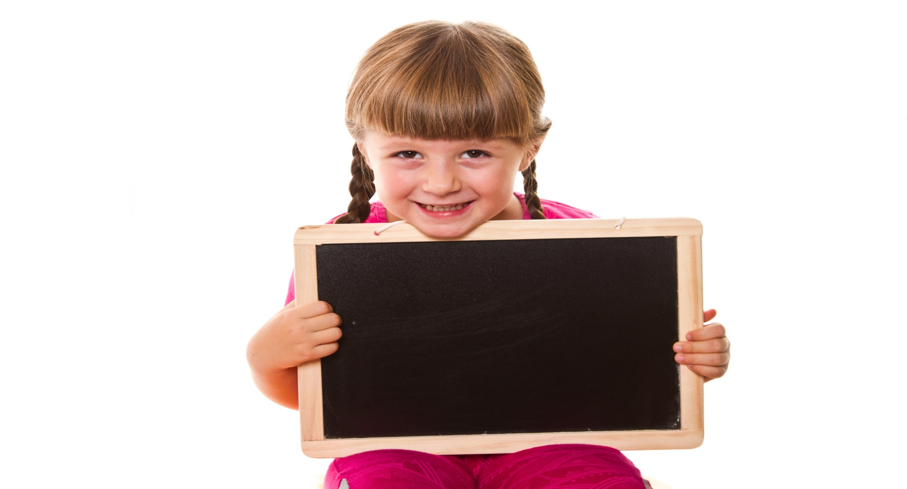
Reading

Slide 8

Pre-reading
Look at the picture and the title, then answer the question: What is the text about?
What can you see in the picture?
Two school boys, a school, and some school things (backpack, ruler, paintbrush, pencil, notebook, paper, highlighters).
2. What’s the title?
School days in the UK.
Possible answer:
A school day of students in the UK.

Slide 9

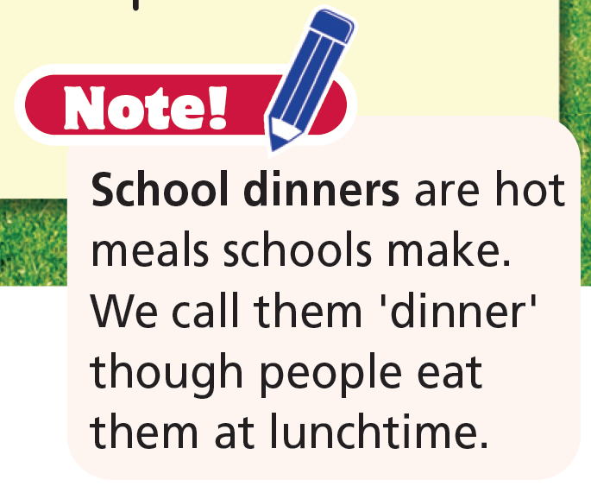
While-reading
1 Michael and Ben are friends. What is a typical school day of theirs? Listen and read to find out.
They get up, have breakfast and then go to school. Then, they have football practice. After that, they go home.
School days in the UK.
Michael gets up at 7:30 a.m. and has his breakfast. His best friend, Ben, lives next door, so they walk to school together. They are in the same class at Greenwood Primary School. There are 30 students in their class. All students wear a school uniform.
The students have registration at 8:45 a.m. and lessons start at 9:00 a.m. There is a short break at 10:30 a.m. and a lunch break at 12:30 p.m. Michael brings a packed lunch from home, but Ben buys a hot school dinner from the canteen.
In the afternoon, there are lessons again from 1:15 p.m. to 3:40 p.m. When school finishes, Michael and Ben have football practice because they play for the school team. At 4:30 p.m., Michael and Ben walk back home.
Michael takes a shower and does his homework. He has dinner at 7:00 p.m. with his family. Then, he chats online. He goes to bed at 9:30 p.m.

Slide 10
Listen and repeat. (Click on each word/ phrase to hear the sound)
uniform (n) /ˈjuːnɪfɔːm/: đồng phục
registration (n) /ˌredʒɪˈstreɪʃən/: sự đăng ký
packed lunch (n phr) /ˌpækt ˈlʌntʃ/: cơm hộp ăn trưa
canteen (n) /kænˈtiːn/: căng-tin
team (n) /tiːm/: đội, nhóm
chat online (v phr) /tʃæt ˈɒnˌlaɪn/: trò chuyện trực tuyến

Slide 11
Listen and repeat. Mind your word stress.
uniform (n) /ˈjuːnɪfɔːm/: đồng phục
registration (n) /ˌredʒɪˈstreɪʃən/: sự đăng ký
packed lunch (n phr) /ˌpækt ˈlʌntʃ/: cơm hộp ăn trưa
canteen (n) /kænˈtiːn/: căng-tin
team (n) /tiːm/: đội, nhóm
chat online (v phr) /tʃæt ˈɒnˌlaɪn/: trò chuyện trực tuyến

Slide 12
Reading comprehension
2 Read the sentences and underline the key words.
1 Michael and Ben walk to school together.
2 There are three breaks in a school day.
3 Ben likes the food from the canteen.
4 Michael and Ben aren’t good at football.
5 Michael has a big family.

Slide 13
2. Read the text and decide if the sentences are R (right), W (wrong) or DS (doesn’t say).
1 Michael and Ben walk to school together.
Michael gets up at 7:30 a.m. and has his breakfast. His best
friend, Ben, lives next door, so they walk to school together.
2 There are three breaks in a school day.
There is a short break at 10:30 a.m. and a lunch break at 12:30 p.m.
R
W

Slide 14
DS
3. Ben likes the food from the canteen.
Michael brings a packed lunch from home, but Ben buys a hot school dinner from the canteen.
4. Michael and Ben aren’t good at football.
When school finishes, Michael and Ben have football practice because they play for the school team.
5. Michael has a big family.
He has dinner at 7:00 p.m. with his family.
W
DS

Slide 15
Extra Practice
Read the questions and underline the key words.
1 Where do Michael and Ben study?
2 How many students are there in their class?
3 What time does the first class start?
4 Do Michael and Ben have lunch at home?
5 How do they come home?
6 What does Michael do in the evening?

Slide 16
Read the text again and answer the questions.
1. Where do Michael and Ben study?
They study at Greenwood Primary School.
2. How many students are there in their class?
There are 30 students in their class.
3. What time does the first class start?
The first class starts at 9:00 a.m.

Slide 17
4. Do Michael and Ben have lunch at home?
No, they don’t. They have lunch at school.
5. How do they come home?
They walk back home.
6. What does Michael do in the evening?
He takes a shower, does his homework, has dinner, chats online, and goes to bed.

Slide 18
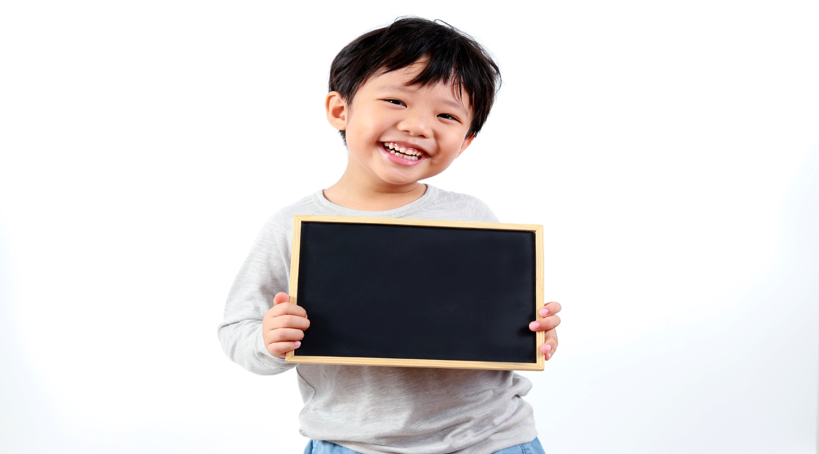
Speaking

Slide 19

3. Read the text again and say what Michael’s daily routine is. Use first, then, next and after (that) to tell the class.
Michael gets up at 7:30 a.m. First, he has his breakfast, then he walks to school.

Slide 20
Michael gets up at 7:30 a.m. First, he has his breakfast and then he walks to school. He has registration at 8:45 a.m. and then lessons. He has a break at 10:30 a.m. and then eats lunch at 12:30 p.m. At 1:15 p.m., he has more lessons. After that, he goes to football practice. Then, at 4:30 p.m., he walks home. After that, he has a shower and next does his homework. At 7:00 p.m., he has dinner with his family. Then, he chats online until 9:30 p.m. After that, he goes to bed.

Slide 21

Production

Slide 22
Tell your friend your typical school day.
PAIRWORK
I get up at six. Then, I brush my teeth, wash my face, and get dressed. After that, my mom takes me to school at 6:30. I have breakfast at school. Our lessons start at 7:00 a.m. and finish at 4:45 p.m. I come home at 5 p.m. Then, I take a shower. Next, I watch TV before I have dinner. After that, I do my homework and go to bed at 9:00 p.m.

Slide 23
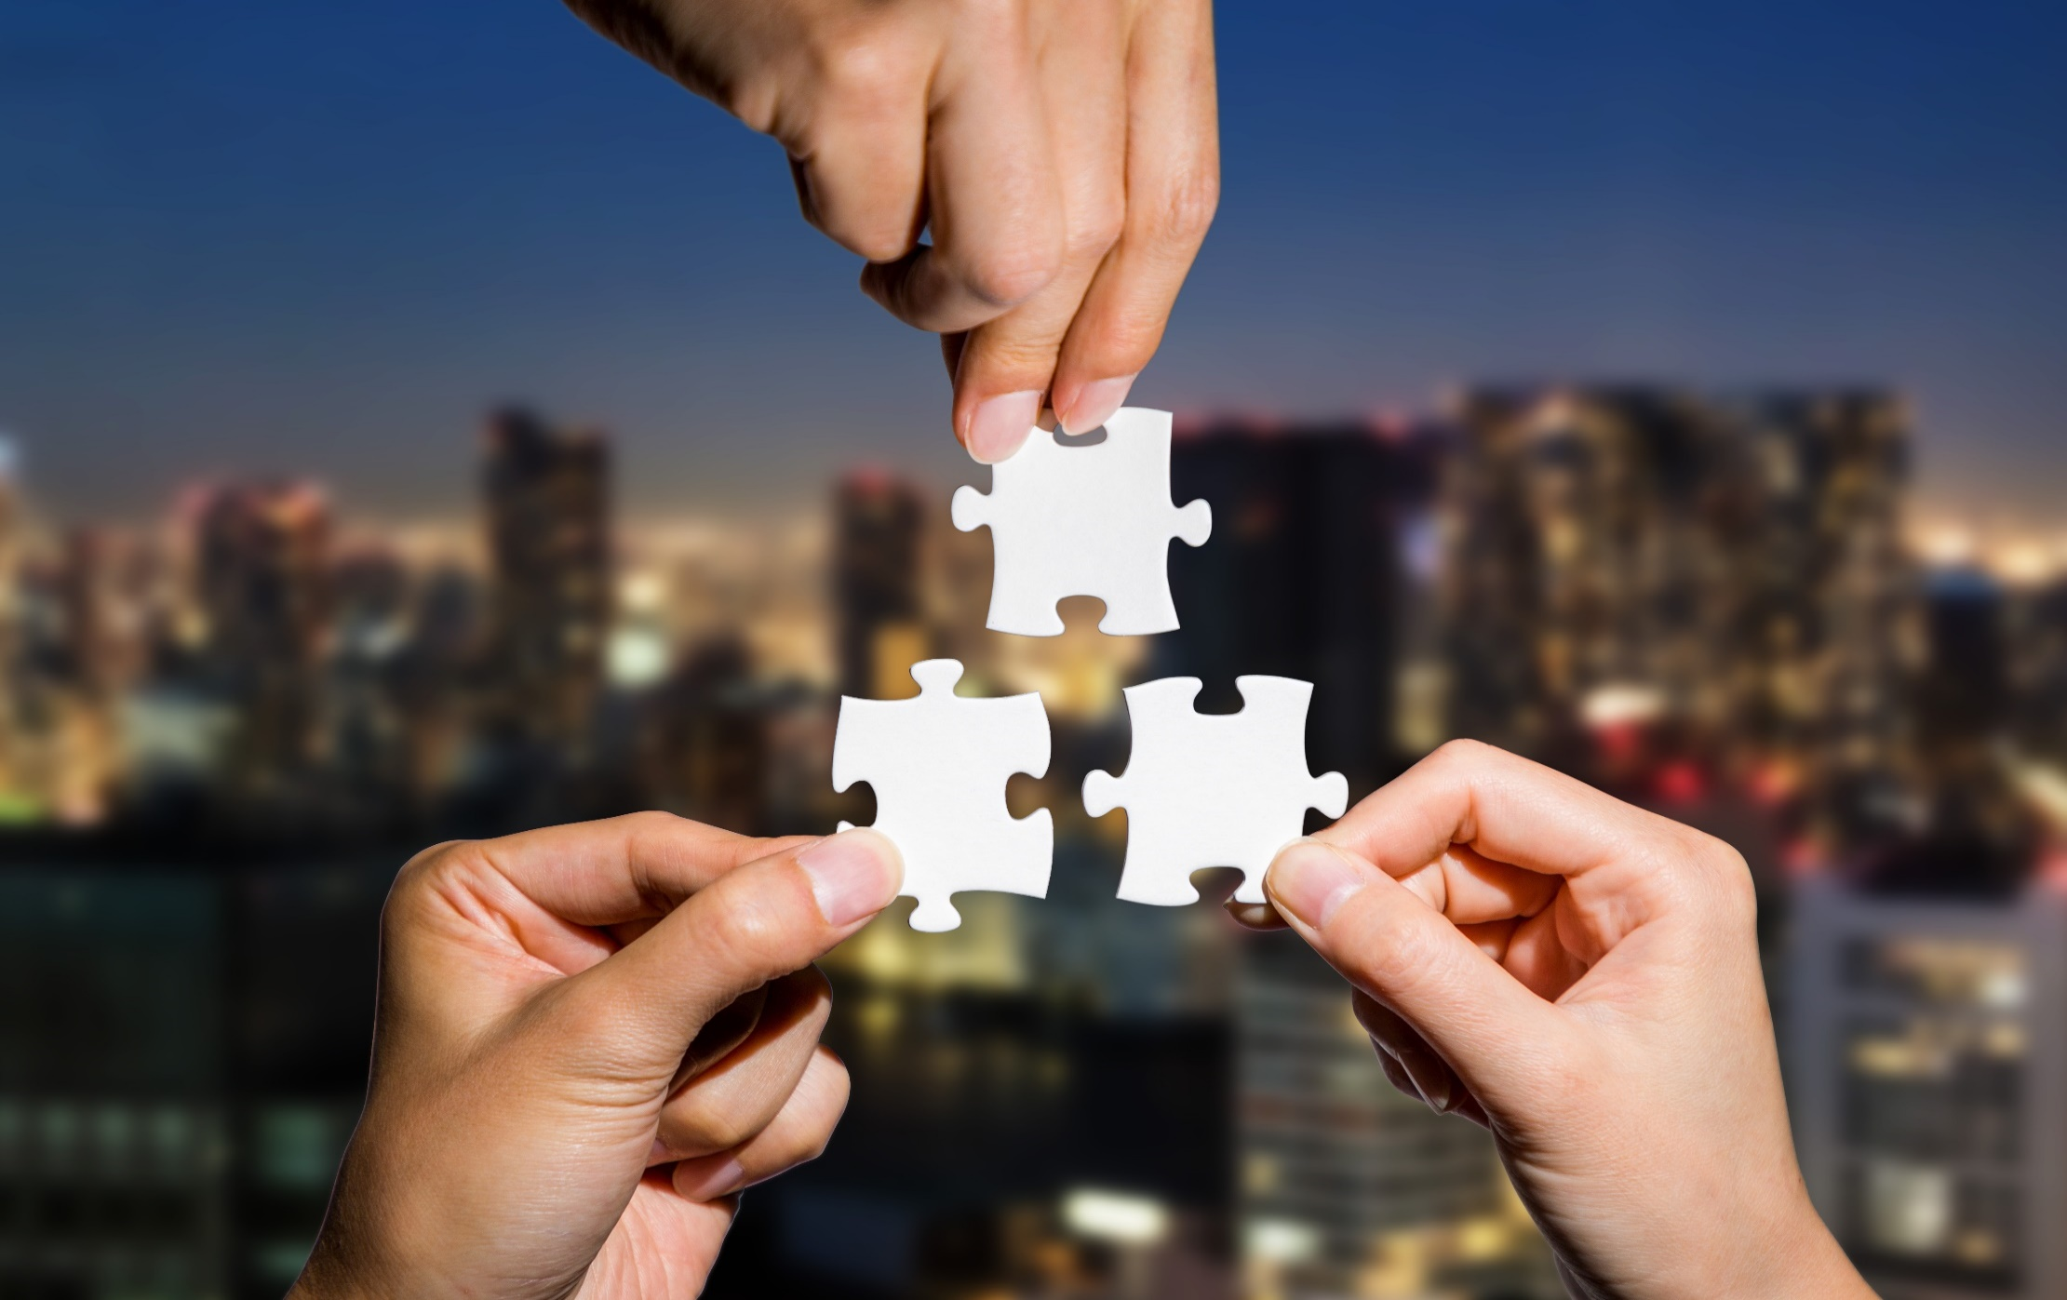
CONSOLIDATION

Slide 24
Write six sentences (about 60 words) about your school day, using first, then, next and after (that).

Slide 25

WRAP-UP

Slide 26
Today’s lesson
Vocabularies
• uniform
• registration
• packed lunch
• canteen
• team
• chat online
Reading
Read a text about a school day of students in the UK.
Practice reading and write Right, Wrong, Doesn’t say.

Slide 27
Homework
Practise the vocabularies and make sentences using them.
Do the exercises in TA 6 Right on WB (p. 22).
Prepare the next lesson (p. 39 SB).

Slide 28
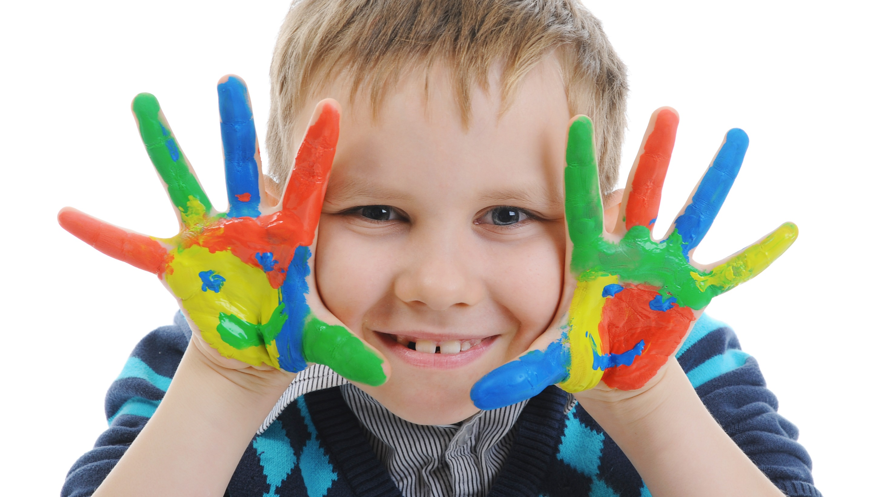
Enjoy your day!

