Slide 1
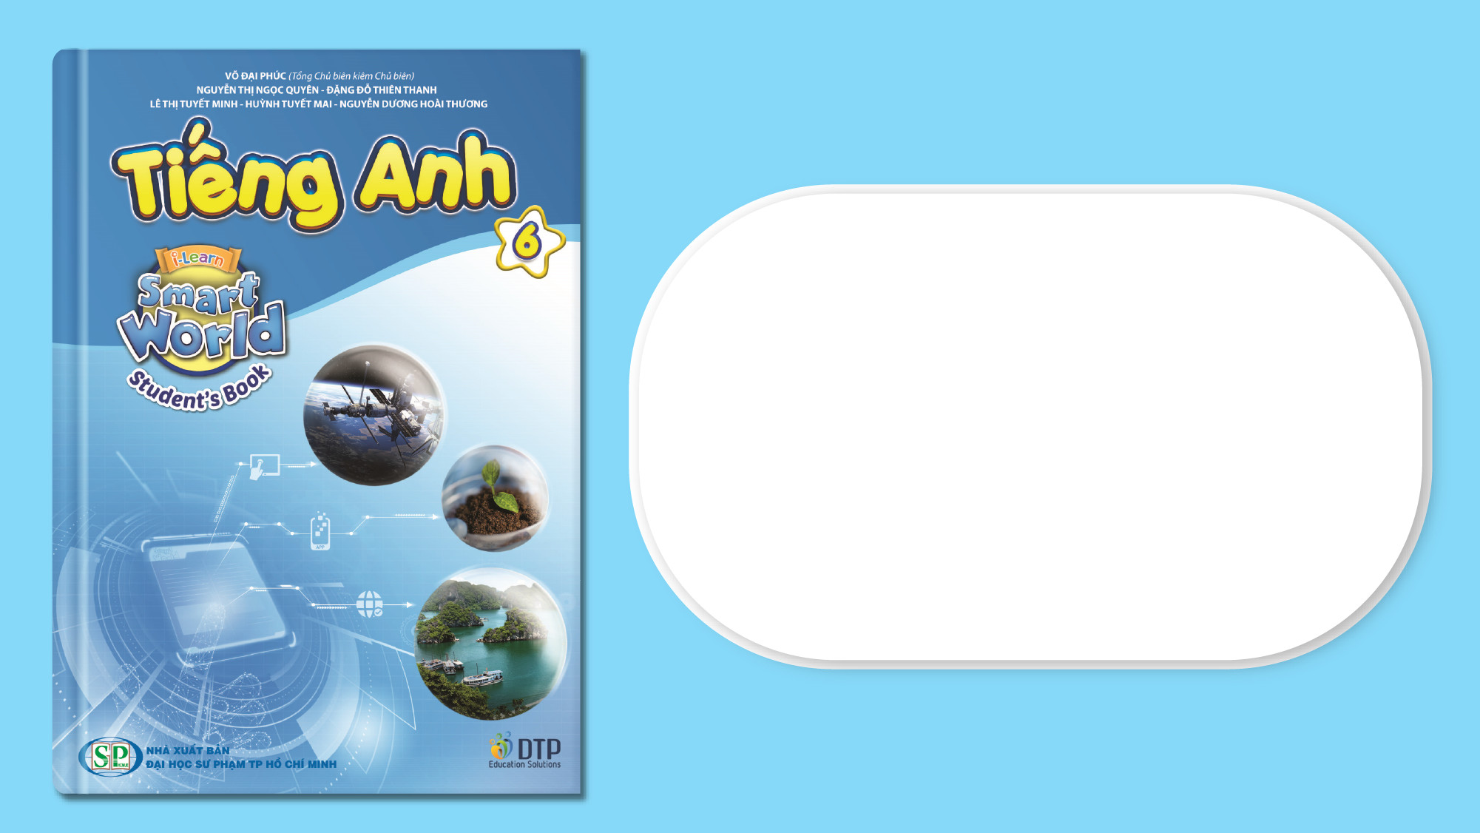
Unit 10: Cities around the World
Lesson 2.2: Grammar
Page 82

Slide 2
Lesson Outline
Warm-up
Grammar
Consolidation
Wrap-up

Slide 3
Objectives
By the end of this lesson, students will be able to…
- Use the comparative and superlative adjectives correctly to compare things.

Slide 4

WARM-UP

Slide 5
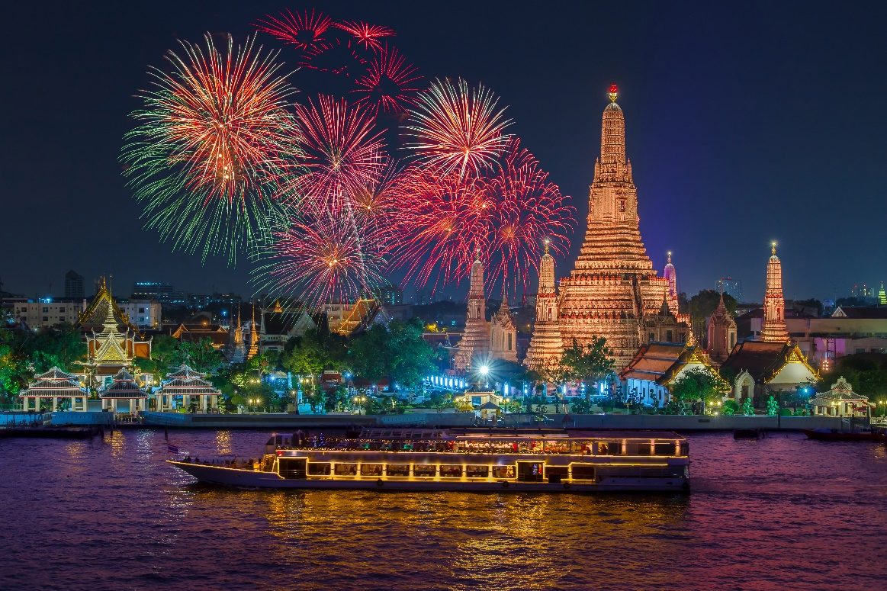
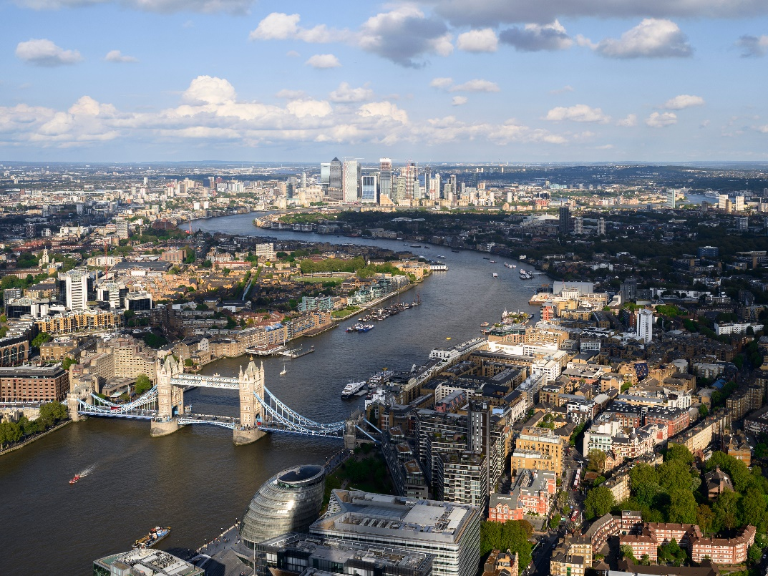
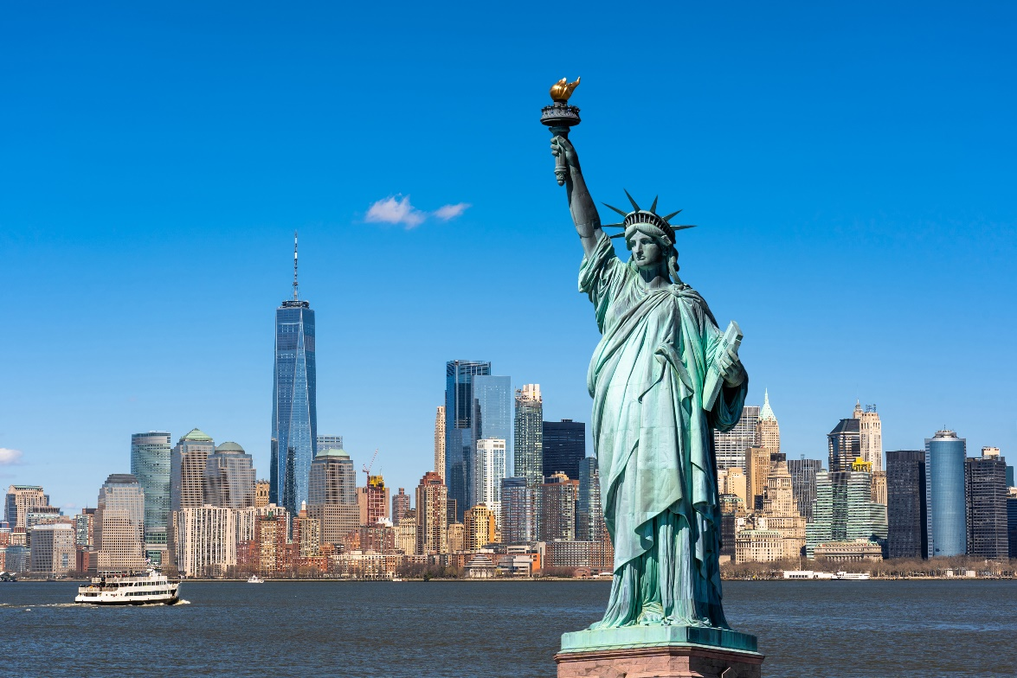
Look at the pictures
What cities are they?
Which city is hotter?
Which city is the most exciting?
Bangkok
London
New York

Slide 6

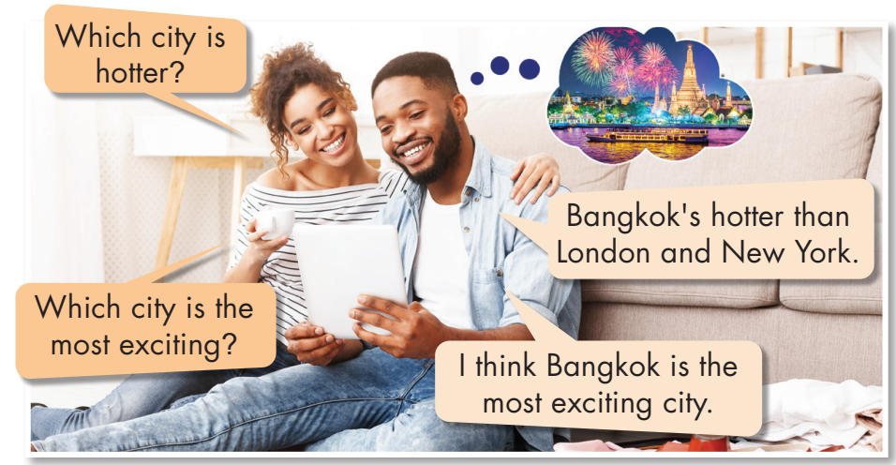
Listen and repeat

Slide 7

Presentation

Slide 8

Presentation
Ex 1: Bangkok is hotter than London.
→ We use comparative adjectives to compare two things.
Ex 2: Bangkok is the most exciting city.
→ We use superlative adjectives to say that the subject has more of something or is better than any other thing.

Slide 9
Presentation
Ex 1: Food in Kuala Lumpur is cheaper than food in Singapore.
Ho Chi Minh city is more crowded than Can Tho City.
Ex 2: Vatican is the smallest city in the world.
Bangkok is the most exciting city in Thailand.
Notes:
Analyze the two examples above to come up with the form of Comparative and superlative in the next slides

Slide 10
Presentation
Form:
Short adjective | Comparative | Superlative
1 syllable
(ex: clean/old/ cool/cold/…)
Adj-er + than
clean – cleaner
the + Adj-est
clean - the cleanest
1 syllable ending in "e"
(ex: nice/close/late/….)
Adj-r + than
nice – nicer
the + Adj-st
nice - the nicest
1 syllabe ending in:
consonant - vowel - consonant
(ex: hot/big/fat/….)
Double the last consonant,
add -er + than
hot – hotter
the + double the last consonant,
add -est
hot - the hottest

Slide 11
Presentation
Form:
Long adjective | Comparative | Superlative
two or more syllables
(ex: careful/beautiful/ exciting/…)
more + adj + than
modern – more modern
the most + adj
modern - the most modern
two syllables ending in "y"
(ex: dirty/happy/silly/…)
Remove "y",
Adj -ier + than
dirty – dirtier than
Remove "y",
the + adj -iest
dirty - the dirtiest

Slide 12
Presentation
Form:
Exceptions
Adjectives | Comparative | Superlative
good bad fun far | better worse more fun farther/further | the best the worst the most fun the farthest/the furthest

Slide 13
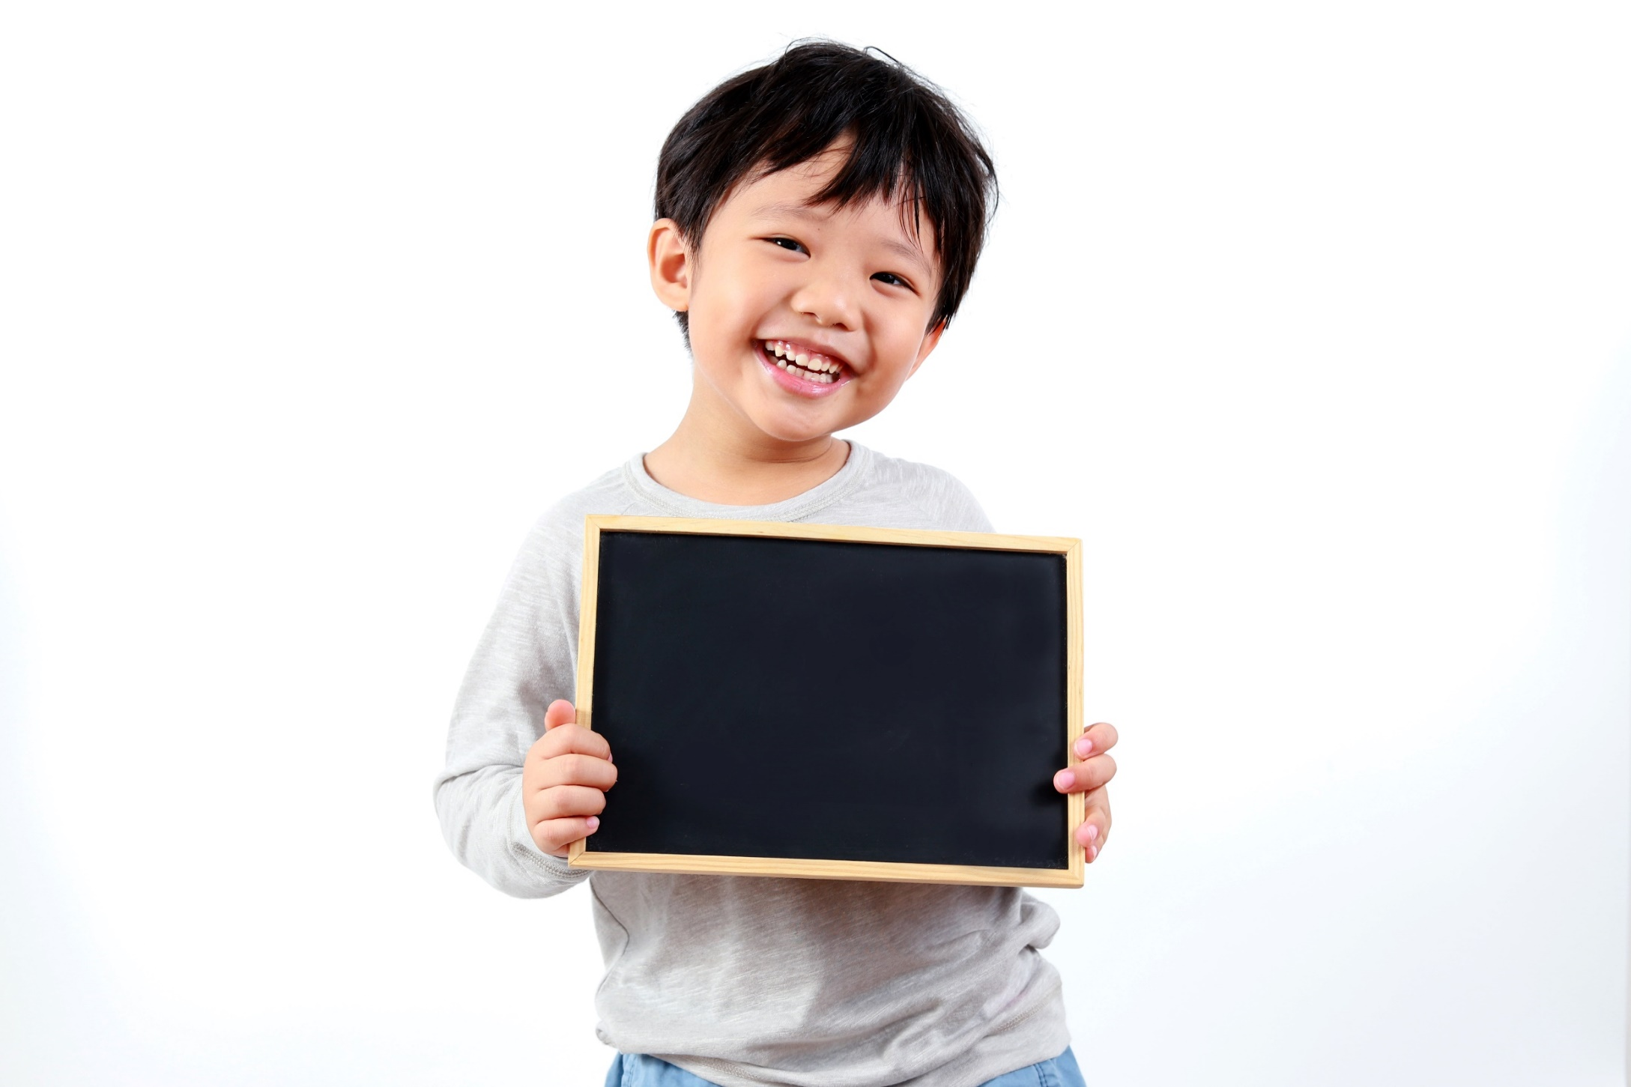
Practice

Slide 14
Practice
b. Fill in the blanks.
Adjectives | Comparatives | Superlatives
exciting | 1. | the most exciting
old | older | 2.
cheap | 3. | 4.
expensive | more expensive | 5.
boring | more boring | 6.
peaceful | 7. | the most peaceful
crowded | 8. | the most crowded
noisy | 9. | 10.
more exciting
the oldest
cheaper
the cheapest
the most expensive
the most boring
more peaceful
more crowded
noisier
the noisiest

Slide 15
Extra Practice
WB page 59
Write the comparative and superlative form of the adjectives
Adjective | Comparative | Superlative
cheap | cheaper
old
funny
boring
large
interesting
expensive
happy
the cheapest
older
the oldest
funnier
the funniest
more boring
the most boring
larger
the largest
more interesting
the most interesting
more expensive
the most expensive
happier
the happiest

Slide 16
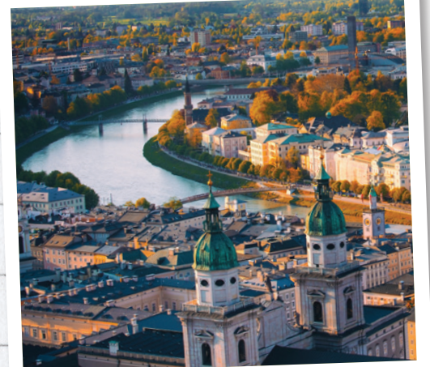
Practice
c. Fill in the blanks.
Tokyo is _______ (big) than London.
Ho Chi Minh City is __________________
(crowded) city in Vietnam.
3. Janet thinks that Vienna is _____________
(peaceful) than Barcelona.
4. The _______ (cold) city in the world is in Russia.
5. Luke thinks Rio de Janeiro is _____________ (modern) than Caracas.
bigger
the most crowded
more peaceful
coldest
more modern

Slide 17
Complete the sentences with the comparative or superlative form of the adjectives in brackets.
Extra Practice
WB page 59
1. I think food in Cairo is ________ (cheap) than in London.
2. Cities are _____________ (modern) than villages.
3. Burj Khalifa is __________ (tall) tower in the world.
4. The Eiffel Tower in Paris is ______ (tall) than the Statue of Liberty in New York.
5. I think big cities are _____________ (exciting) than small town.
6. Seoul is _______ (cold) than Bali in January.
7. Sevilla is ___________ (hot) city in Europe.
cheaper
more modern
the tallest
taller
more exciting
colder
the hottest

Slide 18

Production

Slide 19


In pairs: Compare your city with another city. Share with your partner

Slide 20

CONSOLIDATION

Slide 21
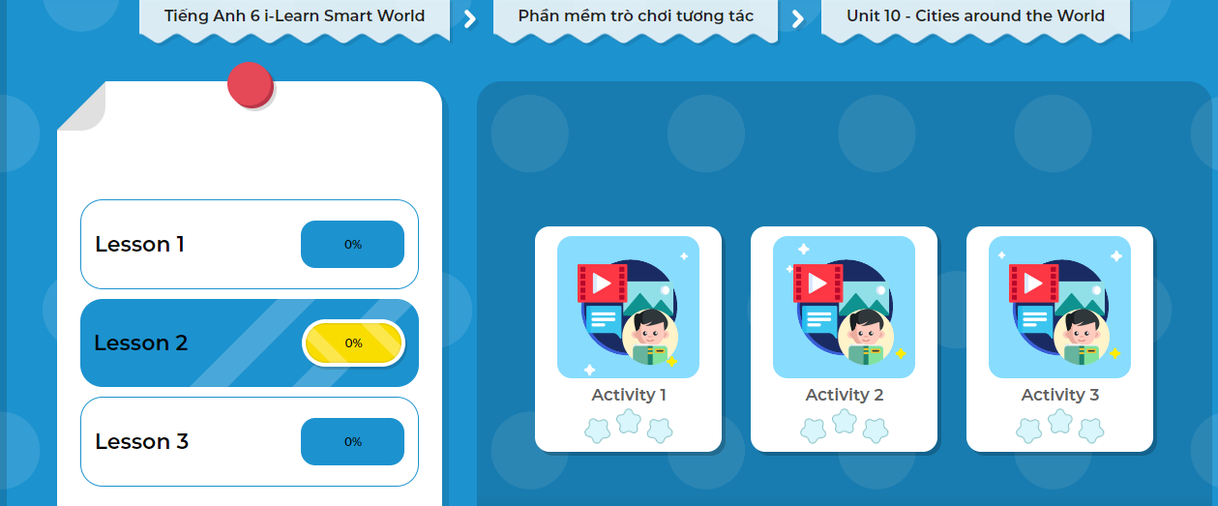
LET’S PLAY!
Click here to play the game!
Notes:
Mở Ứng dụng DHA trên Eduhome. Sách lớp 6, Unit 10, Lesson 2, Activity 2

Slide 22

WRAP-UP

Slide 23
Today’s lesson
Meaning and Use:
Comparative adjectives can be used to compare two things.
Superlative adjectives can be used to say that the subject has more of something or is better than any other thing.
Form:
Comparative:
S₁ + be + short adj + er + than + S₂ (+ be).
S₁ + be + more + long adj + than + S₂ (+ be).
Superlative:
S + be + the + short adj + est + …..
S + be + the most + long adj + …….

Slide 24
Homework
Do the exercises Writing on page 59 Workbook
Complete the grammar notes in Tiếng Anh 6 i-Learn Smart World Notebook on page 61
Prepare the next lesson: Speaking (page 83 SB)

Slide 25
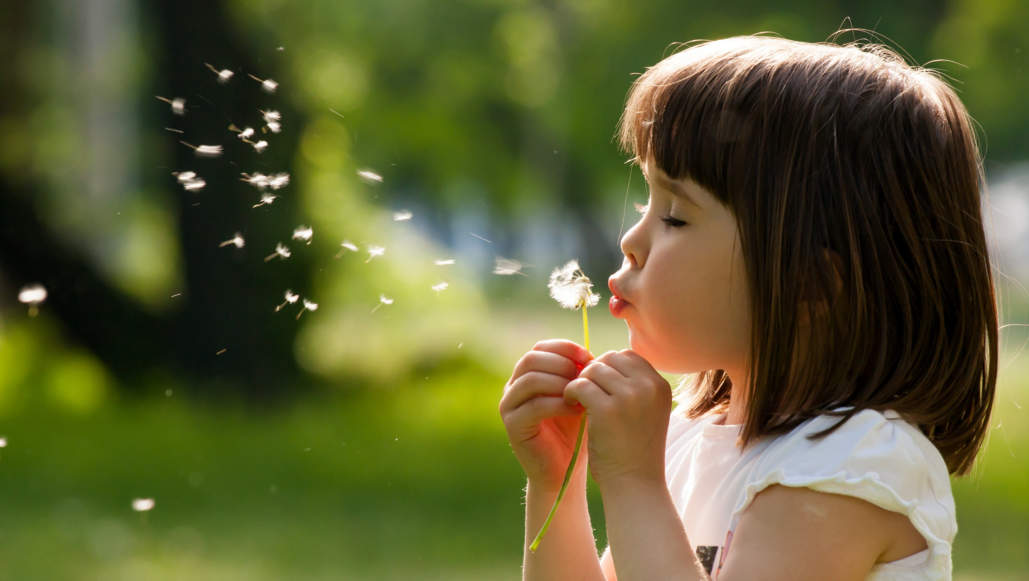
Enjoy your day!

