Slide 2
Find candy = +1+points.
MONSTERS will eat your candy! -1+points.
Steal 2 candies (points)
from another team.
Change candies (points) with another team.

Slide 3
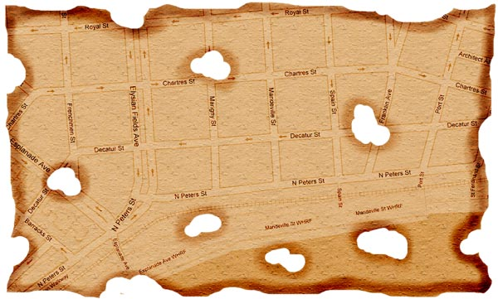
Trick or Treat? Number _ _ , _ _ _ _ Street.
ROYAL ST
3
2
1
5
7
2
9
CHARTRES ST
6
8
3
4
1
4
2
3
1
5
DECATUR ST
6
4
3
8
5
7
1
2
N PETERS ST

Slide 4
My home is on _ _ Street.

Slide 5
There _ _ _ _ _ near my home.

Slide 6
There _ _ _ _ _ near my home.

Slide 7
There _ _ _ _ _ near my home.

Slide 8
There _ _ _ _ _ near my home.

Slide 9
There _ _ _ _ _ near my home.

Slide 10
There _ _ _ _ _ near my home.

Slide 11
There _ _ _ _ _ near my home.

Slide 12
There _ _ _ _ _ near my home.

Slide 13
There _ _ _ _ _ near my home.

Slide 14
There _ _ _ _ _ near my home.

Slide 15
Are there schools near your home?

Slide 16
Are there restaurants near your home?

Slide 17
Are there shops near your home?

Slide 18
Is there a park near your home?

Slide 19
Is there a supermarket near your home?

Slide 20
Is there flower shop near your home?

Slide 21
Is there a school near your home?

Slide 22
Is there a restaurant near your home?

Slide 23
Are there parks near your home?

Slide 24
Are there shops near your home?

Slide 25
Are there supermarkets near your home?

Slide 26
My home is on _ _ Street.

Slide 27
My home is on _ _ Street.

Slide 28
My home is on _ _ Street.

Slide 30
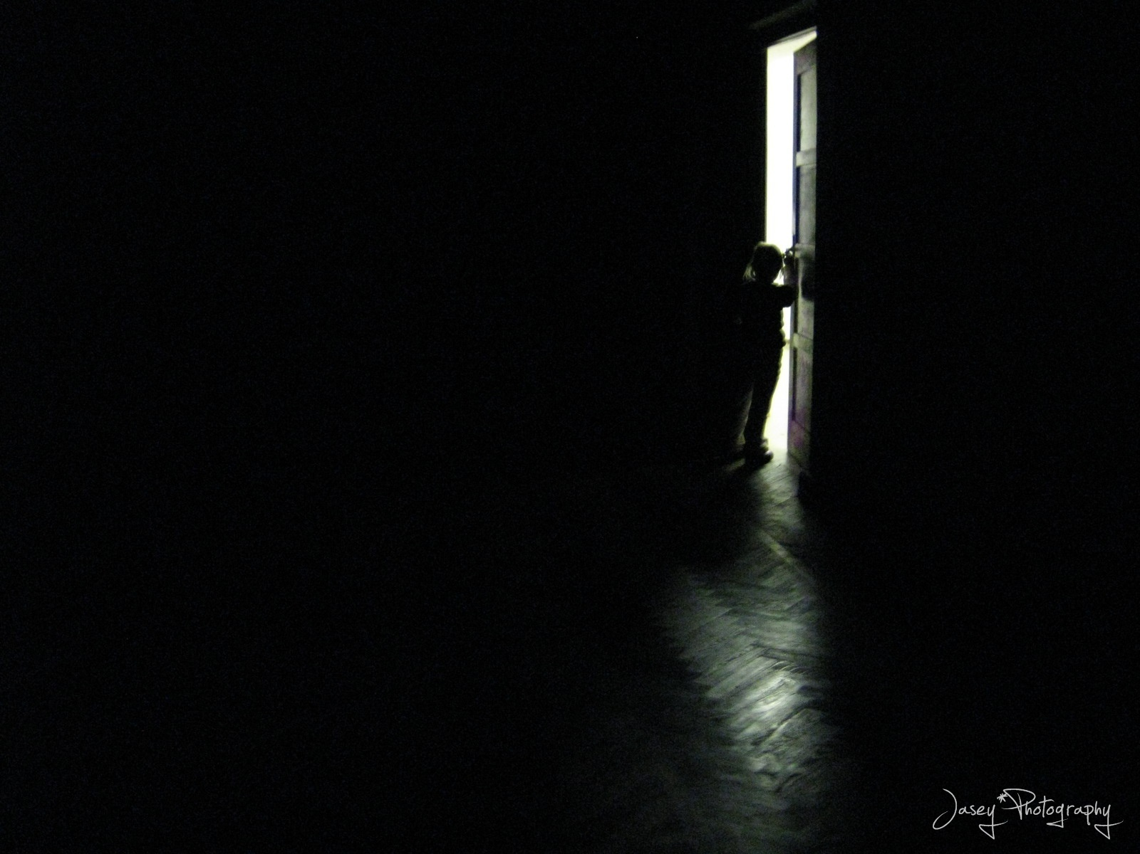
The door is open …
Go inside?

Slide 31
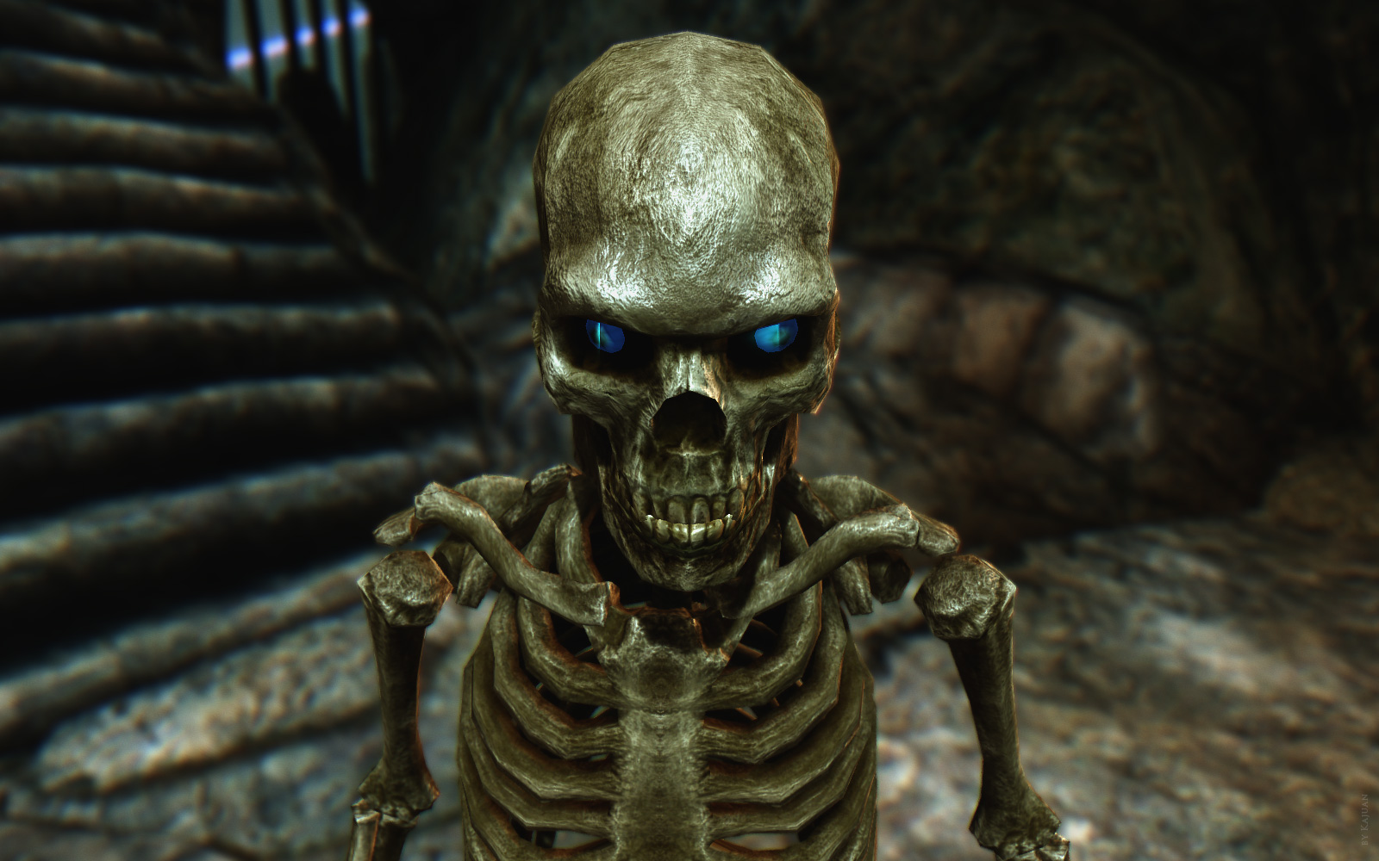
Bye, bye Candy! -3 Candies.

Slide 32
The door is open …
Go inside?

Slide 33
The door is open …
Go inside?

Slide 34
The door is open …
Go inside?

Slide 37
The door is open …
Go inside?

Slide 39
The door is open …
Go inside?

Slide 40
The door is open …
Go inside?

Slide 41
The door is open …
Go inside?

Slide 43
Bye, bye Candy! -1 Candies.

Slide 45
The door is open …
Go inside?

Slide 47
Bye, bye Candy! -1 Candies.

Slide 49
The door is open …
Go inside?

Slide 50
The door is open …
Go inside?

Slide 51
The door is open …
Go inside?

Slide 52
Bye, bye Candy! -3 Candies.

Slide 54
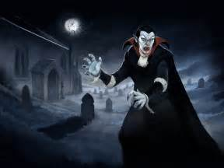
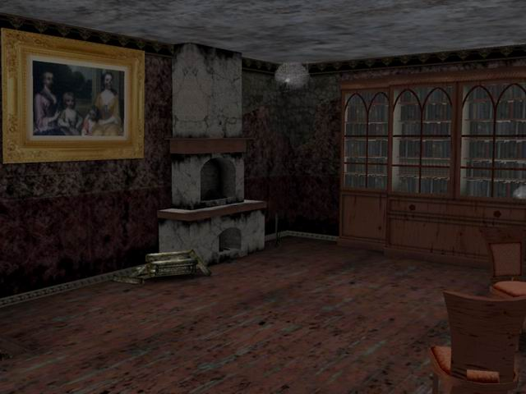
Bye, bye Candy! -3 Candies.
Touch the picture on the TV.
You have 7 seconds …
TV 속 남자를 손으로 만지세요. 반드시 7초 동안 해야합니다..
3
4
5
6
7

Slide 55
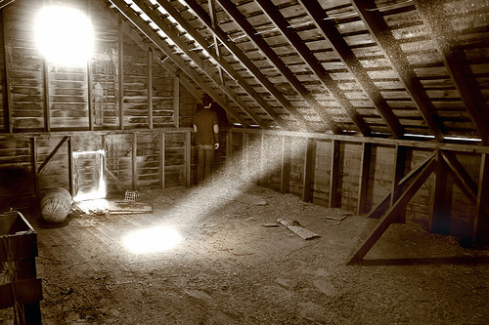
Bye, bye Candy! -3 Candies.
Touch the man on the TV.
You have 7 seconds …
TV 속 남자를 손으로 만지세요. 반드시 7초 동안 해야합니다..
2
3
4
5
6
1
7

Slide 56
Bye, bye Candy! -3 Candies.

Slide 57
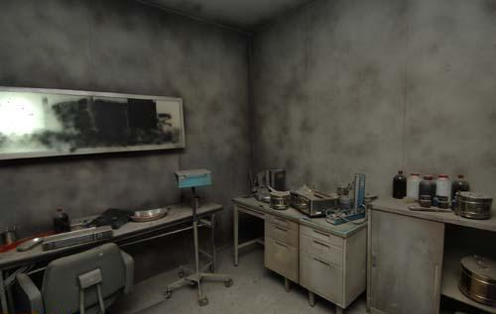
Bye, bye Candy! -3 Candies.

Slide 58
Steal Two (2) Candies!

Slide 59
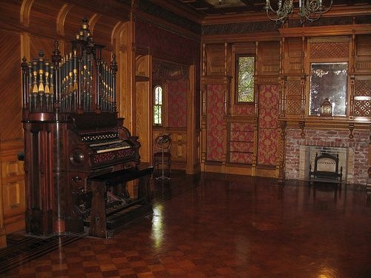
Steal Two (2) Candies!

Slide 60
Steal Two (2) Candies!

Slide 61
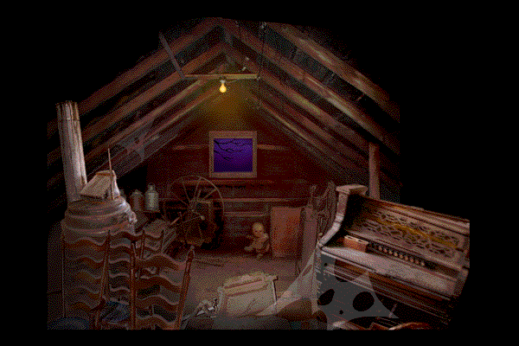
Steal Two (2) Candies!

Slide 62
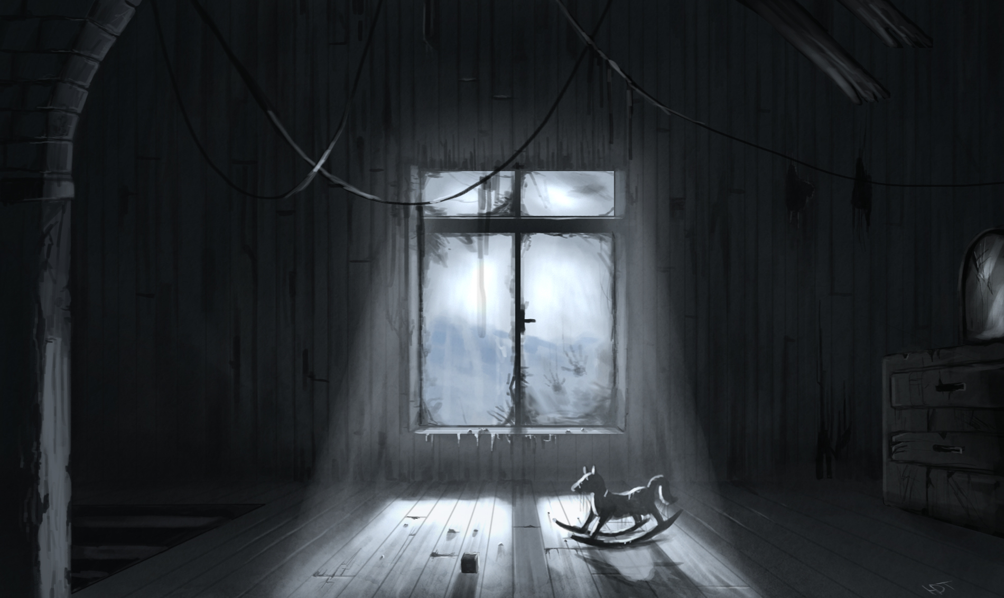
Change Candies

Slide 63
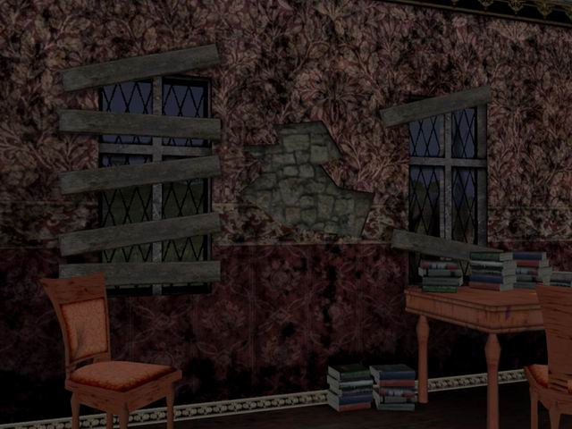
Change Candies

Slide 64
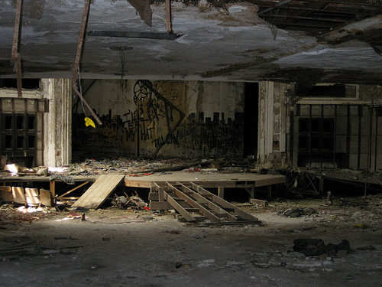
Change Candies

Slide 65
Change Candies

Slide 66
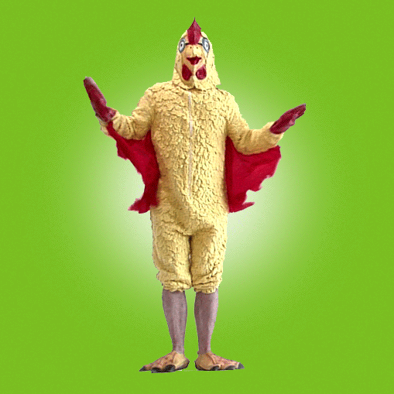
Do the ‘chicken dance’ for 5 seconds or LOSE 2!

