Slide 1
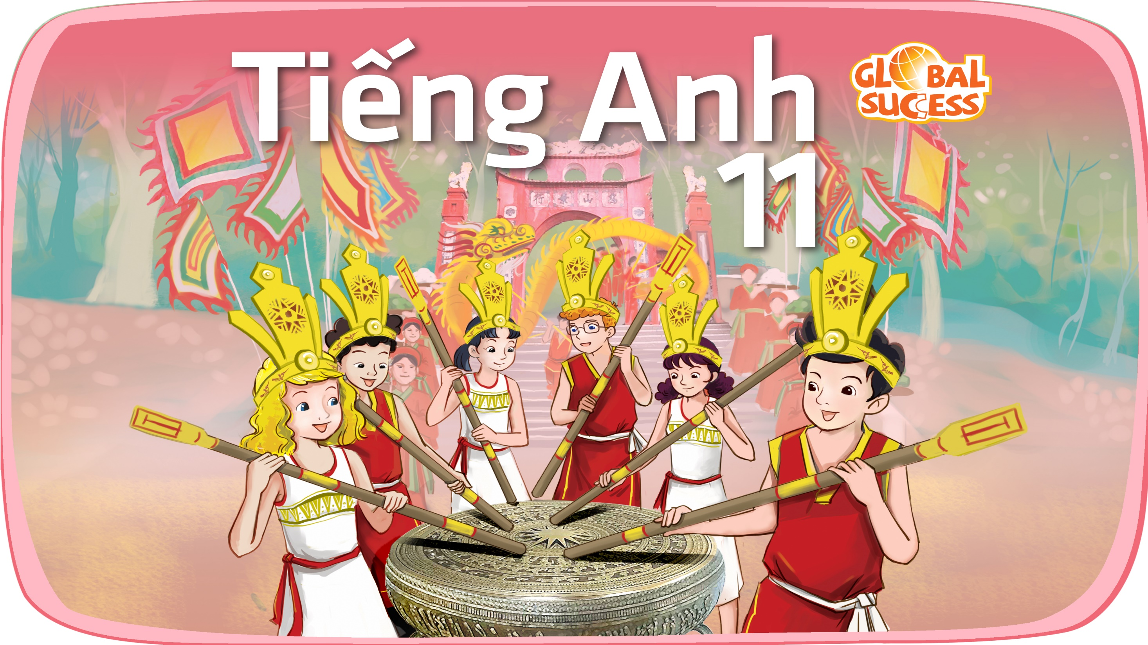

Slide 2
Unit
6
Preserving our heritage
Unit
FAMILY LIFE
LESSON 4
SPEAKING
Preserving cultural heritage

Slide 3
LESSON 4
SPEAKING
WARM-UP
Game: Jumble words
Task 1. Work in pairs. Match the ways to preserve our heritage with the reason for doing so.
Task 2. Complete the conversation with the words and phrase in the box. Then practise it in pairs.
PRE-SPEAKING
WHILE-SPEAKING
Task 3. Make a similar conversation about ways to protect local heritage.
POST-SPEAKING
Task 4. Work in groups. Think of a form of cultural heritage (such as a tradition, a festival, or a form of music) and discuss ways to preserve it.
Wrap-up
Homework
CONSOLIDATION

Slide 4
WARM-UP
GAME: JUMBLE WORDS
- Work in 2 groups.
- Rearrange the letters in the word to make a meaningful word.
- Raise your hands and say BINGO to get the chance to answer.
- One point for each correct answer.
- The team with more points will be the winner of the game.

Slide 5
WARM-UP
Question 1
U/C/O/K/F/I/M/L/S (2 words)
FOLK MUSIC

Slide 6
WARM-UP
Question 2
R/A/S/W/E/S/E/N/A
AWARENESS

Slide 7
WARM-UP
Question 3
L/I/O/M/S/E/D/A/C/I/A (2 words)
SOCIAL MEDIA

Slide 8
WARM-UP
Question 4
N/E/C/M/I/P/O/T/T/O/I
COMPETITION

Slide 9
WARM-UP
Question 5
L/A/E/F/S/I/V/T
FESTIVAL

Slide 10
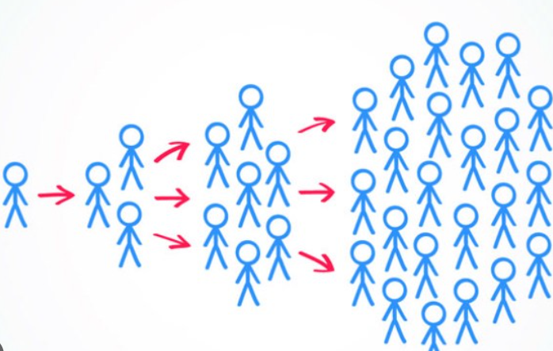

PRE-SPEAKING
spread (v)
/spred/
to affect or make something affect, be known by, or be used by more and more people

Slide 11

PRE-SPEAKING
involved (adj)
/ɪnˈvɒlvd/
being part of something or connected with something

Slide 12
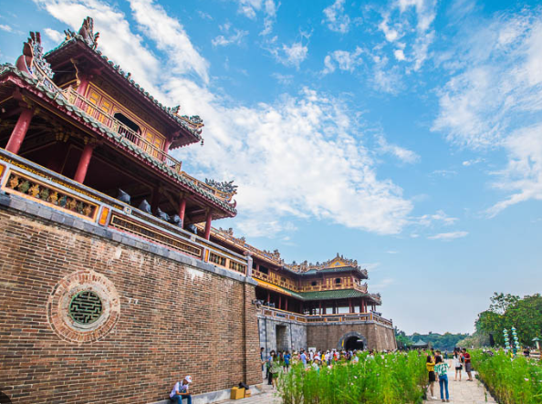
PRE-SPEAKING
cultural heritage (n)
/ˈkʌltʃərəl ˈherɪtɪdʒ/
the heritage of tangible and intangible heritage assets of a group or society that is inherited from past generations.

Slide 13
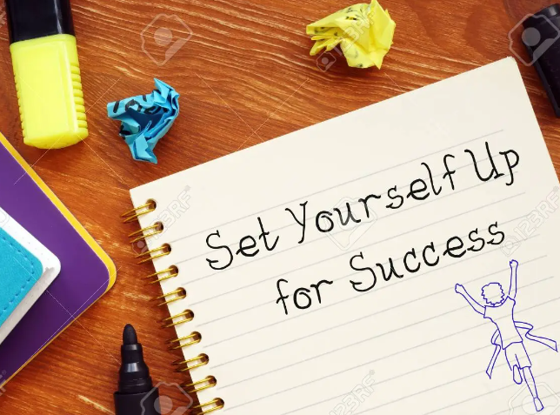
PRE-SPEAKING
(to) set up
/set ʌp/
to create something or start it

Slide 14
PRE-SPEAKING
Form | Pronunciation | Meaning
1. spread (v) | /spred/ | to affect or make something affect, be known by, or be used by more and more people
2. involved (adj) | /ɪnˈvɒlvd/ | being part of something or connected with something
3. cultural heritage (n) | /ˈkʌltʃərəl ˈherɪtɪdʒ/ | the heritage of tangible and intangible heritage assets of a group or society that is inherited from past generations.
4. (to) set up | /set ʌp/ | to create something or start it

Slide 15
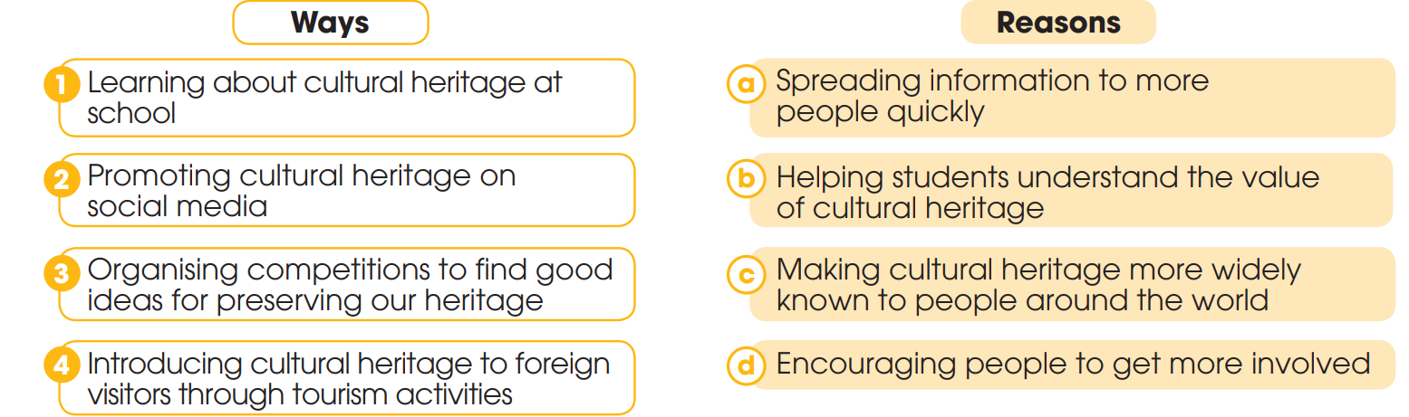
PRE-SPEAKING
1
Work in pairs. Match the ways to preserve our heritage with the reason for doing so

Slide 16
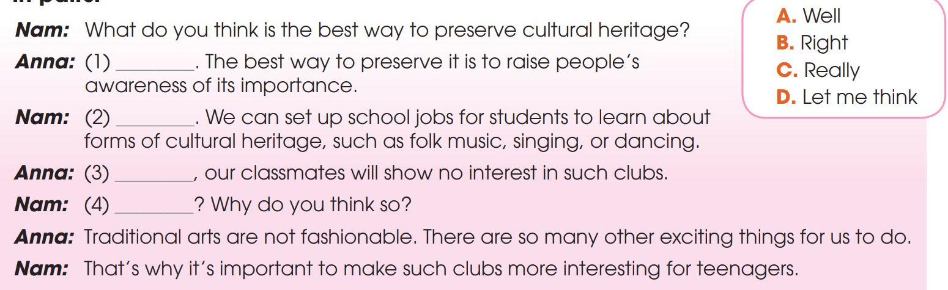
PRE-SPEAKING
2
Complete the conversation with the words and phrase in the box. Then practise it in pairs
D
B
A
C

Slide 17
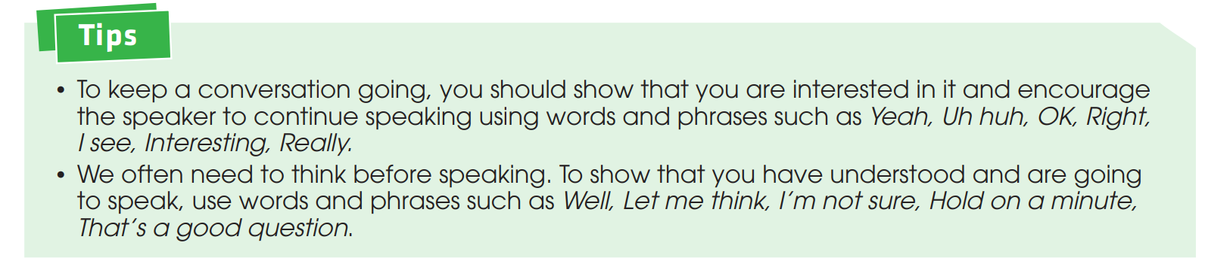
WHILE-SPEAKING
3
Work in pairs. Make a similar conversation about ways to protect local heritage

Slide 18
POST-SPEAKING
4
Work in groups. Think of a form of cultural heritage (such as a tradition, a festival, or a form of music) and discuss ways to preserve it. Report your group’s ideas to the whole class.

Slide 19
CONSOLIDATION
1
Wrap-up
What have you learnt today?
How to keep a conversation going;
Vocabulary to talk about how to preserve cultural heritage

Slide 20
CONSOLIDATION
2
Homework
Do exercises in the workbook.
Prepare for Lesson 5 - Unit 1.

Slide 21

Website: hoclieu.vn
Fanpage: facebook.com/sachmem.vn/

