Slide 1
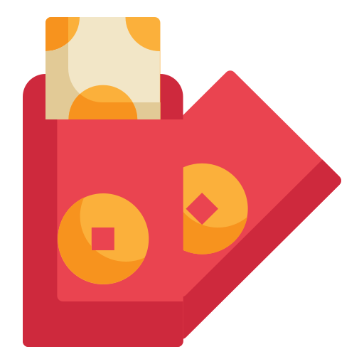

Slide 2

Unit
6
OUR TET HOLIDAY
LESSON 6: SKILLS 2

Slide 3



LESSON 6: SKILLS 2
LESSON 1: GETTING STARTED
WARM-UP
Cultural Sharing Circle
Task 1: Listen and tick.
Task 2: Listen and answer the questions.
Extra activity: True or False.
LISTENING
Task 3: Make a list.
Task 4: Complete the email.
WRITING
CONSOLIDATION
Wrap-up
Homework

Slide 4
WARM-UP
Cultural Sharing Circle

Slide 5
WARM-UP
Each participant shares a personal story or memory related to celebrating Tet within one minute

Slide 6
WARM-UP
LET’S START

Slide 7


LISTENING
Listen and tick () the things you hear.

1.
old things
4.
cakes


2.
peach flowers
5.
wishes

3.
new clothes
6.
good luck

Slide 8

LISTENING
1.
What do they throw away before Tet?
Old things.
2.
What do they clean and decorate?
(Their) houses.
Listen again and answer the questions in one or two words.
3.
What colour are the envelopes?
Red.
- Read the questions carefully and underline keywords in each question
4.
Who cooks banh chung?
(His) father.
5.
What shouldn’t they break?
Anything.

Slide 9
LISTENING
Tick T (True) or F (False)
 | T | F
1. They do many things before Tet.
2. Nguyen’s mother goes shopping and buys food, red envelopes, and apricot blossom
3. His father cooks banh chung in the oven.
4. He shouldn’t break anything because it brings bad luck.





Slide 10

WRITING
Discuss and make a list of four things that you think children should and shouldn’t do at Tet
Children should
1.
2.
Children shouldn’t
3.
4.

Slide 11

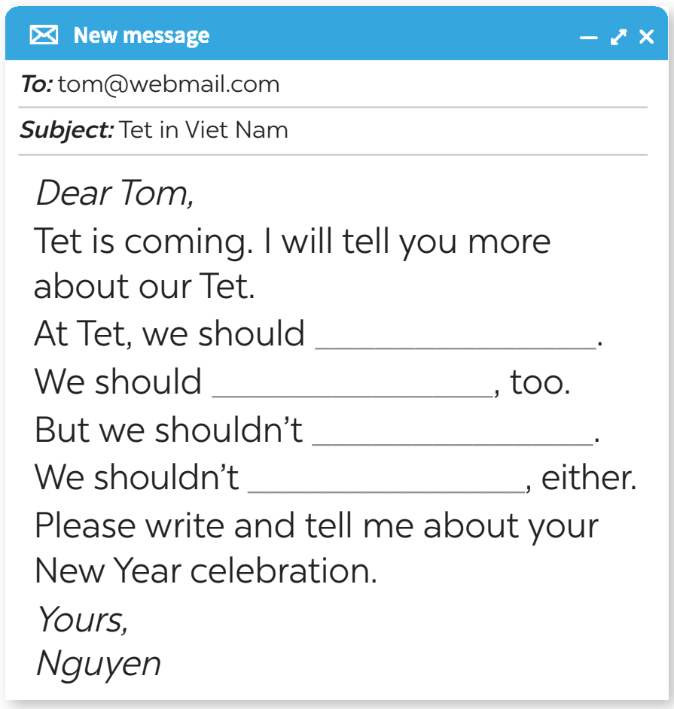
WRITING
Complete the email, using your ideas in 3.

Slide 12

CONSOLIDATION
1
Wrap-up
What have we learnt in this lesson?
Listen for specific information about preparations for Tet
Write an email about what people should/ shouldn’t do at Tet

Slide 13

CONSOLIDATION
2
Homework
Imagine that you are Tom – Nguyen’s pen friend. Write a letter back to Nguyen to tell him about what people should and shouldn’t do in the New year in your country.

Slide 14






Website: hoclieu.vn
Fanpage: facebook.com/www.tienganhglobalsuccess.vn/

