Slide 1

Unit 1: Home & Places
Lesson 1b: Grammar
Page 24

Slide 2
Lesson Outline
Warm-up
Grammar
Consolidation
Wrap-up

Slide 3
Objectives
By the end of this lesson, students will be able to…
- Learn grammar about plurals.
- Learn grammar about this/these and that/those.
- Remember the rules and use them in real situations.

Slide 4

WARM-UP

Slide 5
Choose the word whose main stress is placed differently from that of the others.
A. basketball B. capital C. grandfather D. gymnastics
/ˈkæpɪtl/
/ˈɡrænfɑːðə/
/dʒɪmˈnæstɪks/
/ˈbɑːskɪtbɔːl/
A. toilet B. chimney C. appliance D. cupboard
/ˈtɔɪlət/
/ˈtʃɪmni/
/əˈplaɪəns/
/ˈkʌbəd/
A. polite B. clever C. funny D. friendly
/pəˈlaɪt/
/ˈklevə/
/ˈfʌni/
/ˈfrendli/

Slide 6

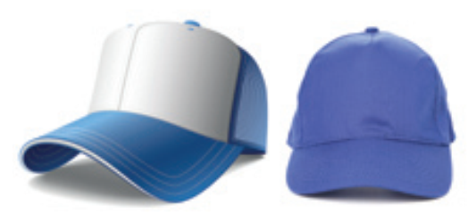
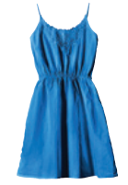
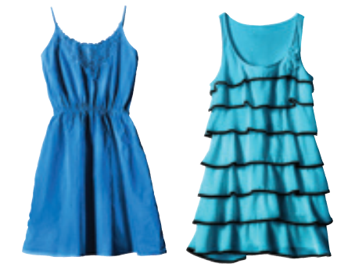
How many caps are there in each picture?
One cap
Two caps
How many dresses are there in each picture?
One dress
Two dresses

Slide 7

It’s time to learn …

Slide 8

Presentation

Slide 9
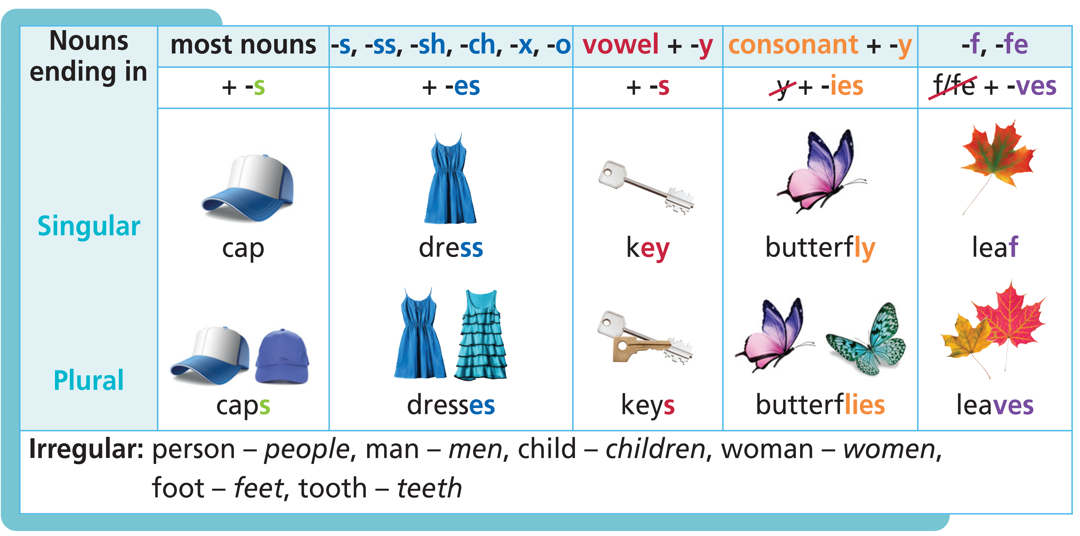
Plurals

Slide 10
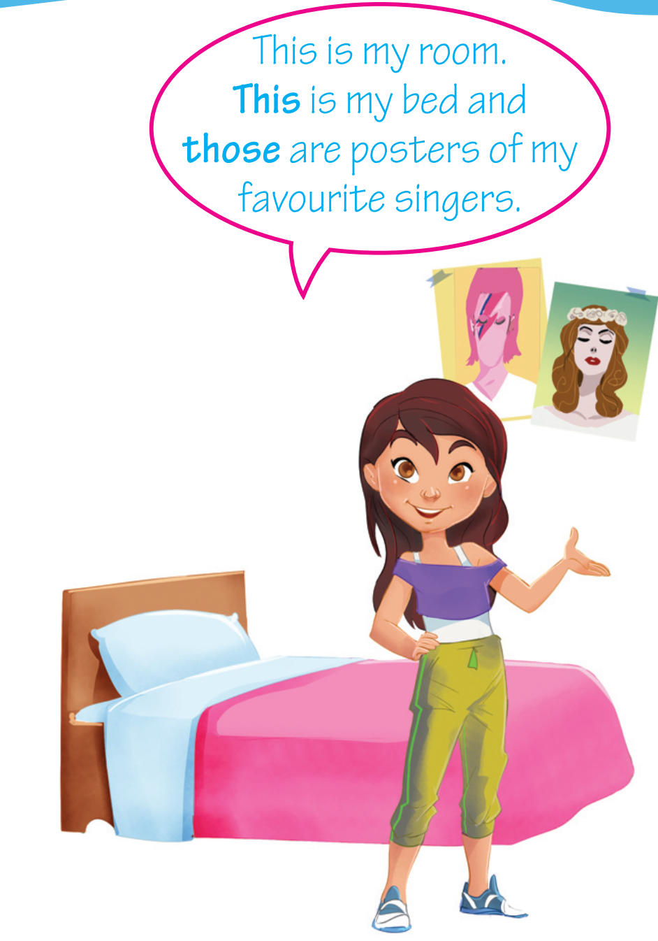
this/these – that/those
We use this for singular nouns near us.
We use these for plural nouns near us.
We use that for singular nouns far from us.
We use those for plural nouns far from us.

Slide 11
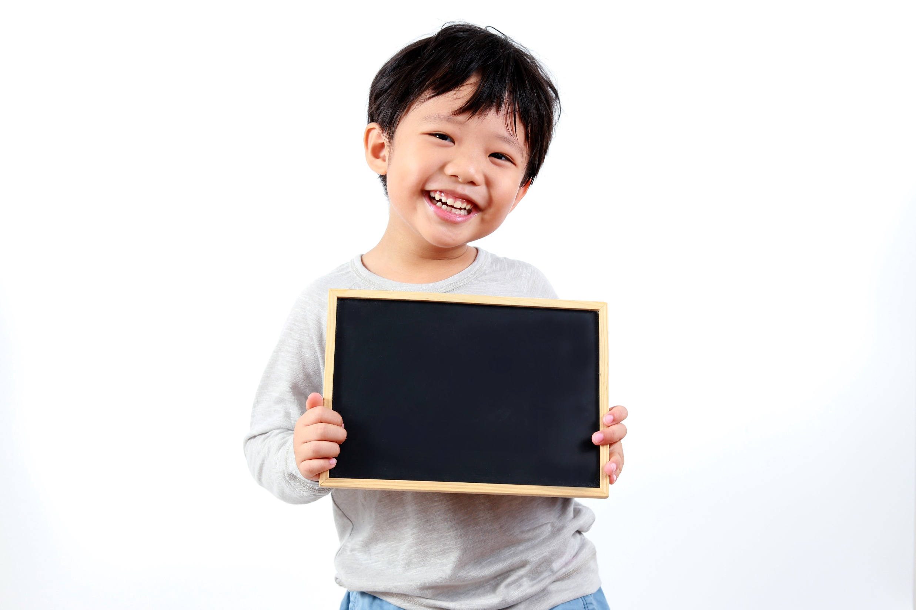
Practice

Slide 12
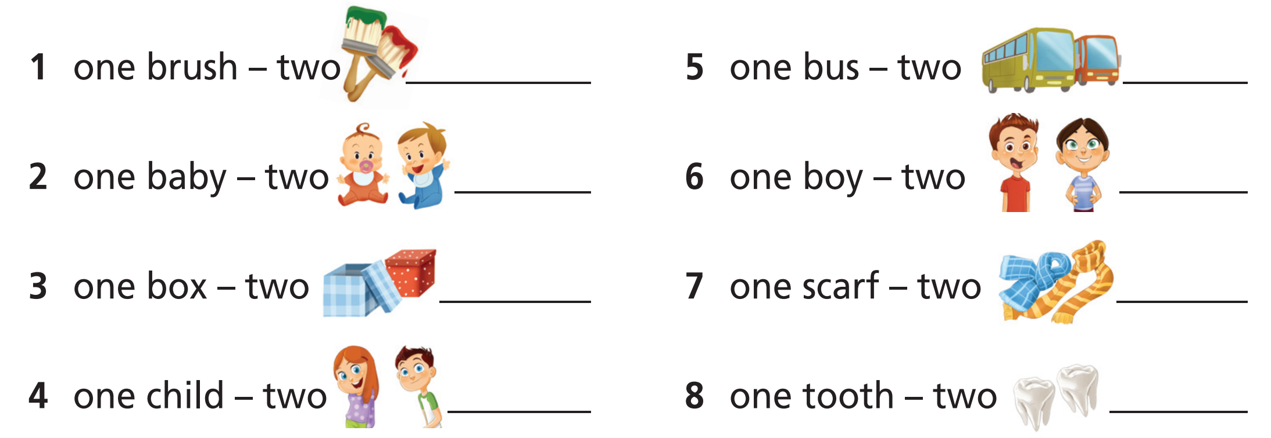
1 Read the theory box. Write the plurals.
brushes
buses
babies
boys
boxes
scarves
children
teeth

Slide 13
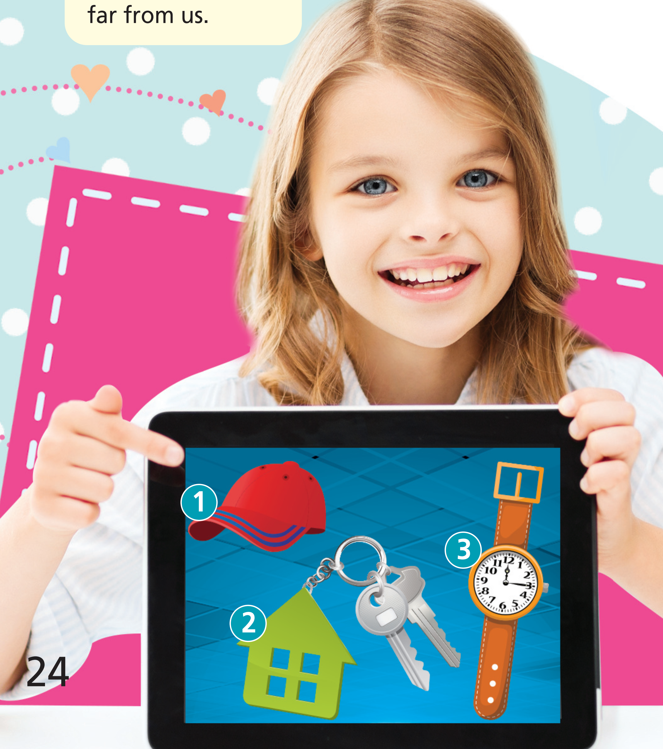
2 Look at the picture. Write what Mary says.
1 This is my cap.
2 These are my keys.
3 This is my watch.

Slide 14
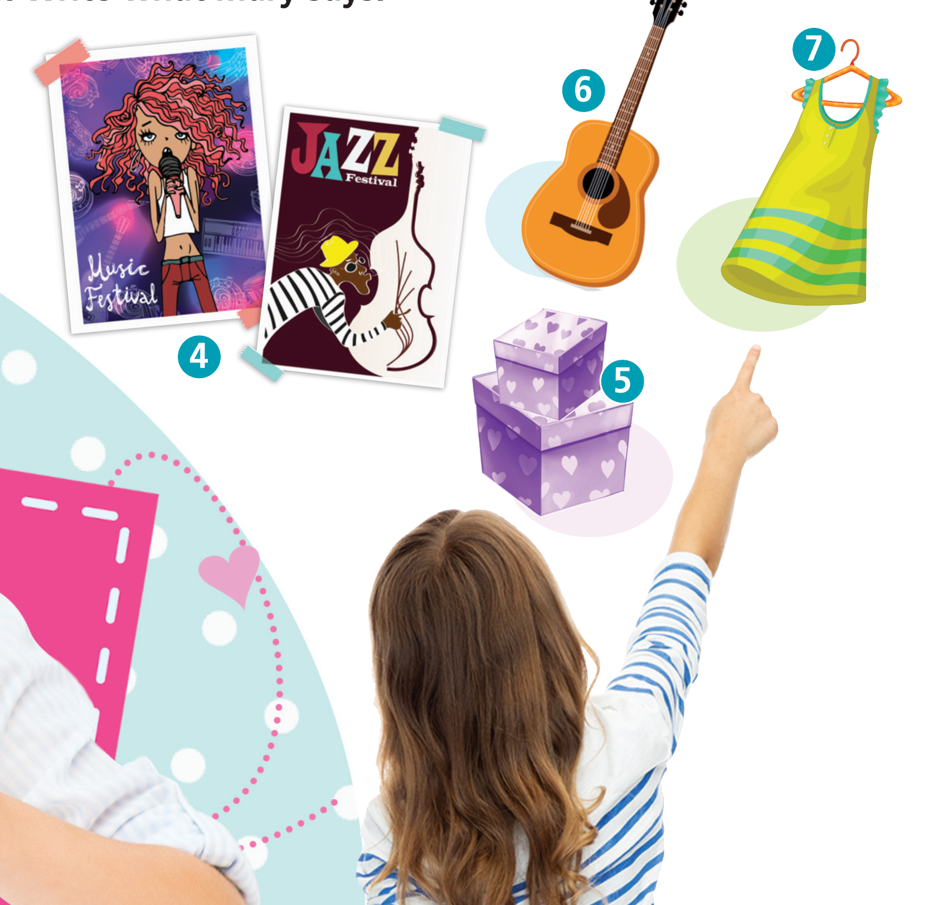
2 Look at the picture. Write what Mary says.
4 Those are my posters.
5 Those are my boxes.
6 That is my guitar.
7 That is my dress.

Slide 15
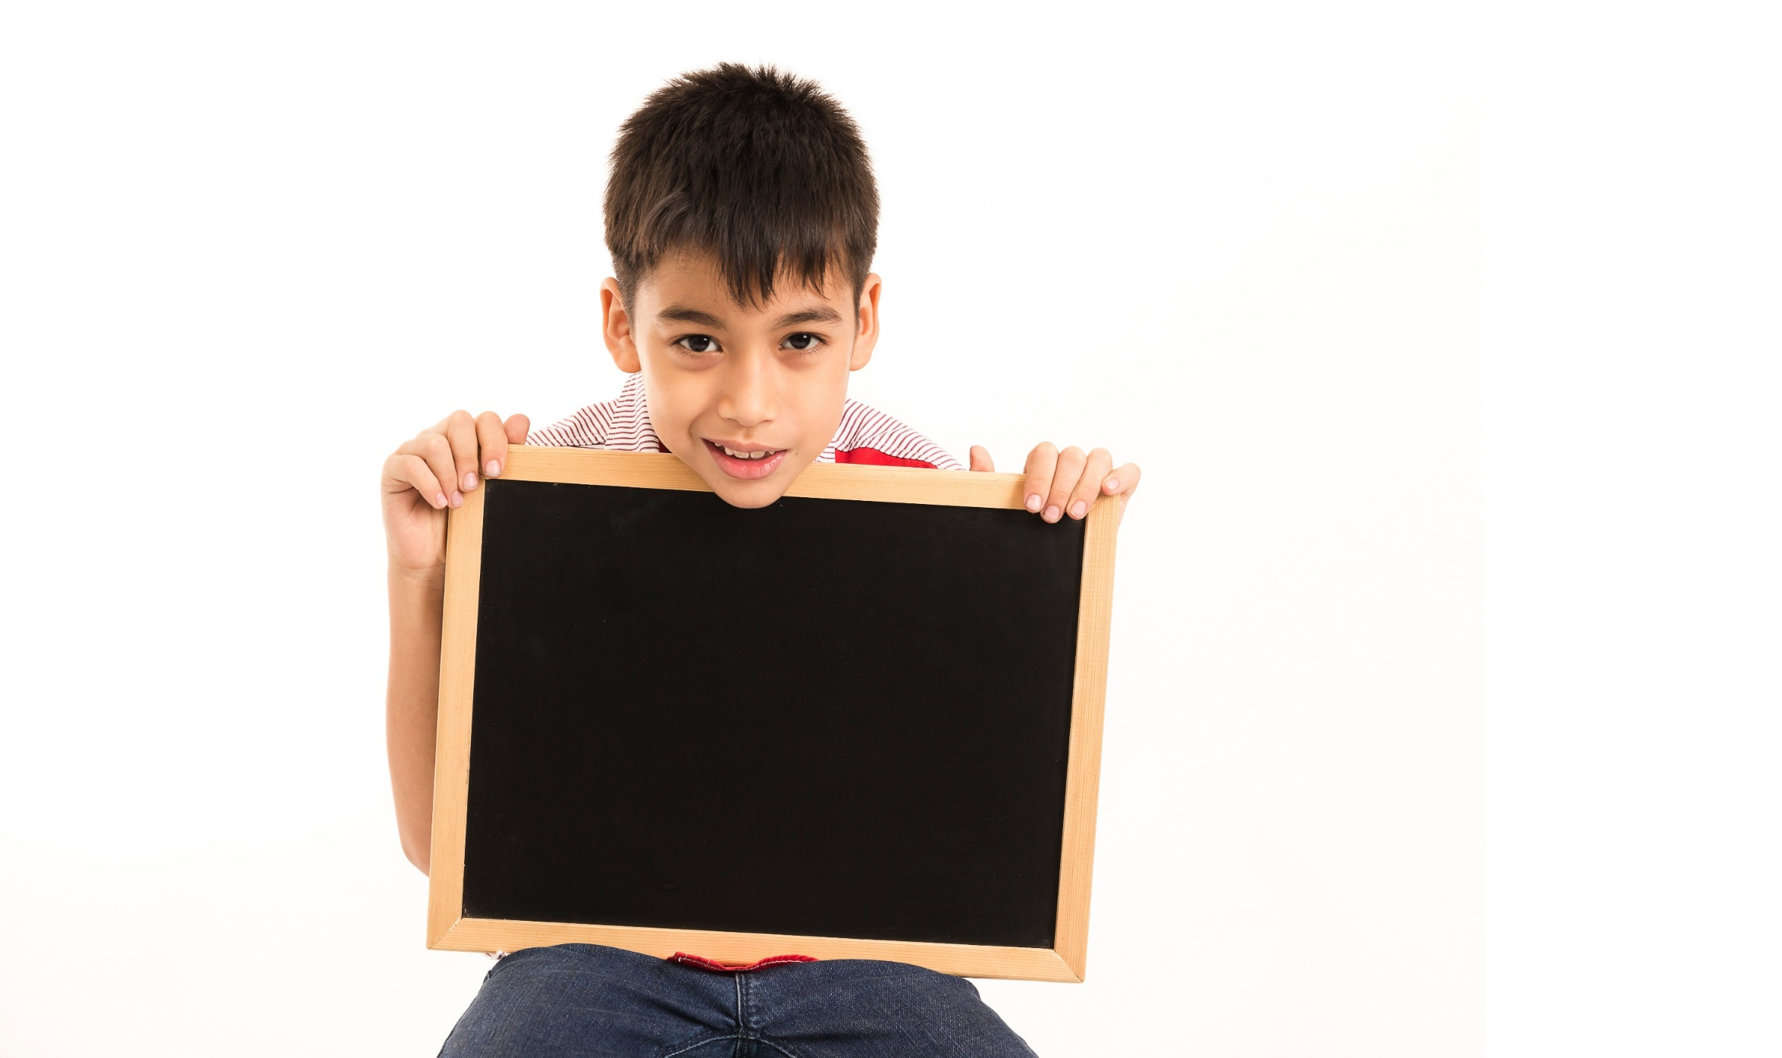
MORE
PRACTICE

Slide 16
Further practice
Write the words in the plural.
1. book - ________________
2. man - ________________
3. watch -_______________
4. toy - _________________
5. shelf - _________________
6. house - ________________
7. foot -__________________
8. fly - ___________________
books
shelves
men
houses
watches
feet
toys
flies

Slide 17
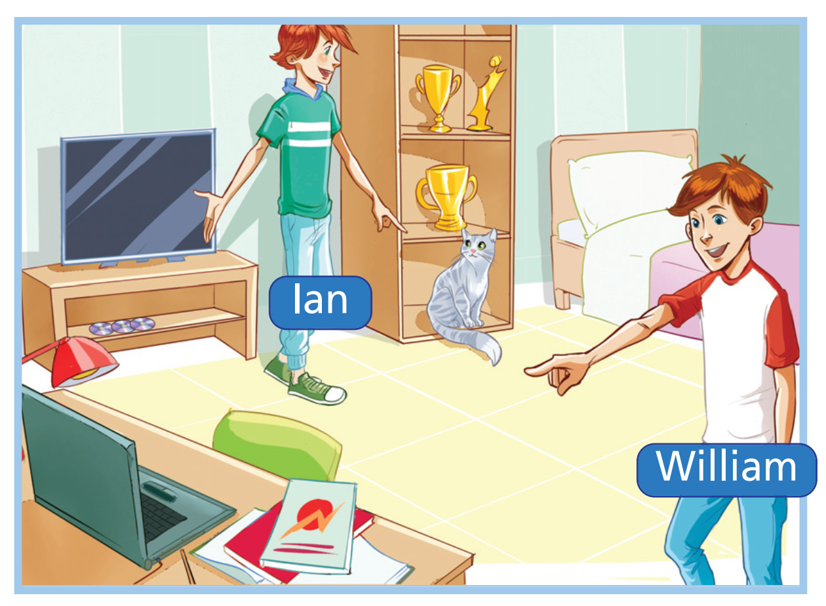
WB p. 13
Fill in the gaps with this, these, that, or those.
1 Ian: _________ is my cat, Fluffy.
2 William: _________ are our books.
3 William: _________ is my new laptop.
4 Ian: _________ are our cups.
This
Those
That
These

Slide 18
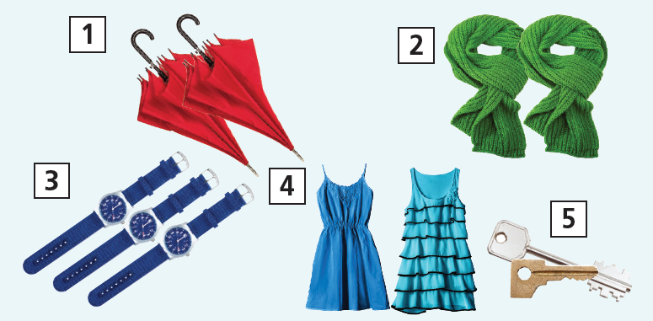
Grammar Bank
P. 65
★★ What can you see in the pictures? Write the sentences.
I can see two umbrellas.
1 __________________________________________
2 __________________________________________
3 __________________________________________
4 __________________________________________
5 __________________________________________
I can see two scarves.
I can see three watches.
I can see two dresses.
I can see two keys.

Slide 19
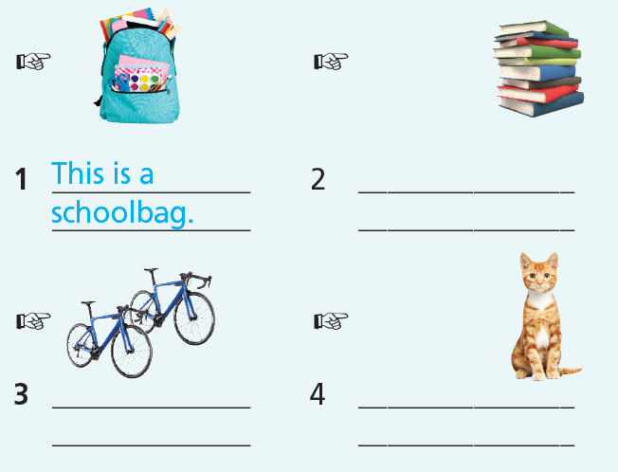
Grammar Bank
P. 65
Look and write as in the example.
Those are books.
These are bicycles.
That is a cat.

Slide 20

Production

Slide 21
Work in pairs. Point at the things in the classroom and make sentences with this/that/these/those + singular/plural.

Slide 22

CONSOLIDATION

Slide 23
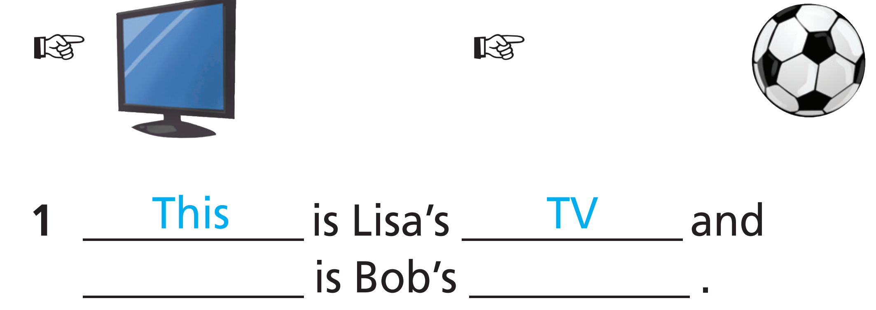
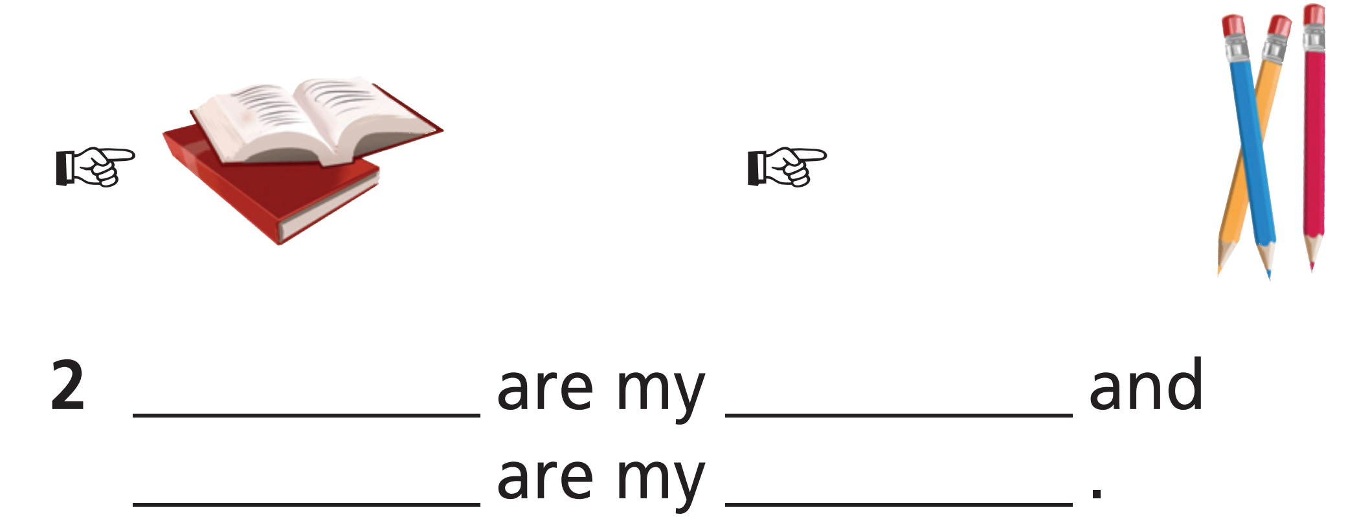
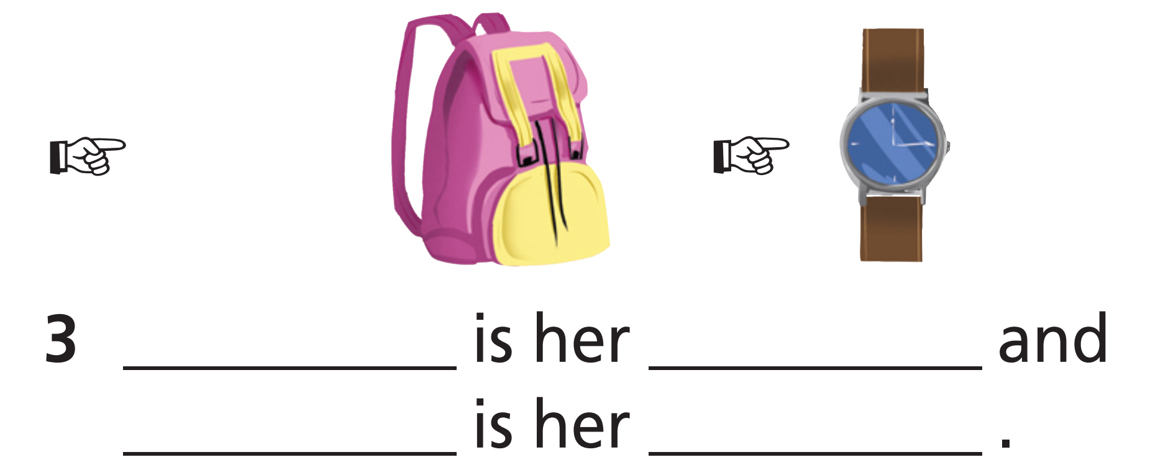
Fill in the gaps with this, these, that, those and the missing noun.
That
ball
These
books
Those
pencils
That
schoolbag
This
watch

Slide 24

WRAP-UP

Slide 25
Today’s lesson
Grammar
Singular-plural
This/that/these/those

Slide 26
Homework
Practise the vocabularies and grammar and make sentences using them.
Do the exercises in TA 6 Right on WB (p. 13).
Complete the grammar notes in TA 6 Right on Notebook
(p. 14).
Prepare the next lesson (p. 25 SB).

Slide 27
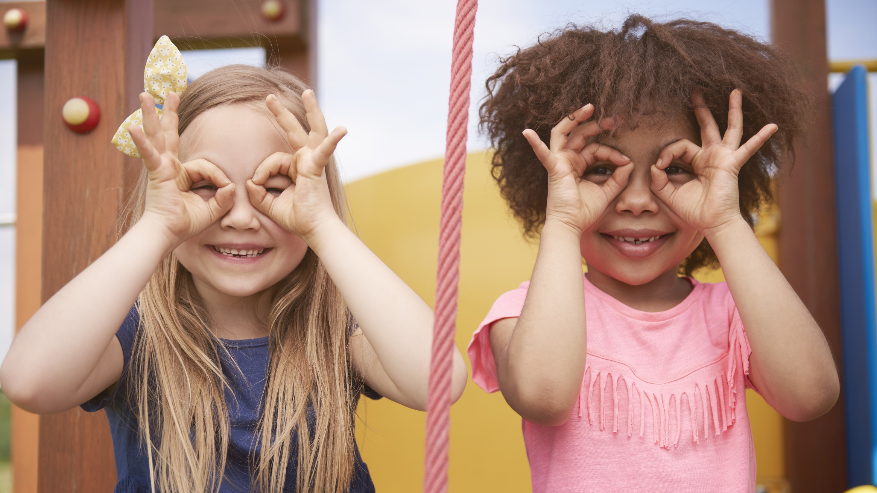
Enjoy your day!

