Slide 1
KEY ENGLISH TEST 1 SPEAKING TEST 4

Slide 2
KET SPEAKING
Time allowed - 8-10 minutes
Normally you will do the speaking test with another candidate. The two of you will meet two examiners. One of the examiners will talk to you, the other does not particpate in the conversations.
There are two parts to the speaking test:
Speaking part 1: short questions and answers between you and the examiner
Speaking part 2: the examiner gives you some information or a card with some ideas for questions. You have to talk with the other candidate and ask or answer questions. How to prepare for KET Speaking
Speak as much as you can, with your friends
Practise asking and asnwering questions about daily life
Practise giving information about yourself

Slide 3
SPEAKING PART 1

Slide 4
Part 1:
Remember to add more details to your answer to make it longer
What is your favorite meal of the day?
What food do you like best?
What food don’t you like?
Do you love cooking?
Who often does the cooking in your family?
Talk about the dish that you like best

Slide 5
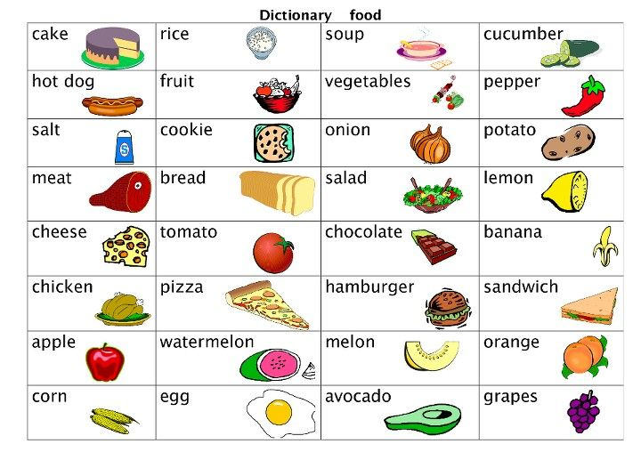
FOOD

Slide 6
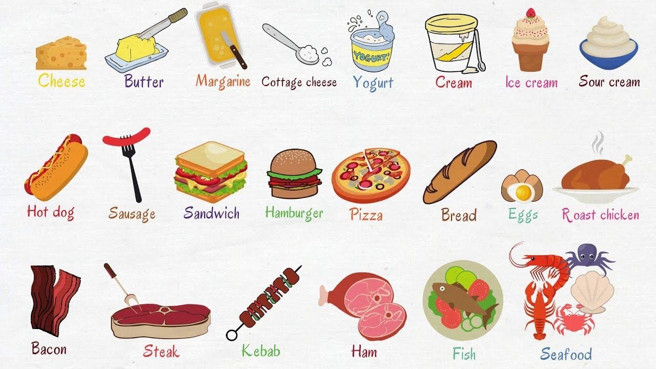

Slide 7
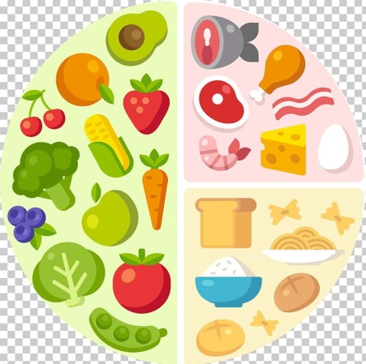
Sample answers:
What is your favorite meal of the day?
What food do you like best?
What food don’t you like?
Do you love cooking?
Who often does the cooking in your family?
My favorite meal is the dinner because my family often has a big dinner with many good dishes.
I love meat the best because it has a lot of nutrition
I don’t like shrimp because I have an allergy to shrimp.
Yes, I do. I often try different recipes to cook for my family
My mother does the cooking and sometimes, my sister helps my mother with it.
- Nutrition: chất dinh dưỡng
- Allergy: dị ứng
- Recipe: công thức nấu ăn

Slide 8
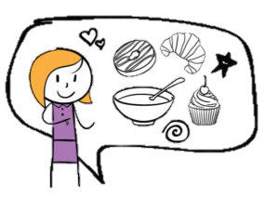
Favorite dish
The answer should be at least 3 sentences
Helpful outline and vocabulary
Dish
What the dish is
What it is made of
Why you like it
For example: Beef noodles
It is made of rice, beef and many kinds of herbs with tasteful broth (nước dùng)
I love beef noodles because it is one of the famous dishes in Vietnam. My mom also cooks it very well.

Slide 9
Practice
Do you often eat fast food?
Are you a good cook?
At what times do you usually eat your meals?
Did you have breakfast / lunch today?
Do you always eat vegetables?
Do you eat fruit every day?
What food do you think is unhealthy?

Slide 10
SPEAKING PART 2
Asking and answering questions using these prompt cards

Slide 11
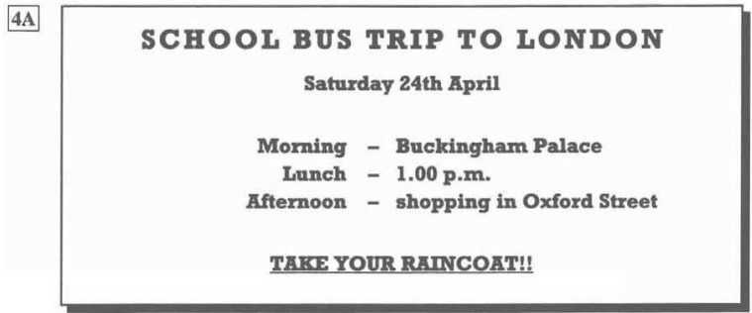
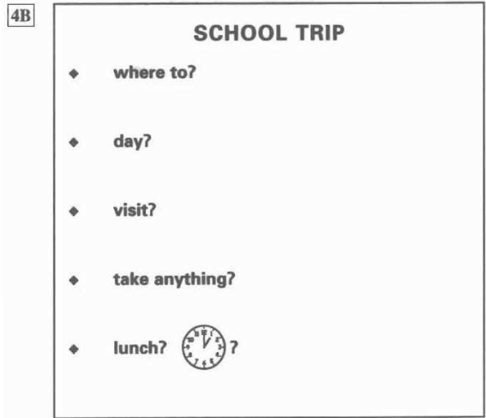
Where do we go in the school trip?
When is the school trip?
Which place do we visit?
Do we need to take anything with us?
What time do we have lunch?
Can you think of other questions or other ways to ask and answer?

Slide 12
Now, imagine you are a teacher. Talk about the school trip based on the given information

Slide 13
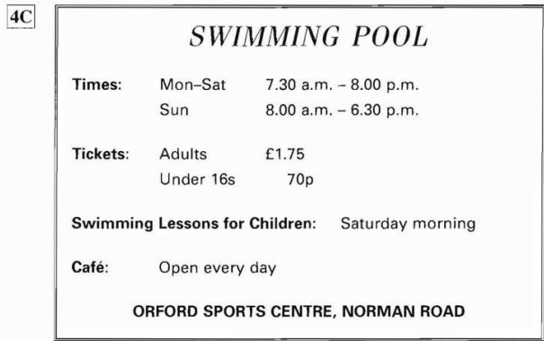
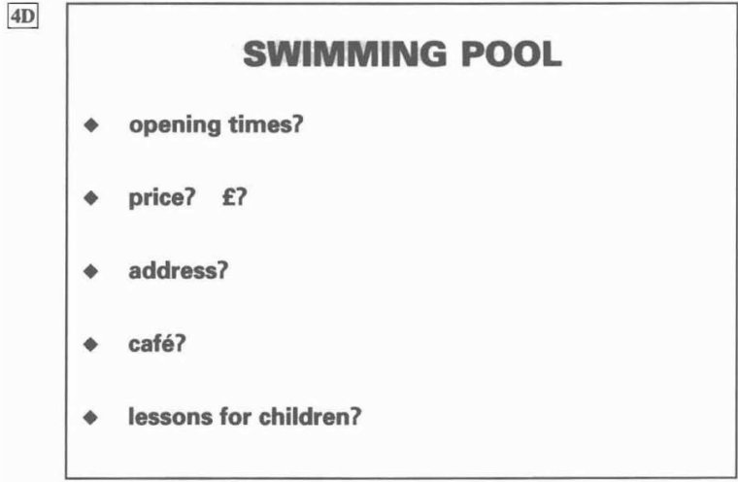
What is the opening time of the swimming pool?
How much is a ticket?
What is the address of the pool?
Is there a café there?
Do they have lessons for children?

Slide 14
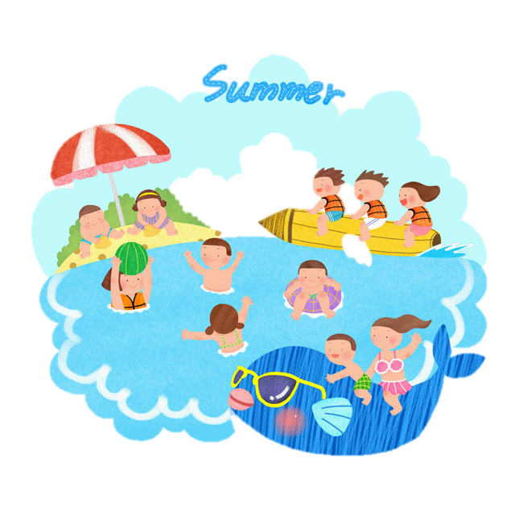
Now, imagine you are introducing the swimming pool to visitors. Talk about the pool based on the given information

