Slide 1


Slide 2

Unit
7
1
VIET NAM AND INTERNATIONAL ORGANIZATIONS
Unit
FAMILY LIFE
LESSON 6
WRITING
LESSON 8
LOOKING BACK AND PROJECT

Slide 3

Unit
1
1
FAMILY LIFE
Family Life
Unit
OBJECTIVES
Knowledge
Review the vocabulary and grammar of Unit 7
Apply what you have learnt (vocabulary and grammar) into practice through a project
Core competence
Develop communication skills and creativity
Develop critical thinking skill
Be collaborative and supportive in pair work and team work
Develop presentation skills
Personal qualities
Understand more about international organizations
Develop self-study skills

Slide 4
LESSON 8
LOOKING BACK AND PROJECT
WARM-UP
Game: Outlast
Task 1: Pronunciation: Listen and mark the primary stress in the words in bold. Then practise saying the sentences.
Task 2: Vocabulary: Complete the text with the correct forms of the verbs in the box.
Task 3: Grammar: Write another sentence using the word(s) in brackets. Make sure it has the same meaning as the previous one.
LOOKING BACK
PROJECT
Project: An international organisation
CONSOLIDATION
Homework

Slide 5
LESSON 8
LOOKING BACK AND PROJECT
WARM-UP
Game: Outlast

Slide 6
WARM-UP
Game: Outlast
Play in two teams. Each team has 3 Life Points.
Team 1: say the name of an international organization we have learned so far in Unit 7.
Team 2: respond by saying the function of that organization
Switch roles after one round.
If you: repeat what was said / cannot remember anything else/ fail to respond → -1 Life Point.

Slide 7
LESSON 8
LOOKING BACK AND PROJECT
WARM-UP
Game: Outlast
Task 1: Pronunciation: Listen and mark the primary stress in the words in bold. Then practise saying the sentences.
Task 2: Vocabulary: Complete the text with the correct forms of the verbs in the box.
Task 3: Grammar: Write another sentence using the word(s) in brackets. Make sure it has the same meaning as the previous one.
LOOKING BACK

Slide 8

PRONUNCIATION
1
Listen and mark the primary stress in the words in bold. Then practise saying the sentences.
WWF is the world’s largest non-profit environmental organisation.
Viet Nam has become a more active participant in the international community.
Japan is the biggest financial provider to this economic organisation.
UNICEF helps disadvantaged teenagers continue their education.
There are more educational opportunities for Vietnamese students now.

Slide 9
PRONUNCIATION
1
Listen and mark the primary stress in the words in bold. Then practise saying the sentences.
WWF is the world’s largest non-profit en,viron'mental ,organi'sation.
Viet Nam has become a more active par'ticipant in the ,inter'national com'munity.
Japan is the biggest financial provider to this ,eco'nomic ,organi'sation.
UNICEF helps ,disad'vantaged teenagers continue their ,edu'cation.
There are more ,edu'cational ,oppor'tunities for Vietnamese students now.

Slide 10
VOCABULARY
2
Complete the text with the correct forms of the verbs in the box.
aim | commit | enter | welcome | promote
As a member of various international organisations, Viet Nam can (1) ________ into relations with other countries in the international community. Our country (2) ________ to work closely with these organisations to achieve their aims. As Viet Nam (3) ________ to develop its economy, it (4) ________ foreign investors. Viet Nam also creates good conditions for both international and local businesses. This will help (5) ________ our economic growth.

Slide 11
VOCABULARY
2
Complete the text with the correct forms of the verbs in the box.
aim | commit | enter | welcome | promote
As a member of various international organisations, Viet Nam can (1) enter into relations with other countries in the international community. Our country (2) commits to work closely with these organisations to achieve their aims. As Viet Nam (3) aims to develop its economy, it (4) welcomes foreign investors. Viet Nam also creates good conditions for both international and local businesses. This will help (5) promote our economic growth.

Slide 12
GRAMMAR
3
Write another sentence using the word(s) in brackets. Make sure it has the same meaning as the previous one.
1. Viet Nam wasn’t as attractive to foreign tourists as it is nowadays. (more attractive)
→_____________________________________________________________________________
2. The United Nations is the largest international organisation. (larger)
→ ____________________________________________________________________________
3. The international market wasn’t as competitive as it is now. (more competitive)
→ ____________________________________________________________________________
4. No other country is a bigger financial provider to this organisation than Japan. (the biggest)
→ ____________________________________________________________________________

Slide 13
GRAMMAR
Write another sentence using the word(s) in brackets. Make sure it has the same meaning as the previous one.
3
1. Viet Nam wasn’t as attractive to foreign tourists as it is nowadays. (more attractive)
→ Vietnam is more attractive to foreign tourists nowadays than it was in the past.
2. The United Nations is the largest international organisation. (larger)
→ No international organization is larger than the United Nations.
3. The international market wasn’t as competitive as it is now. (more competitive)
→ The international market now is more competitive than it was in the past.
4. No other country is a bigger financial provider to this organisation than Japan. (the biggest)
→ Japan is the biggest financial provider to this organization.

Slide 14
LESSON 8
LOOKING BACK AND PROJECT
WARM-UP
Game: Outlast
Task 1: Pronunciation: Listen and mark the primary stress in the words in bold. Then practise saying the sentences.
Task 2: Vocabulary: Complete the text with the correct forms of the verbs in the box.
Task 3: Grammar: Write another sentence using the word(s) in brackets. Make sure it has the same meaning as the previous one.
LOOKING BACK
PROJECT
Project: An international organisation

Slide 15
PROJECT: An international organization
Work in groups. Do research on an international organisation and present
your findings to the class.
Your presentation should include:
• What is the name of the international organisation?
• When and where was it formed?
• How many member countries does it have? Is Viet Nam a member of this organisation?
• What are the organisation’s aims?
• What are the current activities / projects of this organisation?
• What has this organisation done to help Viet Nam?

Slide 16
LESSON 8
LOOKING BACK AND PROJECT
WARM-UP
Game: Outlast
Task 1: Pronunciation: Listen and mark the primary stress in the words in bold. Then practise saying the sentences.
Task 2: Vocabulary: Complete the text with the correct forms of the verbs in the box.
Task 3: Grammar: Write another sentence using the word(s) in brackets. Make sure it has the same meaning as the previous one.
LOOKING BACK
PROJECT
Project: An international organisation
CONSOLIDATION
Homework

Slide 17
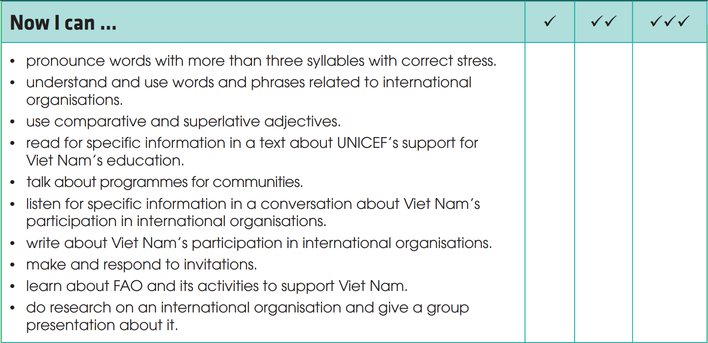
CONSOLIDATION
1
Wrap-up

Slide 18
CONSOLIDATION
2
Homework
Finish workbook exercises
Prepare for the next lesson: Unit 8.

Slide 19


