Slide 1
1
L
E
S
S
O
N
1
2
C
R
E
D
I
T
2
3
S
U
B
J
E
C
T
3
4
C
O
N
D
U
C
T
4
5
M
A
R
K
5
9.What are the students in the examinations called?
6.To check your study
T
S
7.You do not pass and the exam will be called…..
6
E
T
6
4.It is ranked and marked by behavior.
5.If you get 10 in studying, you will happy
8.You go to everyday to widen knowledge.
3.It replaces maths, geogrephy, history …………
2.Students scroring between 7.0 – 8.49 are called ……..
1.We learn my teacher’s ……… by heart.
7
F
A
I
L
7
8
S
C
H
O
O
L
8
9
C
A
N
D
I
D
A
T
E
9

Slide 2
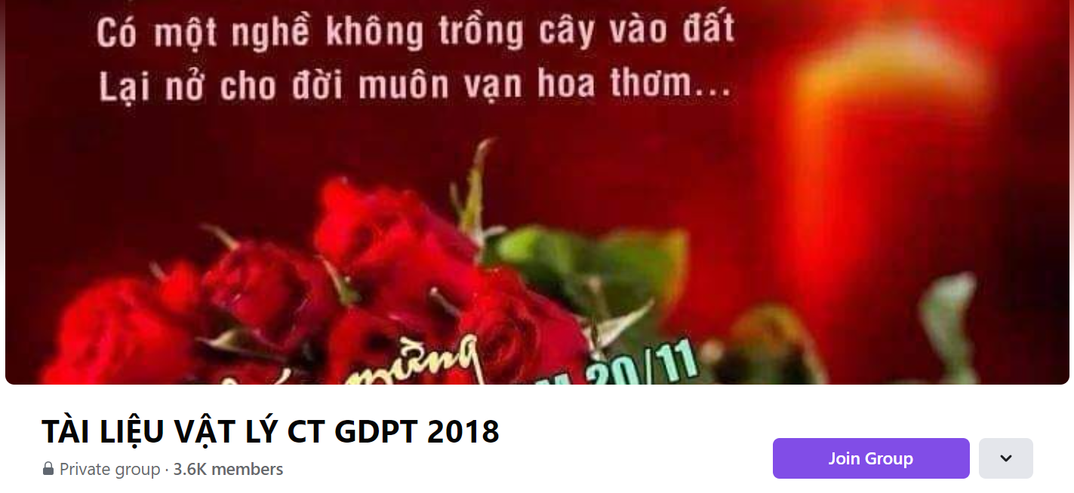
SƯU TẦM: ĐOÀN VĂN DOANH, NAM TRỰC, NAM ĐỊNH
LINK NHÓM DÀNH CHO GV BỘ MÔN VẬT LÝ TRAO ĐỔI TÀI LIỆU VÀ CHUYÊN MÔN CT 2018
https://www.facebook.com/groups/299257004355186

