Slide 1

Unit 5: Sports and hobbies
Lesson 2.1
Page 71

Slide 2
Lesson Outline
Warm-up
Vocabulary
Structure
Consolidation
Wrap-up

Slide 3
Objectives
By the end of this lesson, students will be able to…
Vocabulary: hitting, kicking, catching, throwing
Structure: What are you good at?
- I'm good at kicking.

Slide 4

WARM UP

Slide 5


Swap positions

Slide 6
How to play
The students stand in a circle (or sit on the circle of chairs), except for one student (or the teacher), who stands in the middle. Each student must have a fixed position.
The person in the middle says a sentence that starts with Change positions if you… and ends with some condition (e.g. …have curly hair).
If that condition is true for a student, they have to stand up and find a new position as quickly as possible.
Students who can't find swap positions will be penalized.

Slide 7
1. Change positions if you’re wearing black shoes.
2. Change positions if you have short hair.
3. Change positions if you’re wearing a watch.
4. Change positions if you have curly hair.
5. Change positions if you’re wearing glasses.

Slide 8
6. Change positions if the first letter of your name is H.
7. Change positions if the last letter of your name is N.
8. Change positions if you’re wearing a white shoes.
9. Change positions if you have long hair.
10. Change positions if you love your teacher.

Slide 9

It’s time to learn …

Slide 10
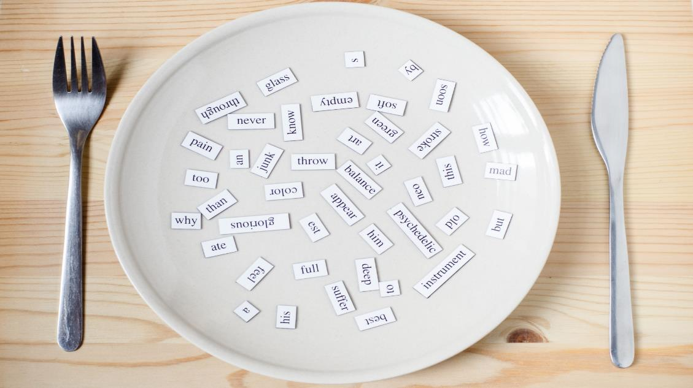
New words
hitting
kicking
catching
throwing

Slide 11

Presentation

Slide 12


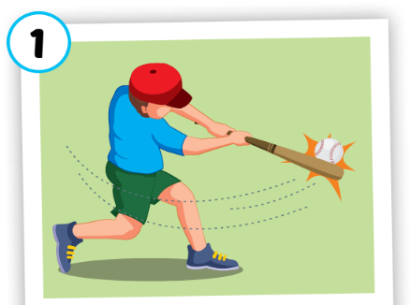
hitting
/ˈhɪtɪŋ/
đánh
Click on each word to hear the sound.

Slide 13
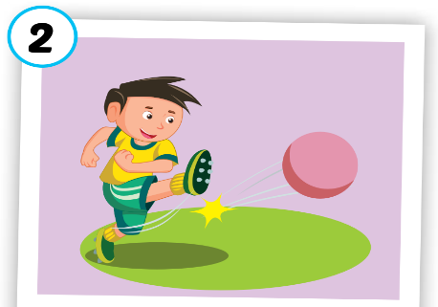
kicking
/ˈkɪkɪŋ/
đá
Click on each word to hear the sound.

Slide 14
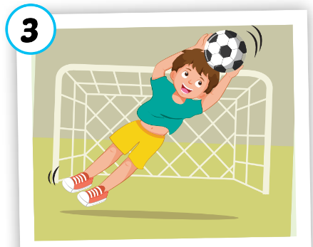
catching
/ˈkætʃɪŋ/
bắt
Click on each word to hear the sound.

Slide 15
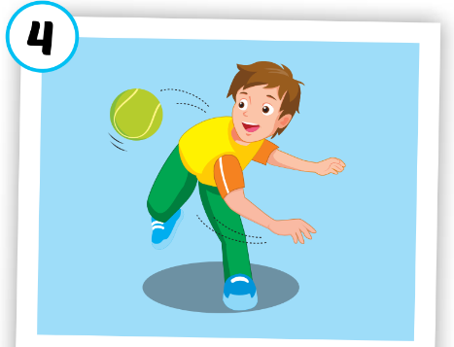
throwing
/ˈθrəʊɪŋ/
ném
Click on each word to hear the sound.

Slide 16




hitting
kicking
catching
throwing
/ˈhɪtɪŋ/
đánh
/ˈkɪkɪŋ/
đá
/ˈkætʃɪŋ/
bắt
/ˈθrəʊɪŋ/
ném
Click on each word to hear the sound.

Slide 17

Practice

Slide 18
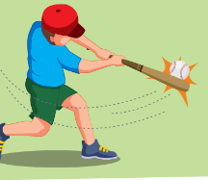
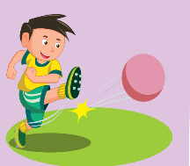
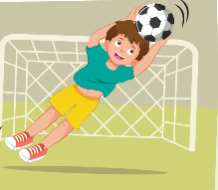
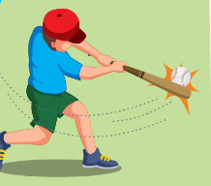
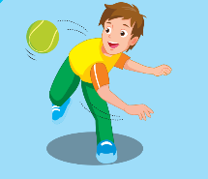
1
2
3
4
5
6
7
8
Click on the square to see the picture
Click on to close the picture.
Notes:
Memory game. GV nhấn vào ô để mở, nếu HS chọn 2 hình không giống nhau, GV nhấn vào hình tròn để đóng hình lại, HS phải nhớ những hình đã mở.

Slide 19

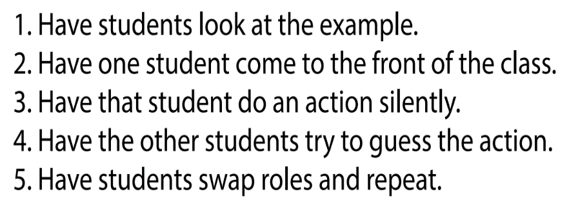

Slide 20
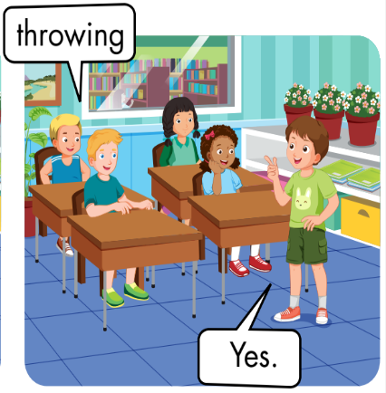

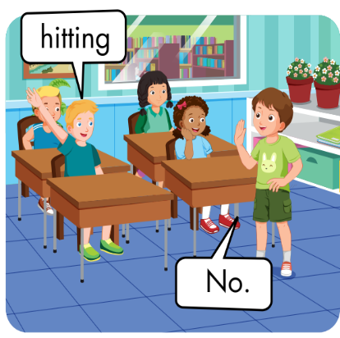

Slide 21

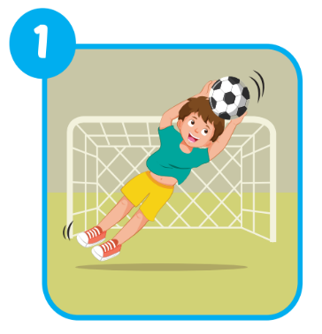
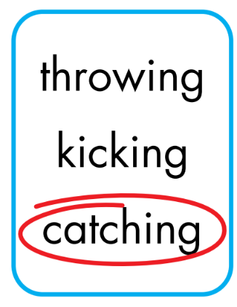
Extra Practice
WB, page 50.

Slide 22
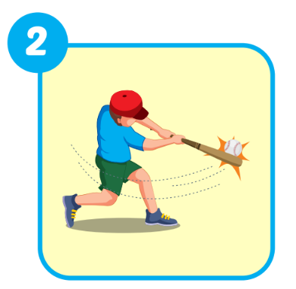
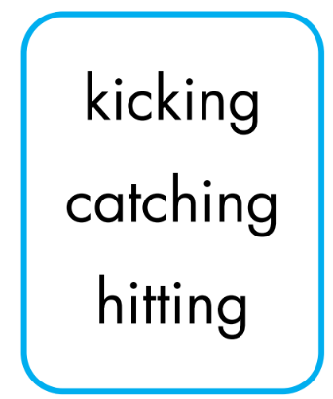
Extra Practice
WB, page 50.

Slide 23
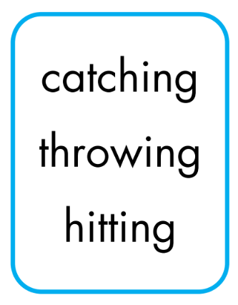
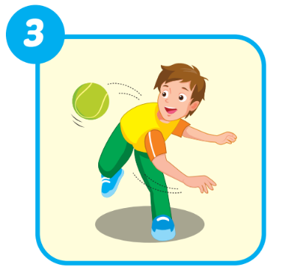
Extra Practice
WB, page 50.

Slide 24
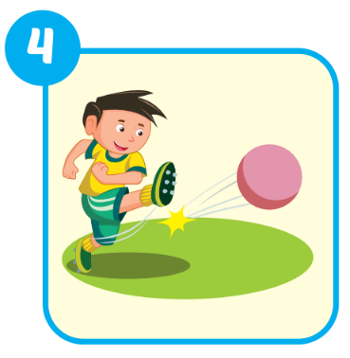
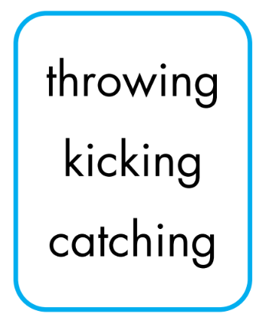
Extra Practice
WB, page 50.

Slide 25

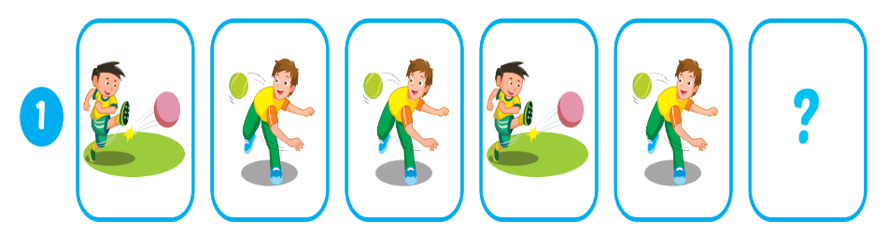

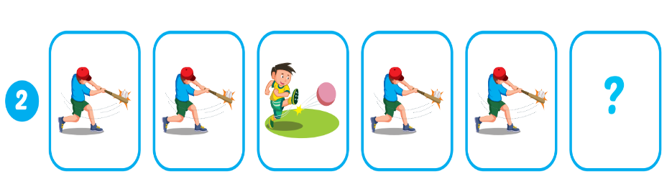
Extra Practice
WB, page 50.
kicking

Slide 26
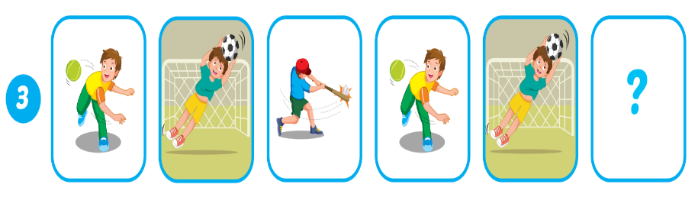
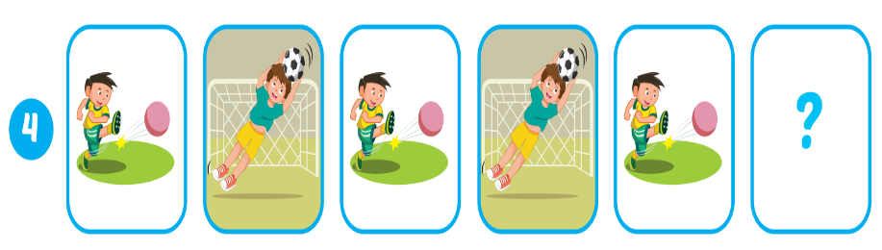
Extra Practice
WB, page 50.
hitting
catching

Slide 27
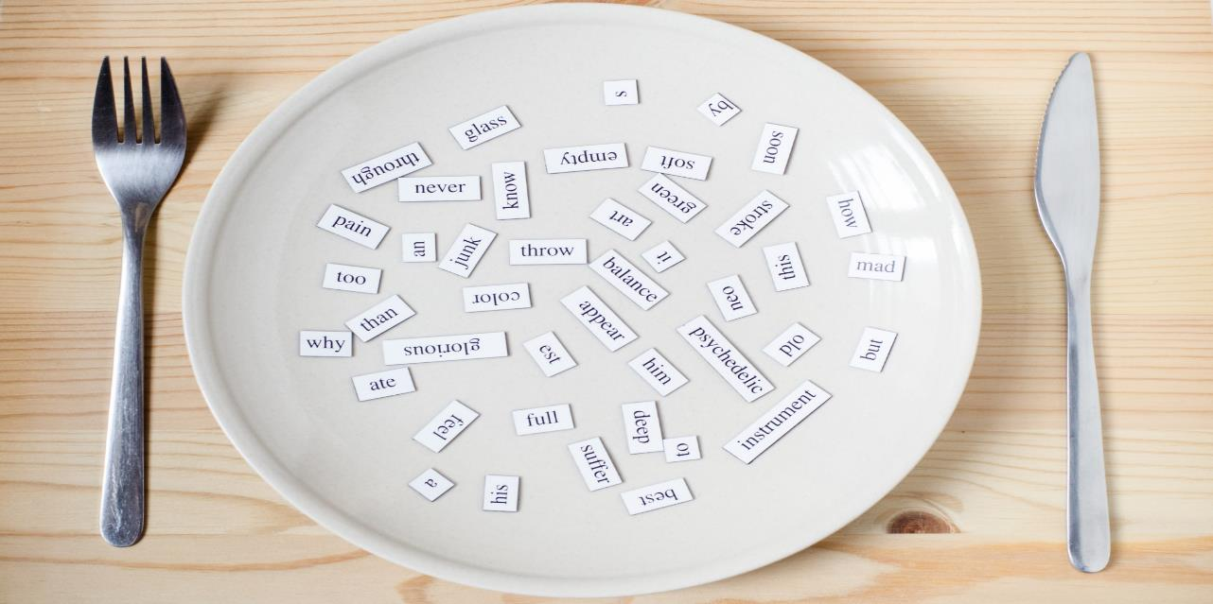
Structures
What are you good at?
- I'm good at kicking.

Slide 28
Presentation

Slide 29

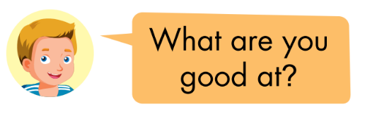
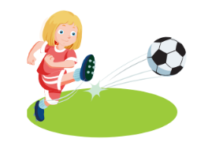
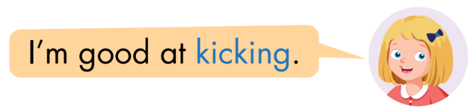

Slide 30
Practice

Slide 31

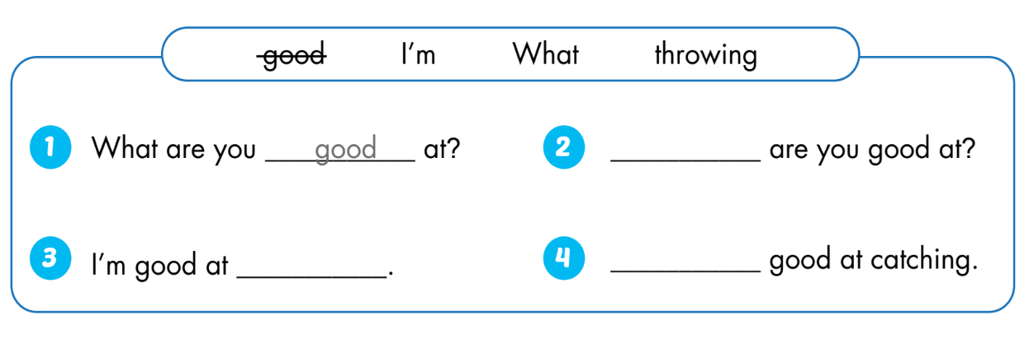
What
throwing
I’m

Slide 32
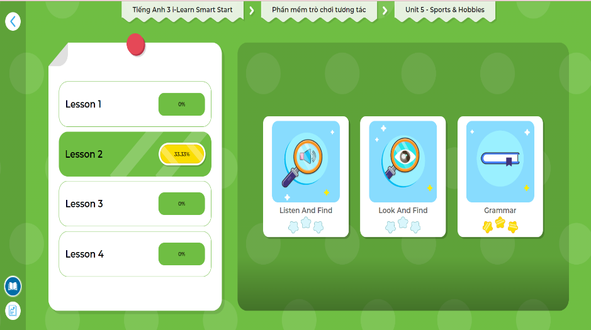
LET’S PLAY!
Click here to play the games.

Slide 33

CONSOLIDATION

Slide 34
Early Production

Slide 35
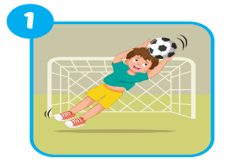
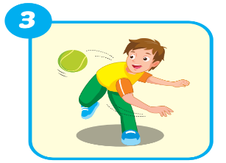


What are you good at?
Lost turn
☹
1
SPIN
4
2
1 more turn
☺
3
I'm good at …
Notes:
GV dùng vòng quay để HS chọn số ngẫu nhiên. Khi chọn vào ô số nào thì sẽ làm câu cho số đó

Slide 36

WRAP-UP

Slide 37
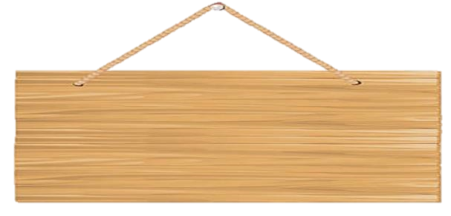




Who is faster?

Slide 38






How to play
Divide students into 2 groups.
The group with the correct answer will move on. The group with the wrong answer will be lost turn.
The group across the river first will win.
Group A
Group B

Slide 39






End
Congratulations
Congratulations
Click on the avatar of the group to move the level.

Slide 40




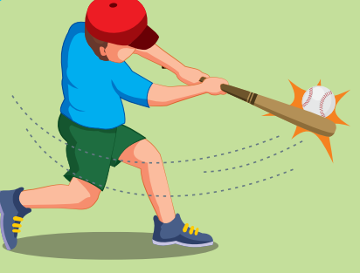
Back
hitting

Slide 41
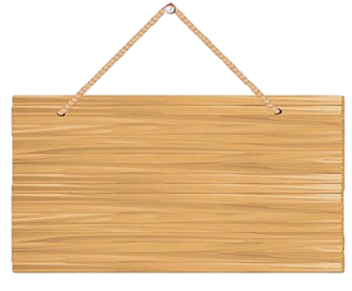

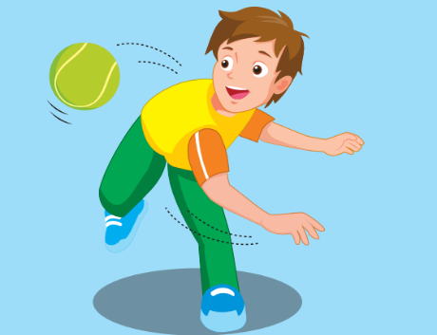
Back
throwing

Slide 42
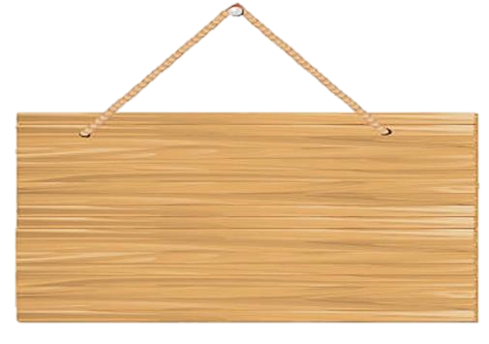

Back
I'm good at…
What are you good at?

Slide 43
Back
A. Kicking
Choose the correct word.
Kicking B. Cautching
C. throwwing D. hiting

Slide 44
Back
catching
Rewrite the word:
iccgthna

Slide 45


Back
I'm good at …
What are you good at?

Slide 46
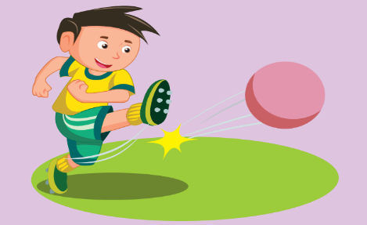
Back
kicking

Slide 47
Back
hitting
Rewrite the word:
ihtgint

Slide 48
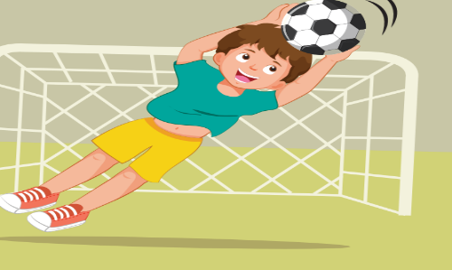
Back
catching

Slide 49
Back
C. throwing
Choose the correct word.
A. kiking B. hicting
C. throwing D. cachting

Slide 50
Today’s lesson
Vocabularies
hitting
kicking
catching
throwing
Structures/ Sentence patterns
What are you good at?
- I'm good at kicking

Slide 51
Homework
Practice vocabularies and structure. Make sentences using them.
Do the exercises in Tiếng Anh 3 i-Learn Smart Start Workbook (page 50)
Do the exercises in Tiếng Anh 3 i-Learn Smart Start Notebook (page 35)
Play the consolidation games in Tiếng Anh 3 i-Learn Smart Start DHA App on www.eduhome.com.vn
Prepare the next lesson (page 72)

Slide 52

Have a nice day!

