Slide 1

Unit 8: Food
Lesson 1.3
Page 112

Slide 2
Lesson Outline
Warm-up
Practice
Speaking
Consolidation
Wrap-up

Slide 3
Objectives
By the end of this lesson, students will be able to…
Vocabulary: Review and practice the vocabularies learnt earlier in the lesson.
Structure: Practice structures:
There are…./There is…

Slide 4

WARM UP

Slide 5


Guessing game
Where is an apple?

Slide 6


Guessing game
Where is a cupcake?

Slide 7

Guessing game
Where is a carrot?

Slide 8
Guessing game
Where is a donut?

Slide 9

It’s time to learn …

Slide 10

Look and write
Pre-Speaking
two carrots
There are _______ _______.
Notes:
Click textbox: pre-speaking to hear the sound

Slide 11
Look and write.
Pre-Speaking
a banana
There is _______ _______.
Notes:
Click textbox: pre-speaking to hear the sound

Slide 12

Look and write.
Pre-Speaking
seven apples
There are _______ _______.
Notes:
Click textbox: pre-speaking to hear the sound

Slide 13
Look and write.
Pre-Speaking
an apple
There is _______ _______.
Notes:
Click textbox: pre-speaking to hear the sound

Slide 14
Look and write.
Pre-Speaking
three donuts
There are _______ _______.
Notes:
Click textbox: pre-speaking to hear the sound

Slide 15
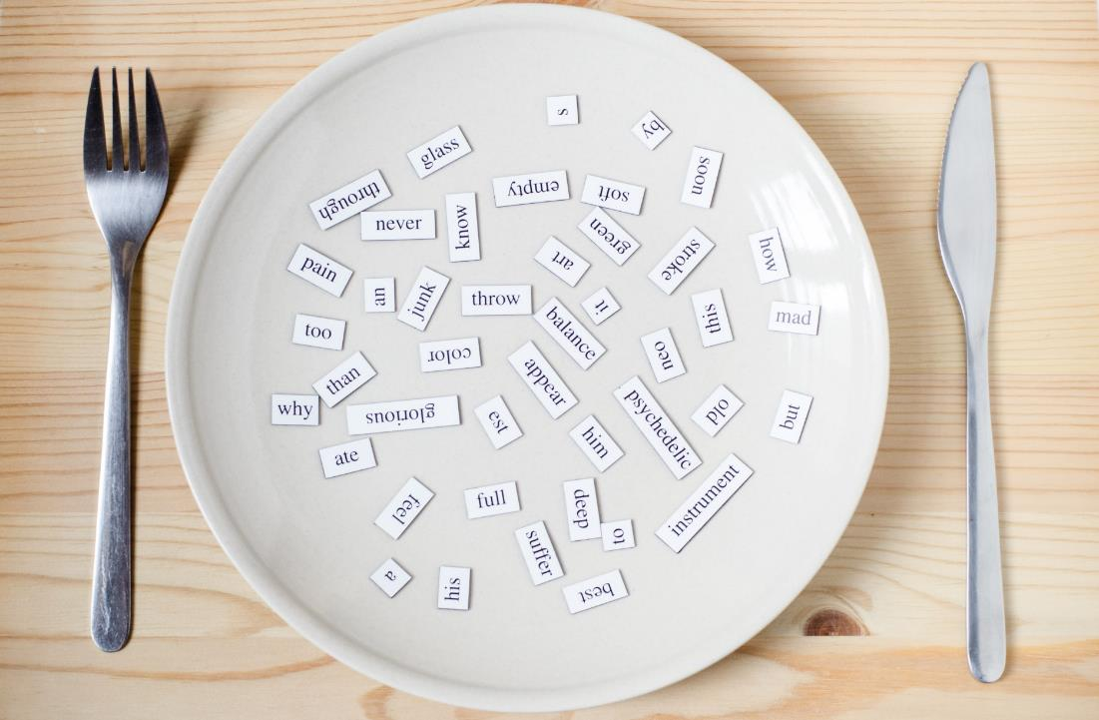
Structures
There are…
There is a/an….

Slide 16
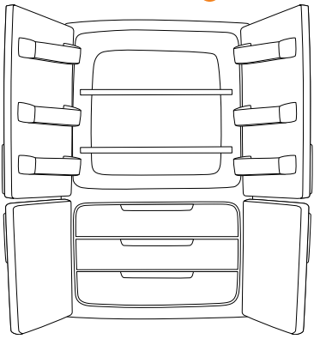

Right or wrong?
There is a donut in your fridge.
Notes:
Click vô tủ lạnh sẽ ra đáp án

Slide 17

Right or wrong?
There are two cupcakes in your fridge.
Notes:
Click vô tủ lạnh sẽ ra đáp án

Slide 18
Right or wrong?
There is an apple in your fridge.
Notes:
Click vô tủ lạnh sẽ ra đáp án

Slide 19
Right or wrong?
There are six carrots in your fridge.
Notes:
Click vô tủ lạnh sẽ ra đáp án

Slide 20

Practice

Slide 21
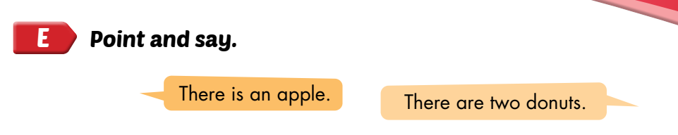


Slide 22

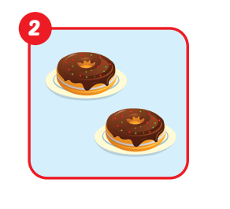
There are two donuts.

Slide 23
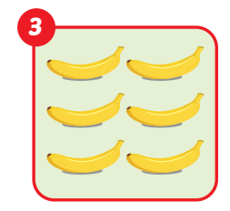
There are six bananas.

Slide 24
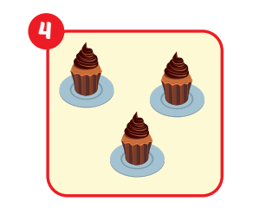
There are three cupcakes.

Slide 25
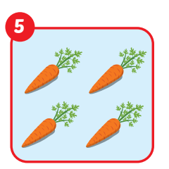
There are four carrots.

Slide 26
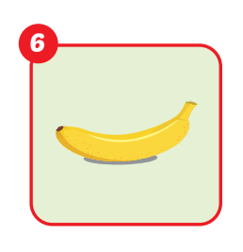
There is a banana.

Slide 27
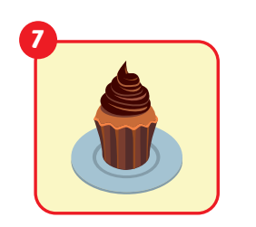
There is a cupcake.

Slide 28
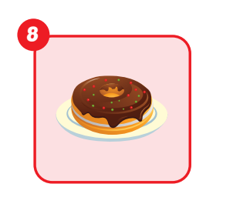
There is a donut.

Slide 29
Post speaking
Game: Count the food

Slide 30


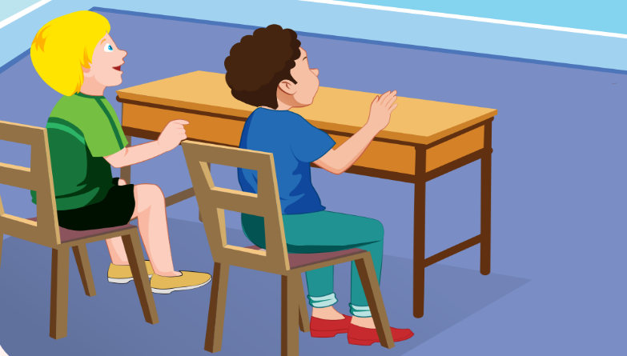

1 : Count the food and make a sentence.
You are given 3 candies
Notes:
Sau khi HS trả lời, click chuột 1 cái để hình biến mất, nếu học sinh trả lời đúng click vô hình món quà để khích lệ

Slide 31

2 : Count the food and make a sentence
You are given 3 candies
Notes:
Sau khi HS trả lời, click chuột 1 cái để hình biến mất, nếu học sinh trả lời đúng click vô hình món quà để khích lệ

Slide 32
3 : Count the food and make a sentence
You are given 3 candies
Notes:
Sau khi HS trả lời, click chuột 1 cái để hình biến mất, nếu học sinh trả lời đúng click vô hình món quà để khích lệ

Slide 33

4 : Count the food and make a sentence
You are given 3 candies
Notes:
Sau khi HS trả lời, click chuột 1 cái để hình biến mất, nếu học sinh trả lời đúng click vô hình món quà để khích lệ

Slide 34
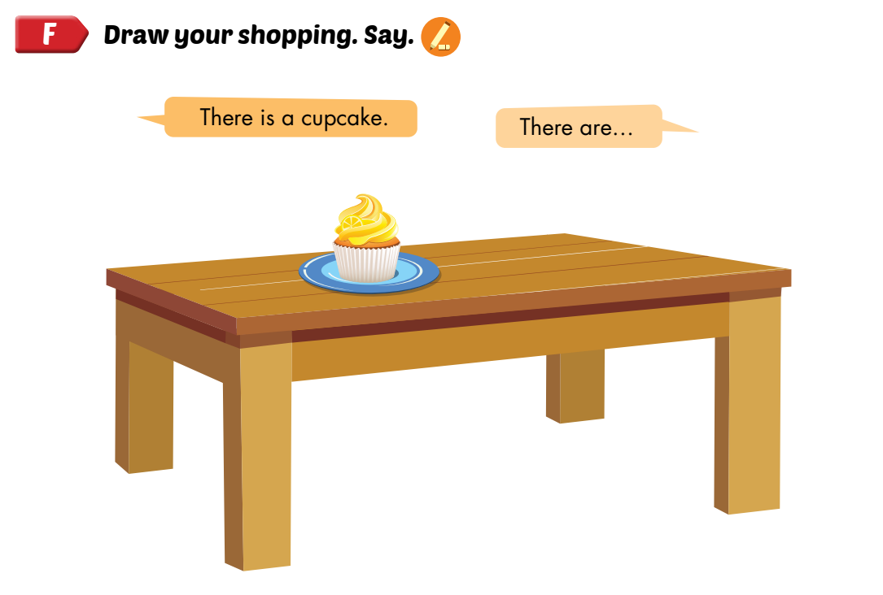
Post speaking

Slide 35

CONSOLIDATION

Slide 36
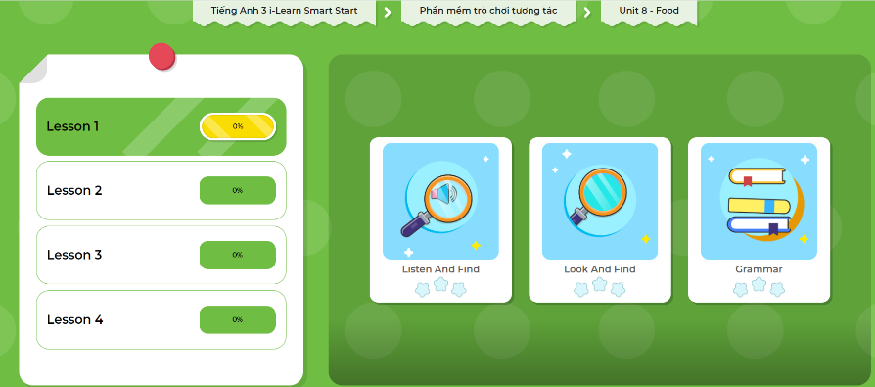
Extra Practice
DHA App
LET’S PLAY!
Click here to play the games

Slide 37

WRAP-UP

Slide 38
Lesson 3
Today’s lesson
Structures/ Sentence patterns
There are…/There is….

Slide 39
Lesson 3
Homework
Practice the vocabularies and structure; and make sentences using them.
Do the exercises in Tiếng Anh 3 i-Learn Smart Start WB (page 79)
Do the exercises in Tiếng Anh 3 i-Learn Smart Start Notebook (page 52)
Prepare the next lesson (page 113 SB)
Play the consolidation games in Tiếng Anh 3 i-Learn Smart Start DHA App on www.eduhome.com.vn

Slide 40
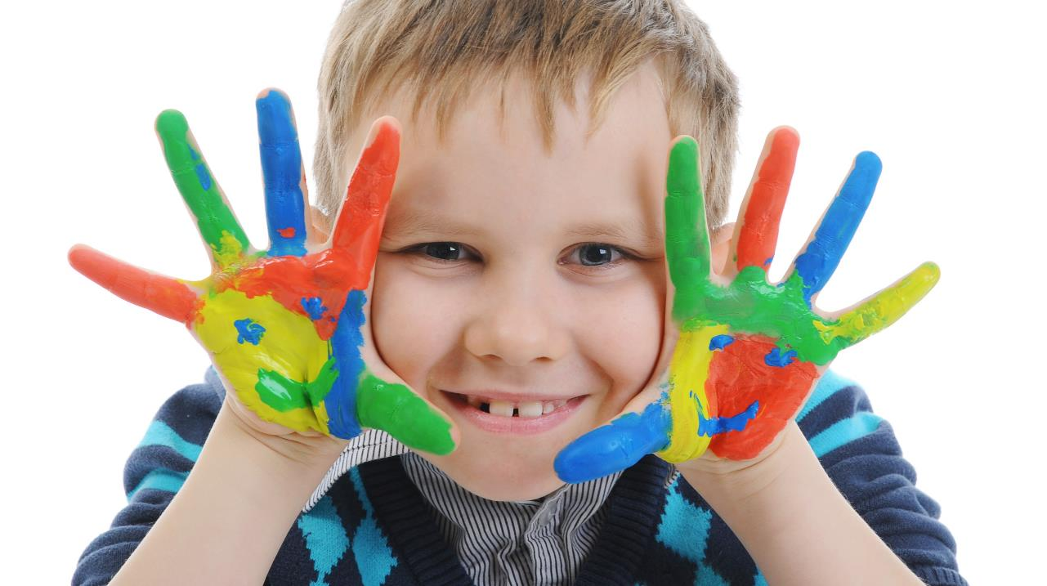
Enjoy your day!

