Slide 1


Slide 2



Unit
11
TRAVELLING IN THE FUTURE
LESSON 5: SKILLS 1
READING
SPEAKING
Unit

Slide 3

OBJECTIVES
By the end of the lesson, students will be able to:
+ Reading:
- read for general and specific information about a future car.+ Speaking:
talk about why a means of transport will / won’t be popular.

Slide 4
LESSON 5: SKILLS 1
WARM-UP
Game: Networking
* Vocabulary
Brainstorming: Look at the picture and find the words or phrases to describe it.
Practice
Task 1: Read the passage and answer the question.
Task 2: Read the passage again and complete the fact file with no more than two words or a number.
Task 3: Retelling
READING
SPEAKING
Task 4: Look at the fact file in 3 then ask and answer questions about it.
PRODUCTION
Task 5: Task 5: Discuss why Roadrunner’s cars will or won’t become popular in the near future. Report your reasons to the class.
CONSOLIDATION
Wrap-up
Home work

Slide 5


LESSON 1: GETTING STARTED
Game: Networking
WARM-UP
Aims of the stage:
To introduce the topic of reading.

Slide 6
WARM-UP
FORMS OF TRANSPORT

Slide 7

LESSON 5: SKILLS 1
WARM-UP
Game: Networking
* Vocabulary
Brainstorming: Look at the picture and find the words or phrases to describe it.
Practice
Task 1: Read the passage and answer the question.
Task 2: Read the passage again and complete the fact file with no more than two words or a number.
Task 3: Retelling
READING
Aims of the stage:
To provide students with some lexical items before reading the text.

Slide 8
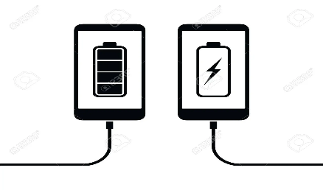
PRE-READING - VOCABULARY
(to) charge
/tʃɑːdʒ/
sạc pin

Slide 9
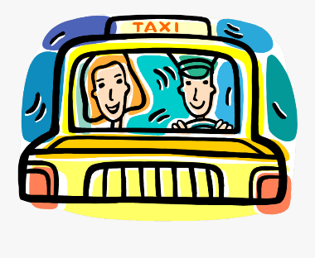
PRE-READING - VOCABULARY
passenger (n)
/ˈpæs.ən.dʒər/
hành khách

Slide 10

PRE-READING - VOCABULARY
economical (a)
/ˌiː.kəˈnɒm.ɪ.kəl/
tiết kiệm nhiên liệu

Slide 11
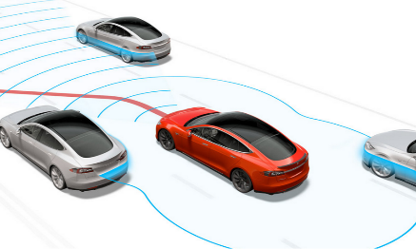
PRE-READING - VOCABULARY
autopilot (adj, n)
/ˈɔː.təʊˌpaɪ.lət/
lái tự động

Slide 12

PRE-READING - VOCABULARY
function (n)
/ˈfʌŋk.ʃən/
chức năng

Slide 13
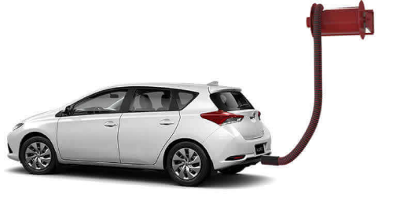
PRE-READING - VOCABULARY
(to) run on
/rʌn ɒn/
chạy bằng (nhiên liệu nào)

Slide 14
PRE-READING - VOCABULARY
New words | Pronunciation | Meaning
1. (to) charge | /tʃɑːdʒ/ | sạc pin
2. passenger (n) | /ˈpæs.ən.dʒər/ | hành khách
3. economical (a) | /ˌiː.kəˈnɒm.ɪ.kəl/ | tiết kiệm nhiên liệu
4. autopilot (adj, n) | /ˈɔː.təʊˌpaɪ.lət/ | lái tự động
5. function (n) | /ˈfʌŋk.ʃən/ | chức năng
6. (to) run on | /rʌn ɒn/ | chạy bằng (nhiên liệu nào)

Slide 15

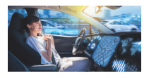
PRE-READING
1
BRAINSTORMING: Look at the picture and find the words or phrases to describe it.
Suggested answer:
The car: convenient, safe, comfortable, modern, automatic, automated, autopilot, etc.
The driver: relaxing / isn’t driving, etc.

Slide 16
LESSON 5: SKILLS 1
WARM-UP
Game: Hangman
* Pre-Reading:
Vocabulary
Brainstorming
While-Reading:
Task 1: Read the passage and answer the question.
Task 2: Read the passage again and complete the fact file with no more than two words or a number.
* Post -Reading:
Task 3: Retelling
READING

Slide 17
WHILE-READING
2
Read the passage and answer the question.
Aim of the task:
To improve Ss’ skills of reading for the general idea.

Slide 18
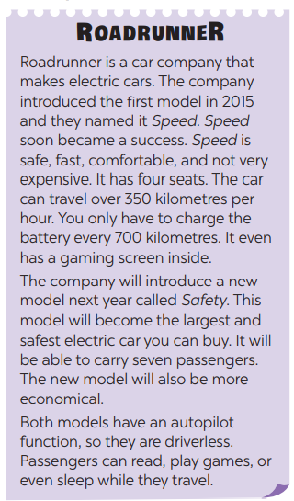
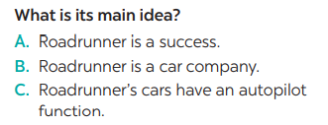

WHILE-READING
2
Read the passage and answer the question.

Slide 19
WHILE-READING
3
Read the passage again and complete the fact file with no more than two words or a number).
Aim of the task:
To improve Ss’ skills of reading for details.

Slide 20
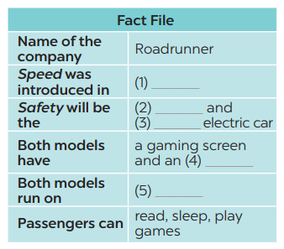
WHILE-READING
3
Read the passage again and decide these statements are True (T) or False (F).
2015
safest/largest
largest/safest
autopilot function
electricity

Slide 21
POST - READING
3
Retelling

Slide 22
LESSON 5: SKILLS 1
WARM-UP
Game: Networking
* Vocabulary
Brainstorming: Look at the picture and find the words or phrases to describe it.
Practice
Task 1: Read the passage and answer the question.
Task 2: Read the passage again and complete the fact file with no more than two words or a number.
Task 3: Retelling
READING
SPEAKING
Task 4: Look at the fact file in 3 then ask and answer questions about it.
PRODUCTION
Task 5: Task 5: Discuss why Roadrunner’s cars will or won’t become popular in the near future. Report your reasons to the class.
CONSOLIDATION
Wrap-up
Home work

Slide 23

SPEAKING
4
Look at the fact file in 3 then ask and answer questions about it.
Aim of the task:
To enable Ss to ask and answer questions about a car company
Suggested questions:
* When was Speed introduced? / When did they introduce Speed?
• What do you know about Safety? / What is special about Safety?
• What functions do these models have?
• What do these models run on?
• What can passengers do when they are travelling in the car?

Slide 24

PRODUCTION
5
Discuss why Roadrunner’s cars will or won’t become popular in the near future. Report your reasons to the class.
“Why Roadrunner’s cars will or won’t become popular in the near future?”.

Slide 25
CONSOLIDATION
1
WRAP-UP
READING
SPEAKING

Slide 26
CONSOLIDATION
2
HOMEWORK
Prepare for the next lesson: Skills 2

Slide 27


