Slide 1

Unit 4: Holidays!
Lesson 4e: Grammar
Page 78

Slide 2
Lesson Outline
Warm-up
Grammar
Consolidation
Wrap-up

Slide 3
Objectives
By the end of this lesson, students will be able to…
use be going to for future plans and intentions; predictions based on what we can see or know.

Slide 4

WARM-UP

Slide 5

Work in pairs.
Discuss the following questions:
What do you plan to do after class?
What are your plans for this weekend?
Where do you want to go on next holiday?
I plan to have lunch with my family, then I go to my dancing class this afternoon.
I plan to go to the park with my family, then we go shopping together.
I want to go to Vung Tau on my next holiday.

Slide 6

It’s time to learn …

Slide 7
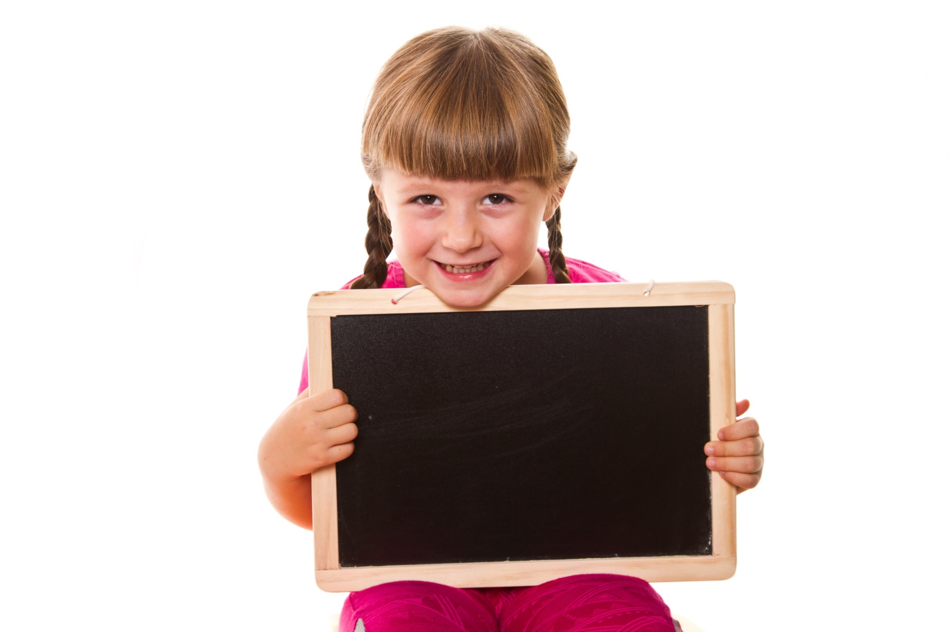
be going to
Presentation

Slide 8
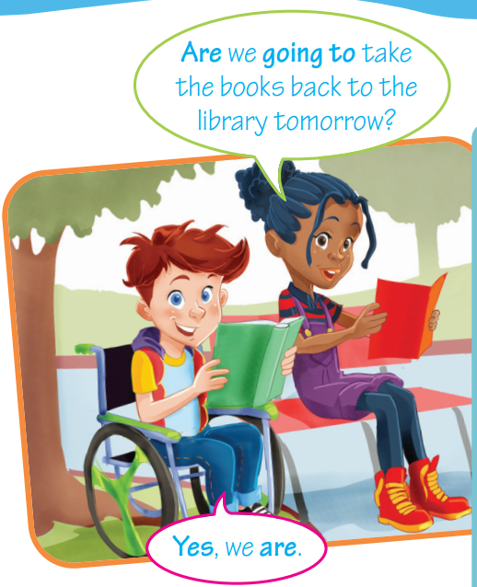
Read the following sentences. Then fill in the table about the structure be going to:
A: I am going to the library this afternoon. Are you going to go with me?
B: No, I’m not. I’m going to the cinema.
A: Is Jack going with you?
B: Yes, he is. Mary and Tom are going to the cinema with me, too.
A: Are you going to go there by bus?
B: Yes, we are. They are going to walk to my house. Then we are going to catch a bus together.

Slide 9
Fill in the table about the structure be going to:
Affirmative | Negative
I am going to swim. You ……………………….. swim. He/ She/ It ……………………….. swim. We/ You/ They ……………………….. swim. | I am not going to swim. You ……………………….. swim. He/ She/ It ……………………….. swim. We/ You/ They ……………………….. swim.
interrogative | short answers
Am I going to swim? ………. you going to swim? ……….he/ she/ it going to swim? ………. we/ you/ they going to swim? | Yes, I am./ No, I’m not. Yes, you ………../ No, you ……….. Yes, he/ she/ it ……/ No, he/ she/ it …… Yes, we/ you/ they ….../ No, we/ you/ they …..
are going to
are not going to
is going to
is not going to
are going to
are not going to
Are
are
aren’t
Is
is
isn’t
Are
are
aren’t

Slide 10
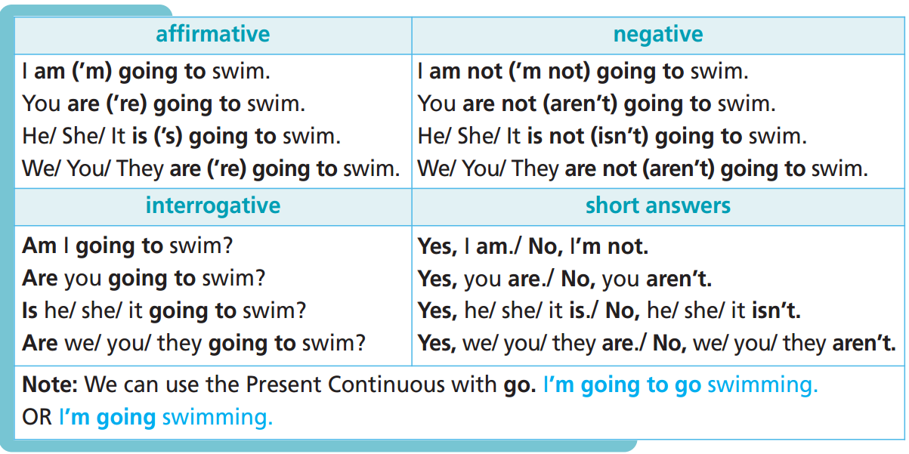
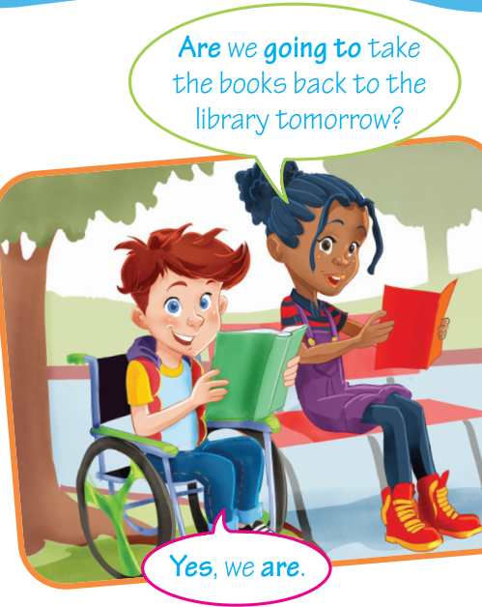
Remember:

Slide 11
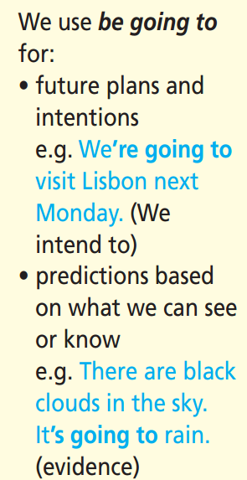

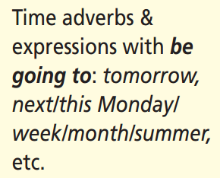
Remember:

Slide 12
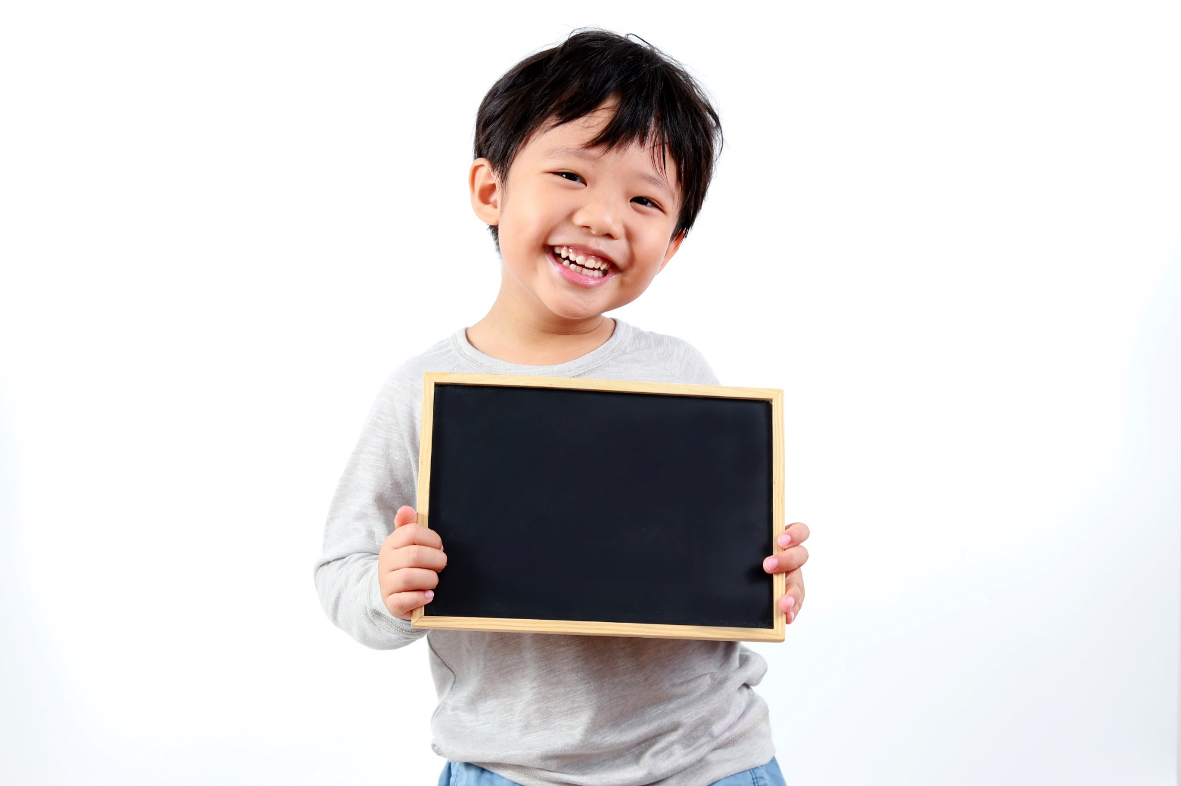
Practice

Slide 13
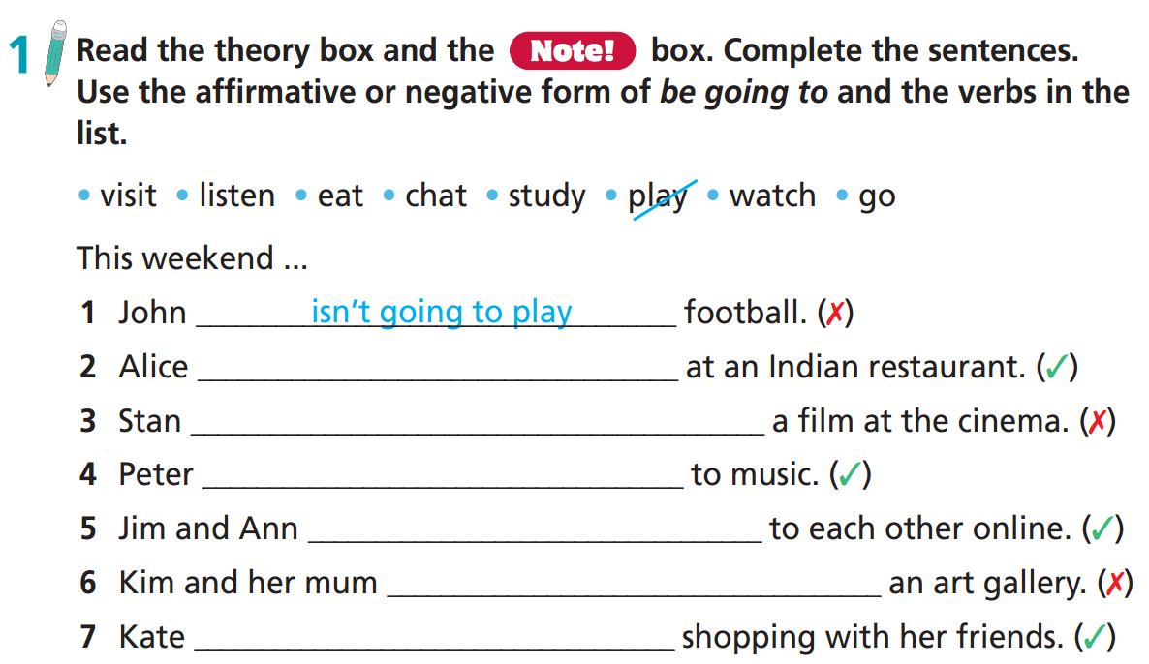
is going to eat
isn’t going to watch
is going to listen
are going to chat
aren’t going to visit
is going to go

Slide 14
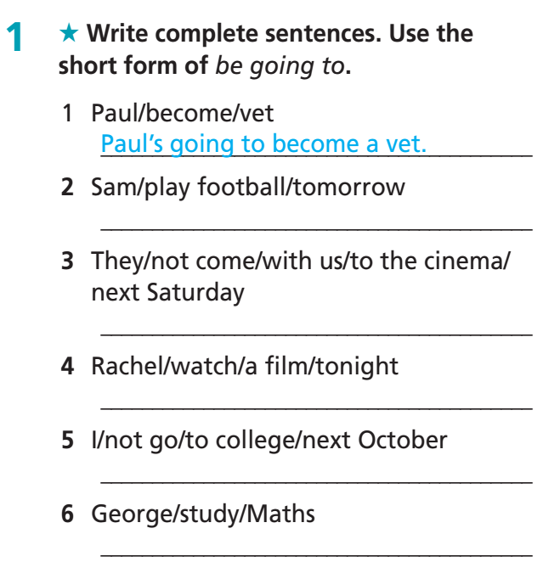
Extra Practice
WB page 42
Sam’s going to play football tomorrow.
They aren’t going to come with us to the cinema next Saturday.
Rachel’s going to watch a film tonight.
I’m not going to go to college next October.
George’s going to study Maths.

Slide 15
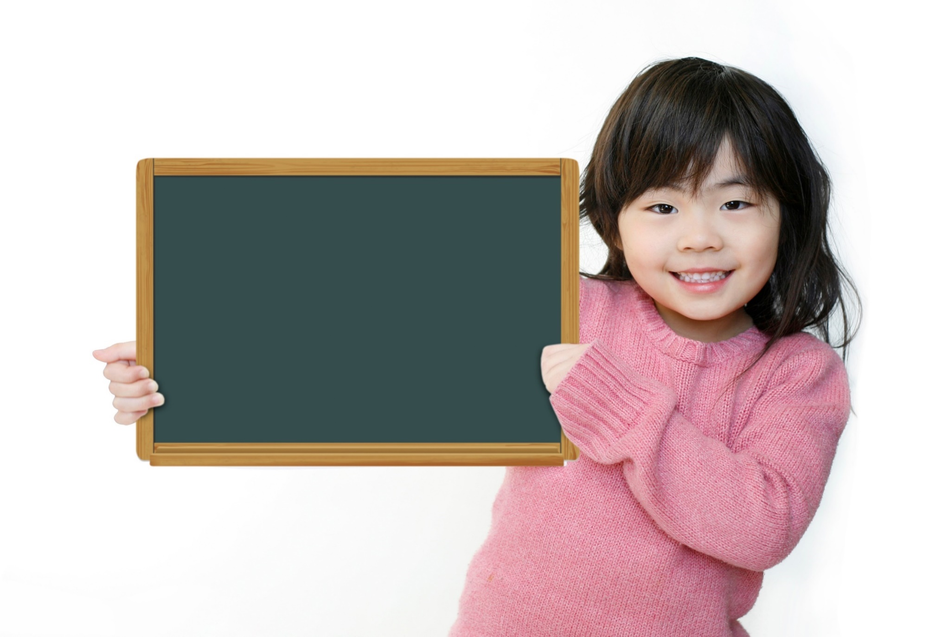
Production

Slide 16
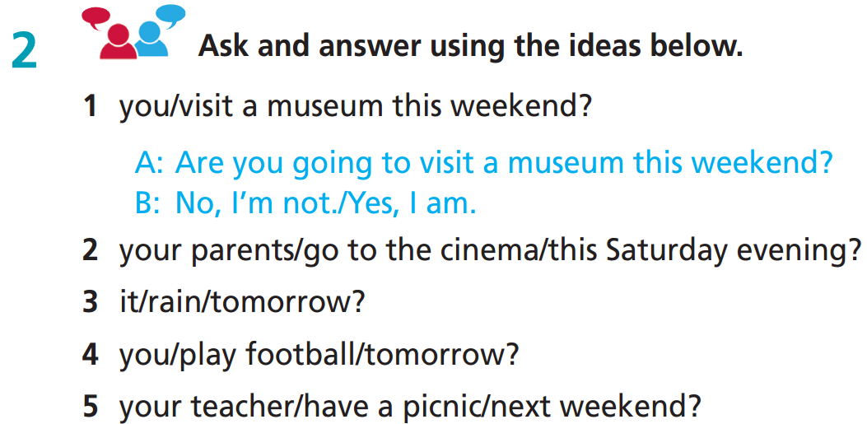
2. A: Are your parents going to go to the cinema this Saturday evening?
B: Yes, they are./No, they aren’t.
3. A: Is it going to rain tomorrow?
B: Yes, it is./No, it isn’t.
4. A: Are you going to play football tomorrow?
B: Yes, I am./No, I’m not.
5. A: Is your teacher going to have a picnic next weekend?
B: Yes, he/she is./No, he/she isn’t.

Slide 17
Work in pairs.
Are you going to play football this weekend?
Activities | You | Your friend
play football this weekend | Yes | No
visit cousin this weekend | No | Yes
…….. this weekend
…….. next Friday morning
…….. next Friday morning
…….. next summer
…….. next summer
……..
No, I’m not.
Are you going to visit your cousin this weekend?
Yes, I am.
I’m going to play football this weekend. I’m not going to visit my cousin. ….. My friend is Clara. She isn’t going to play football this weekend. She is going to visit her cousin this weekend……

Slide 18
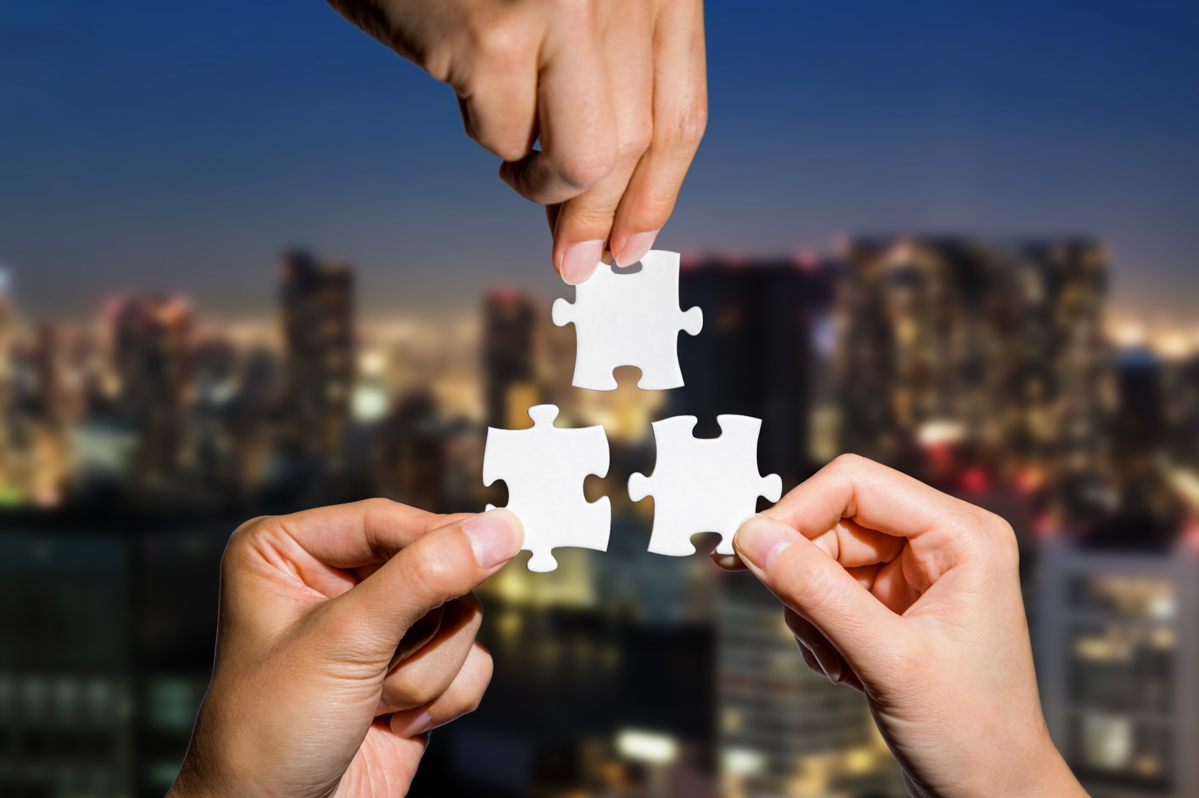
CONSOLIDATION

Slide 19
Write a paragraph (50-70 words) about your plans for your birthday party. Remember to use structure be going to. You can use the following information:
Where are you going to celebrate the party?
When are you going to celebrate the party?
Who are you going to invite to the party?
What activities are you going to have at the party?
What are you going to wear to the party?

Slide 20
Write a paragraph (50-70 words) about your plans for your birthday party. Remember to use structure be going to. You can use the following information:
e.g.
I’m going to celebrate my birthday party at home next Saturday night. I’m going to invite my parents and my friends. I’m going to buy a big birthday cake. I’m going to eat a good meal with my parents and my friends. Then I’m going to receive presents from them. I’m going to wear a new dress at the party.

Slide 21

WRAP-UP

Slide 22
Today’s lesson
Grammar
use be going to for future plans and intentions; predictions based on what we can see or know.

Slide 23
Homework
Practise the vocabulary and make sentences using them.
Do the exercises in TA 6 Right on WB (p. 42).
Do the exercises in TA 6 Right on Notebook (p. 42).
Prepare for the next lesson (p. 79 SB).

Slide 24
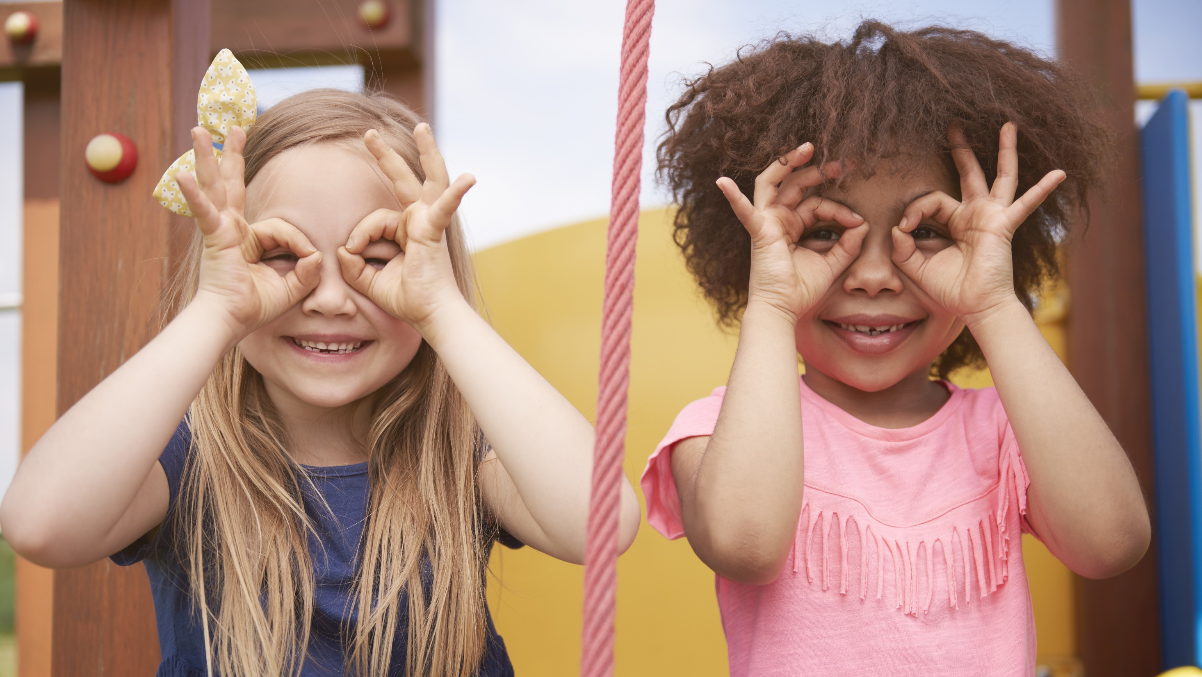
Enjoy your day!

