Slide 1








COLOURS
START

Slide 2

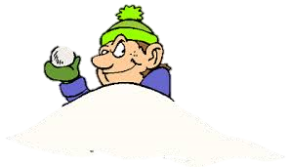
Please, help me to decorate the Christmas tree! Beware that naughty boy!
PLAY

Slide 3









Thank you!
NEXT
Let’s decorate the Christmas tree
Click on the RED bauble

Slide 4
Thank you!
NEXT
Let’s decorate the Christmas tree
Click on the YELLOW bauble

Slide 5
Thank you!
NEXT
Let’s decorate the Christmas tree
Click on the BLUE bauble

Slide 6
Thank you!
NEXT
Let’s decorate the Christmas tree
Click on the PINK bauble

Slide 7
Thank you!
NEXT
Let’s decorate the Christmas tree
Click on the GRAY bauble

Slide 8
Thank you!
NEXT
Let’s decorate the Christmas tree
Click on the GREEN bauble

Slide 9
Thank you!
NEXT
Let’s decorate the Christmas tree
Click on the PURPLE bauble

Slide 10
Thank you!
NEXT
Let’s decorate the Christmas tree
Click on the ORANGE bauble

Slide 11
Merry Christmas!
EXIT

Slide 12
Merry Christmas!

Slide 13

SƯU TẦM: ĐOÀN VĂN DOANH, NAM TRỰC, NAM ĐỊNH
LINK NHÓM DÀNH CHO GV BỘ MÔN VẬT LÝ TRAO ĐỔI TÀI LIỆU VÀ CHUYÊN MÔN CT 2018
https://www.facebook.com/groups/299257004355186

