Slide 1


Slide 2

Unit
5
1
Unit
FAMILY LIFE
INVENTIONS
LESSON 6
WRITING
Writing about the benefits of an invention

Slide 3

Unit
1
1
FAMILY LIFE
Family Life
Unit
OBJECTIVES
Writing about the benefits of an invention

Slide 4
LESSON 6
WRITING
Unit
GETTING STARTED
WARM-UP
Hot seat
Activity 1: Choose an invention in this unit. Draw a diagram to show how it is used. Then work in groups to guess one another's inventions.
Activity 2: Rewrite the second sentence so that it has a similar meaning to the first. Use the expressions and the prompts below to help you.
PRE-WRITING
WHILE-WRITING
Activity 3: Write a paragraph (120 - 150 words) to describe two or three benefits of the invention you chose in 1. Use the outline below to help you.
POST-WRITING
Feedback
CONSOLIDATION
Wrap-up
Homework

Slide 5
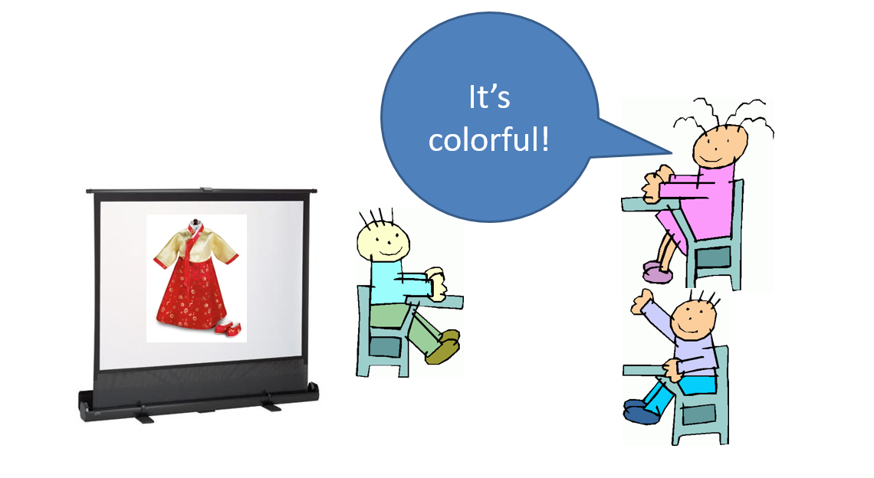
LESSON 6
WRITING
Unit
GETTING STARTED
WARM-UP
Hot seat
Work in groups.
Representative of each group sits on a chair, facing the class.
Others from each group look at the picture shown on slide and give hints about it.
Representative of each group says out loud the word.

Slide 6

Electric light

Slide 7

Airplane

Slide 8
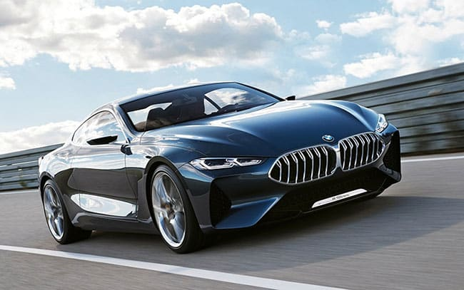
Automobile

Slide 9
LESSON 6
WRITING
Unit
GETTING STARTED
WARM-UP
Hot seat
Activity 1: Choose an invention in this unit. Draw a diagram to show how it is used. Then work in groups to guess one another's inventions.
Activity 2: Rewrite the second sentence so that it has a similar meaning to the first. Use the expressions and the prompts below to help you.
PRE-WRITING

Slide 10
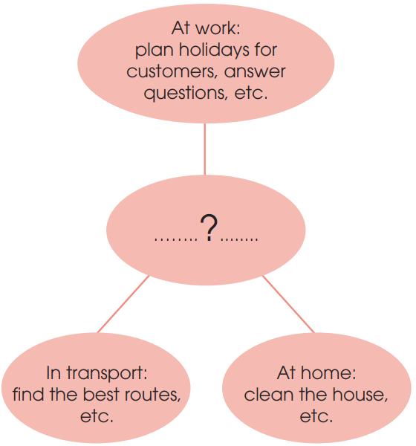
PRE-WRITING
1
Choose an invention in this unit. Draw a diagram to show how it is used. Then work in groups to guess one another's inventions. (p.58).
Choose an invention from the unit,
keep it secret.
Draw a diagram in a notebook or on a piece of paper, listing some benefits or uses of the invention.
Work in groups, swap the diagrams with others.
Take turns reading the diagrams and guessing the inventions.

Slide 11
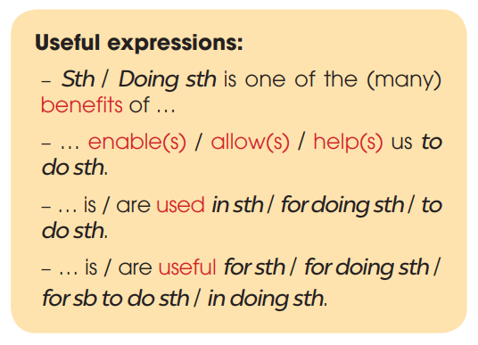
PRE-WRITING
2
Rewrite the second sentence so that it has a similar meaning to the first. Use the expressions and the prompts below to help you. (p.58)

Slide 12
PRE-WRITING
2
Rewrite the second sentence so that it has a similar meaning to the first. Use the expressions and the prompts below to help you. (p.58)
1. AI helps drivers to find the best routes in transport.
-> Helping drivers to find the best routes is one of the benefits of AI in transport.
2. Vacuum cleaners allow us to clean the house quickly.
-> Vacuum cleaners are useful for cleaning / in cleaning the house quickly.
3. Smartphones are used for learning languages.
-> Smartphones help us to learn languages.
4. Telephones are useful in communicating over long distances.
-> Telephones are used to communicate / for communication / for communicating over long distances.

Slide 13
LESSON 6
WRITING
Unit
GETTING STARTED
WARM-UP
Hot seat
Activity 1: Choose an invention in this unit. Draw a diagram to show how it is used. Then work in groups to guess one another's inventions.
Activity 2: Rewrite the second sentence so that it has a similar meaning to the first. Use the expressions and the prompts below to help you.
PRE-WRITING
WHILE-WRITING
Activity 3: Write a paragraph (120 - 150 words) to describe two or three benefits of the invention you chose in 1. Use the outline below to help you.

Slide 14
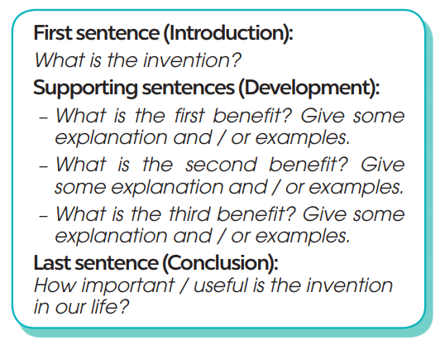
WHILE-WRITING
3
Write a paragraph (120 - 150 words) to describe two or three benefits of the invention you chose in 1. Use the outline below to help you. (p.58).

Slide 15
WHILE-WRITING
3
Write a paragraph (120 - 150 words) to describe two or three benefits of the invention you chose in 1. Use the outline below to help you. (p.58).
Sample:
Electricity is one of the great inventions of the past, because it has brought many benefits for people. First, electricity can be used to light our houses and streets. Without it, the world will be dark and dangerous. Second, electricity is also useful in heating. For example, in cold areas, electric heaters can keep us warm and healthy in long winters. Finally, the most important use of electricity is to run machines. Without electricity, factories, schools and hospitals cannot run normally. Everyone and everything will stop working. Other inventions, such as TVs, computers and robots will become useless without electricity. In conclusion, electricity plays a very important part in our life today and we cannot live without it.

Slide 16
LESSON 6
WRITING
Unit
GETTING STARTED
WARM-UP
Hot seat
Activity 1: Choose an invention in this unit. Draw a diagram to show how it is used. Then work in groups to guess one another's inventions.
Activity 2: Rewrite the second sentence so that it has a similar meaning to the first. Use the expressions and the prompts below to help you.
PRE-WRITING
WHILE-WRITING
Activity 3: Write a paragraph (120 - 150 words) to describe two or three benefits of the invention you chose in 1. Use the outline below to help you.
POST-WRITING
Feedback

Slide 17


POST-WRITING
Peer review
Teacher’s feedback

Slide 18
LESSON 6
WRITING
Unit
GETTING STARTED
WARM-UP
Hot seat
Activity 1: Choose an invention in this unit. Draw a diagram to show how it is used. Then work in groups to guess one another's inventions.
Activity 2: Rewrite the second sentence so that it has a similar meaning to the first. Use the expressions and the prompts below to help you.
PRE-WRITING
WHILE-WRITING
Activity 3: Write a paragraph (120 - 150 words) to describe two or three benefits of the invention you chose in 1. Use the outline below to help you.
POST-WRITING
Feedback
CONSOLIDATION
Wrap-up
Homework

Slide 19
CONSOLIDATION
1
Wrap-up
Write about the benefits of an invention.

Slide 20
CONSOLIDATION
2
Homework
Prepare for the next lesson: Unit 5: Communication and culture/ CLIL.
2. Do exercises in the workbook

Slide 21


